Slide 1
Research on the Theory of the TeV energy scale (Terascale)
Howard Haber
SCIPP Theory
March 5, 2026
For further details, check out my webpage:
https://scipp-legacy.pbsci.ucsc.edu/~haber/

Slide 2
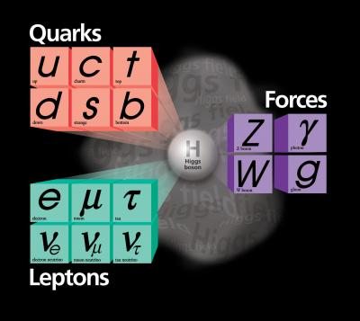
The Standard Model (SM) of Particle Physics
The elementary particles consists of three generations of spin-1/2 quarks and leptons, the gauge bosons of SU(3)xSU(2)xU(1), and
the Higgs boson.
Technically, massive neutrinos
require an extension of the Standard
Model, but most likely the relevant
scale of the new physics lies way
beyond the terascale.

Slide 3
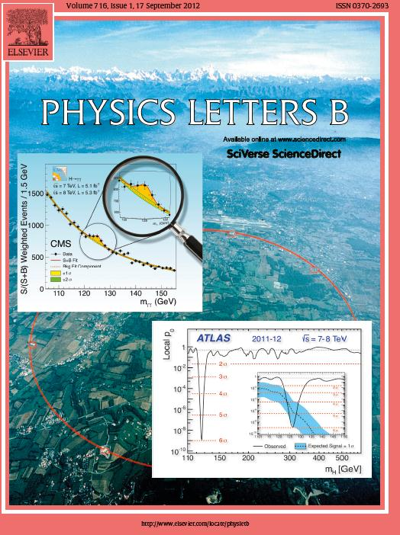
On July 4, 2012, the discovery
of a new boson is announced
which may be the long sought
after Higgs boson.
The discovery papers are
published two months later
In Physics Letters B.
ATLAS Collaboration:
Physics Letters B716 (2012) 1—29
CMS Collaboration:
Physics Letters B716 (2012) 30—61

Slide 4

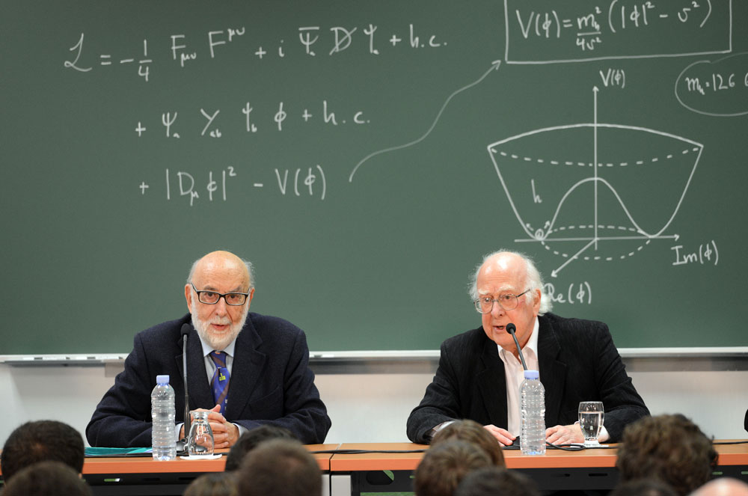
Winners of the 2013 Nobel Prize in Physics
François Englert
and
Peter Higgs

Slide 5
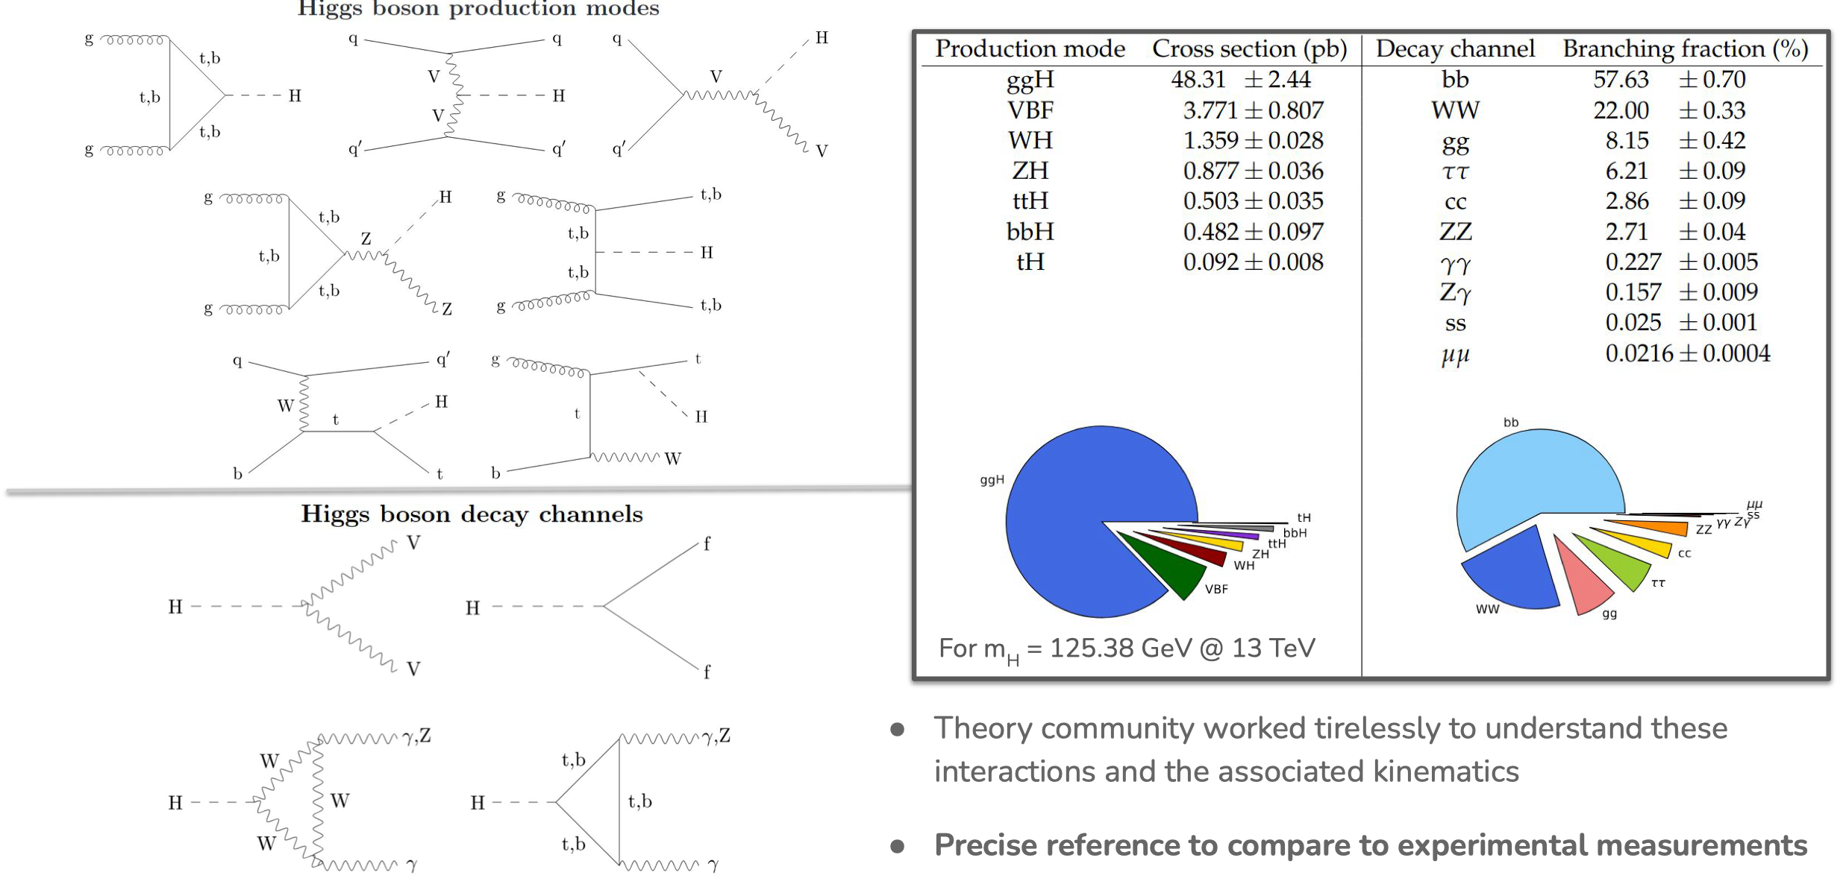
Higgs boson production and decay mechanisms
Taken from a 02/24/2026 seminar by Jonathon Langford on behalf of the CMS Collaboration

Slide 6
Higgs boson production cross sections at a pp collider
With nearly 140 fb⁻¹ of data delivered by the LHC in Run 2 to both ATLAS and CMS in 2015—2018 at a center of mass energy of 13 TeV, roughly 7.7 million Higgs bosons per experiment were produced, assuming the Higgs mass is 125 GeV.

Slide 7
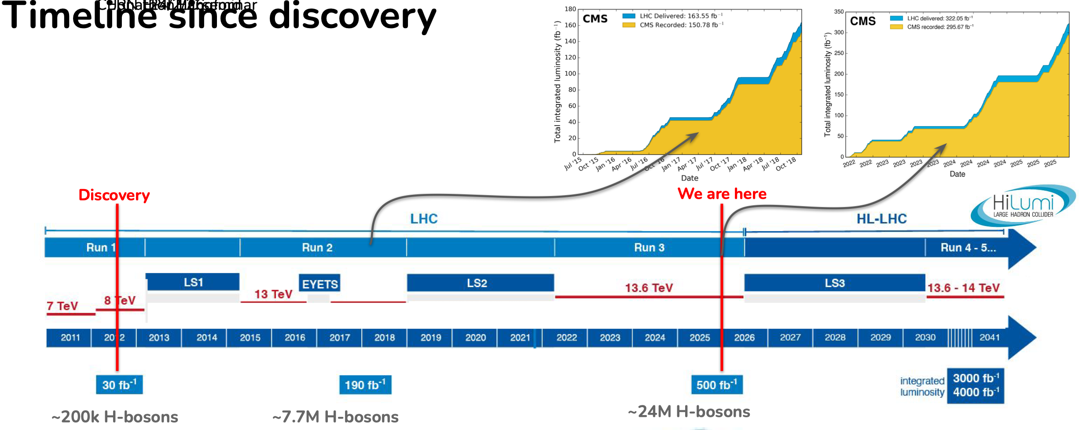
Taken from a 02/24/2026 seminar by Jonathon Langford on behalf of the CMS Collaboration

Slide 8
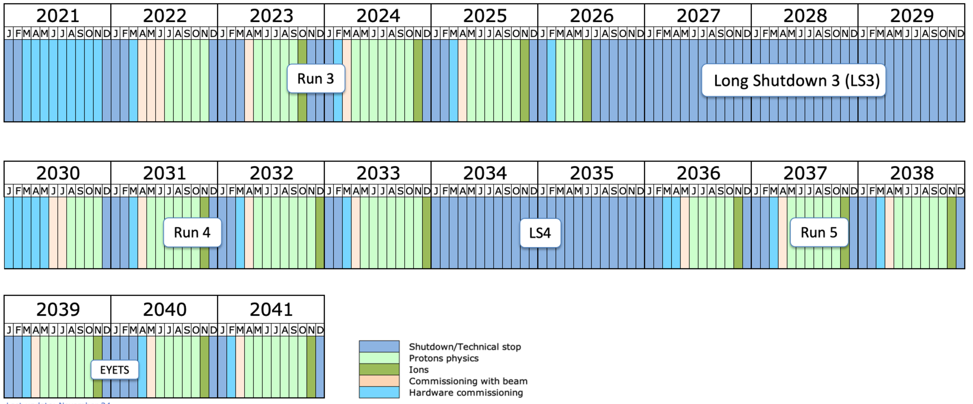
Taken from Harvey Newman’s Chair Report at the USLUA Annual Meeting (12/17/24)
Long Term LHC Schedule (to 2041):
Update Sept. 2024
Short YETS 25/26
Extend Run 3 to end June 2026
Start LHC LS3 July 2026
Start final Hardware Commissioning January 2030
First beam June 2030
LS3 - beam to beam: 3 years 11 months, 47 months
Towards HL LHC: Challenge and Opportunity
Looking forward to a massive
(~380/fb) Run3 dataset by end 2026
A challenge to the LHC Phase 1
accelerator and experiment designs
8
Notes:
8

Slide 9
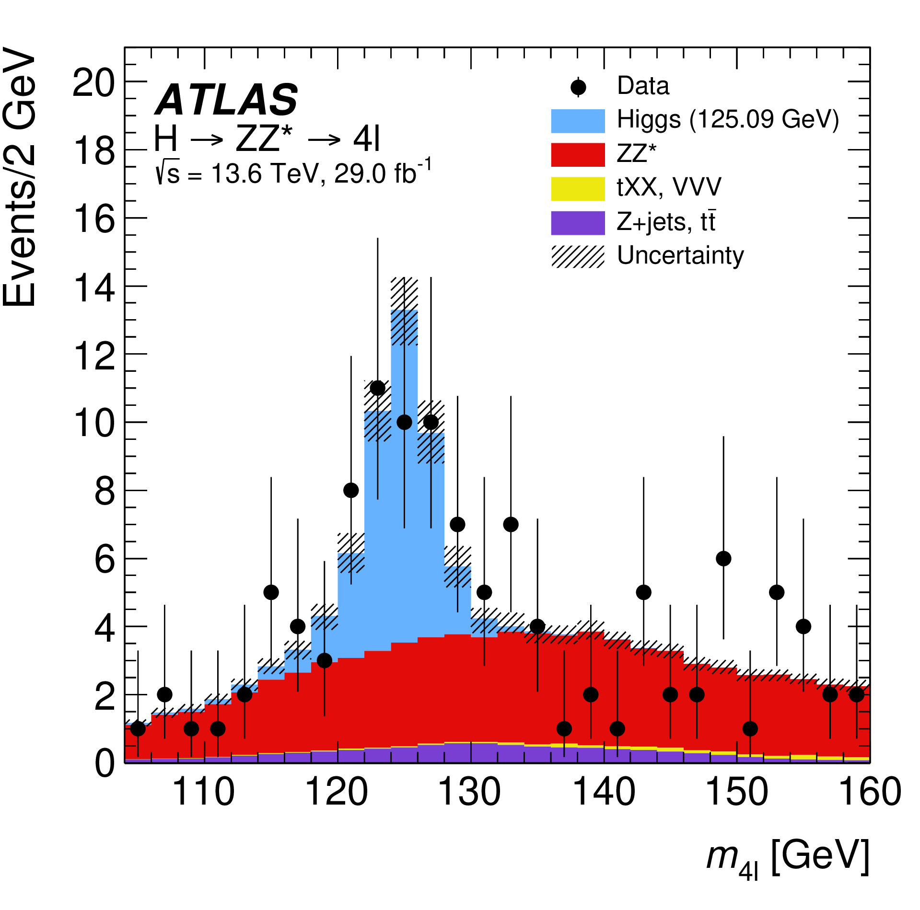
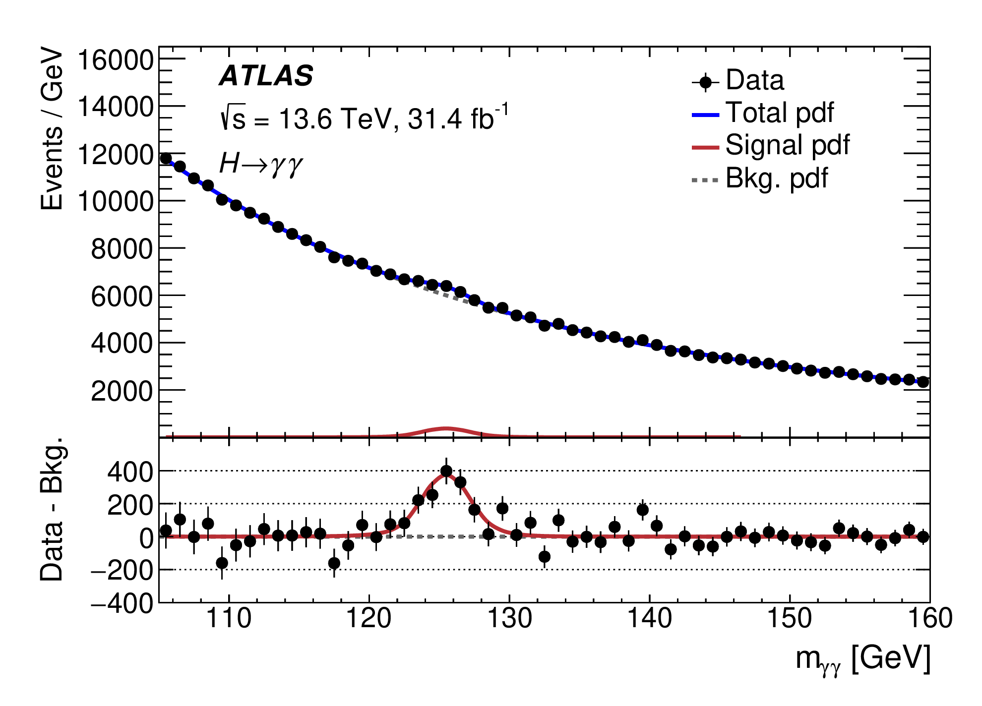
ATLAS Run 3 observations of the Higgs boson
Taken from Eur. Phys. J. C 84 (2024) 78

Slide 10
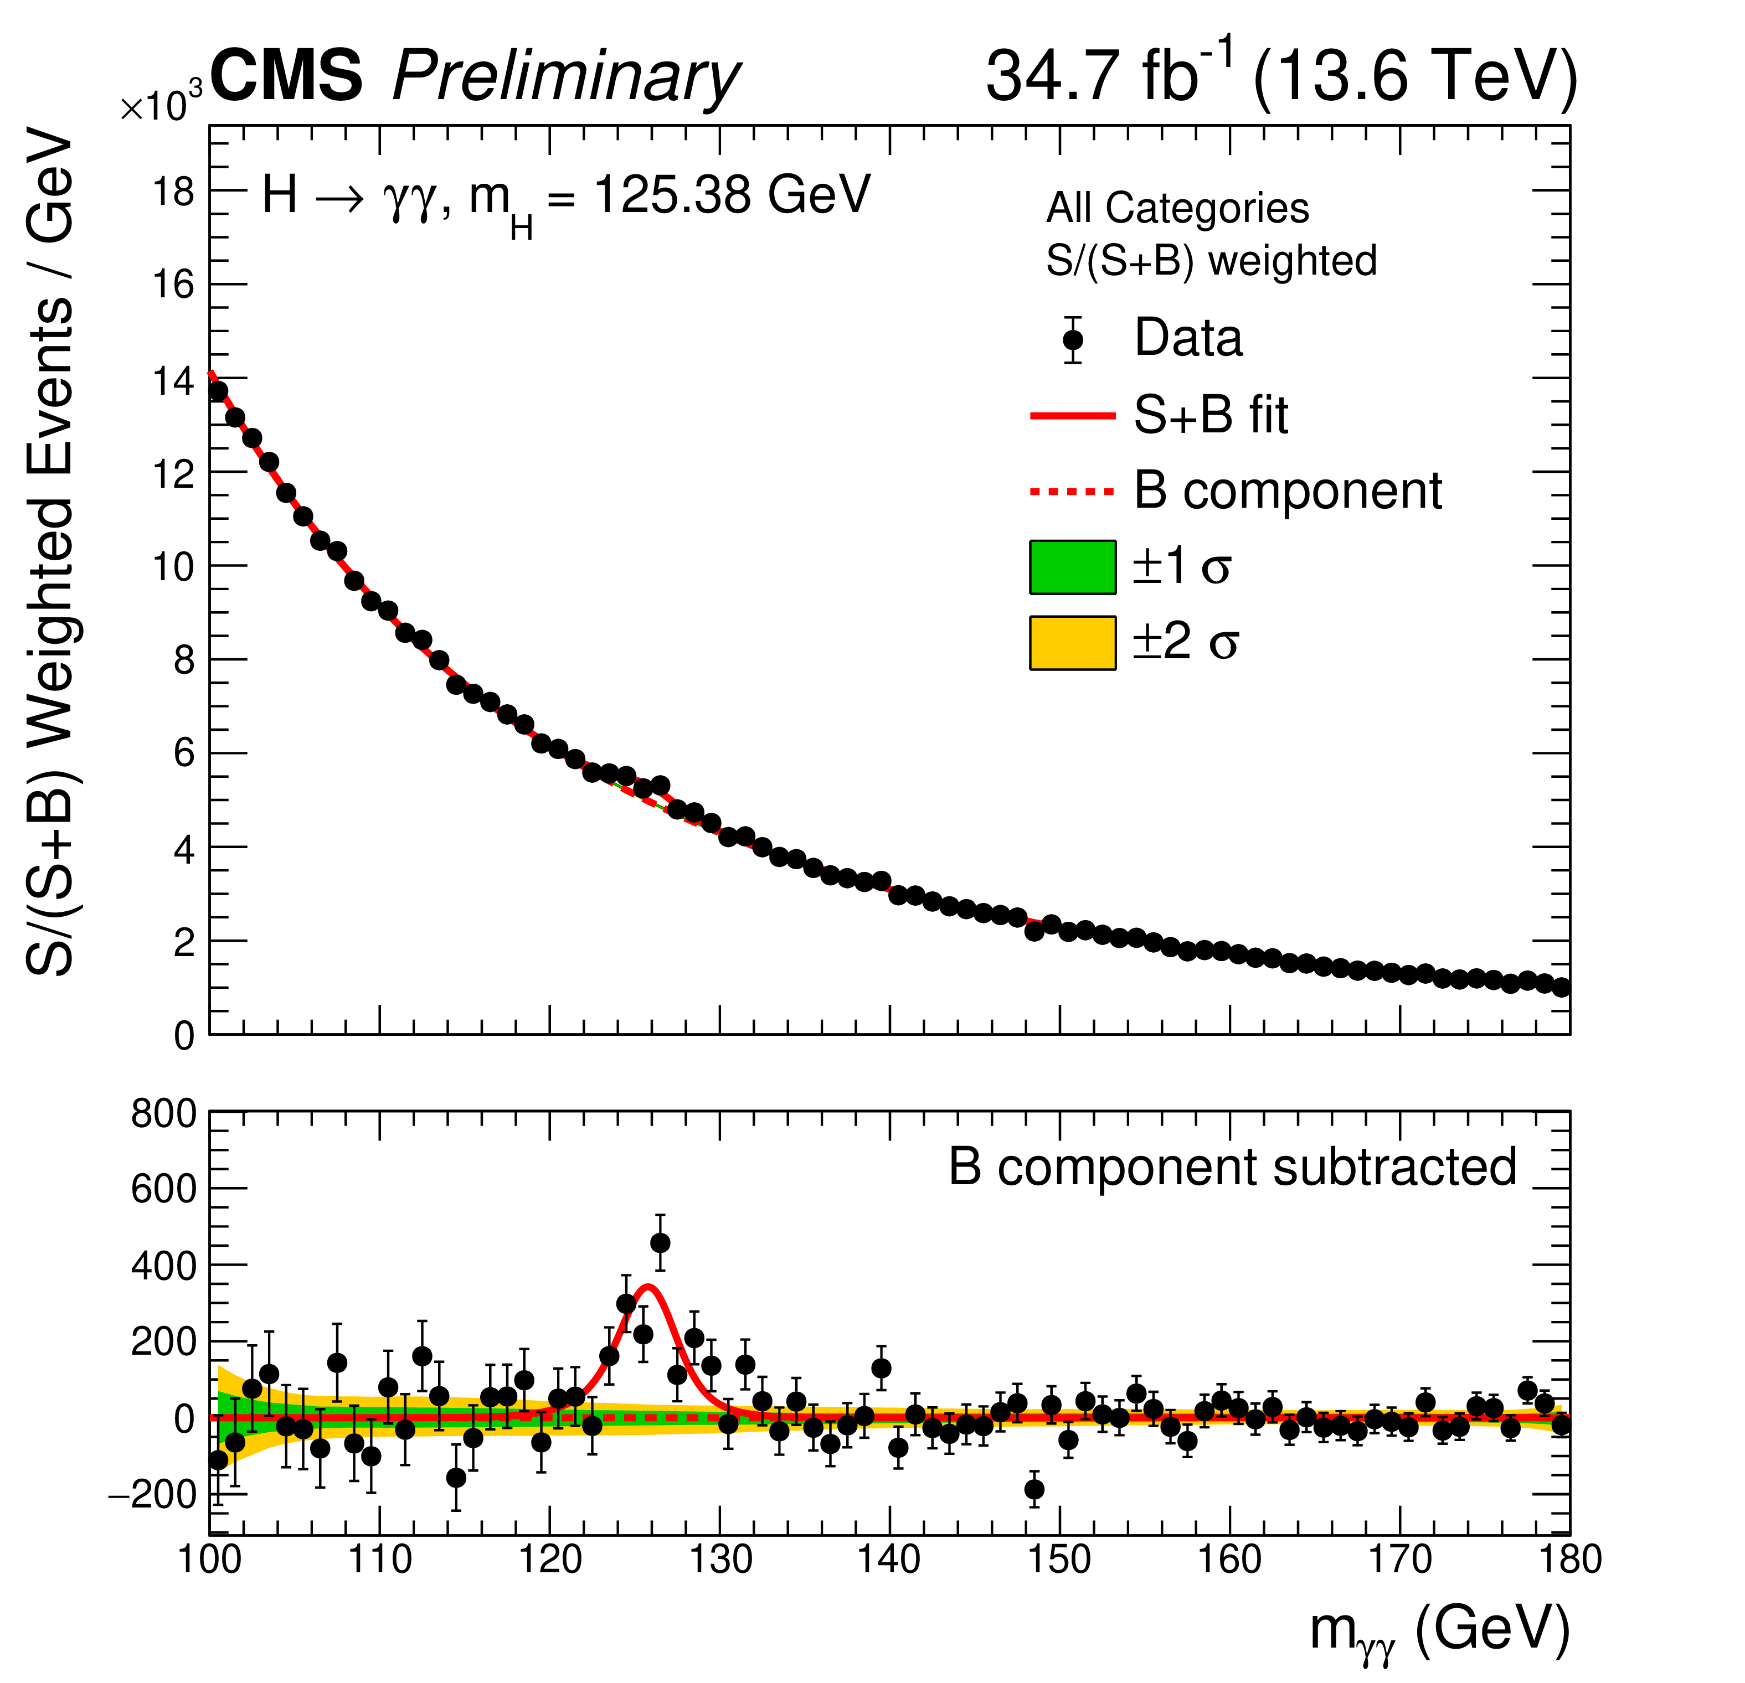
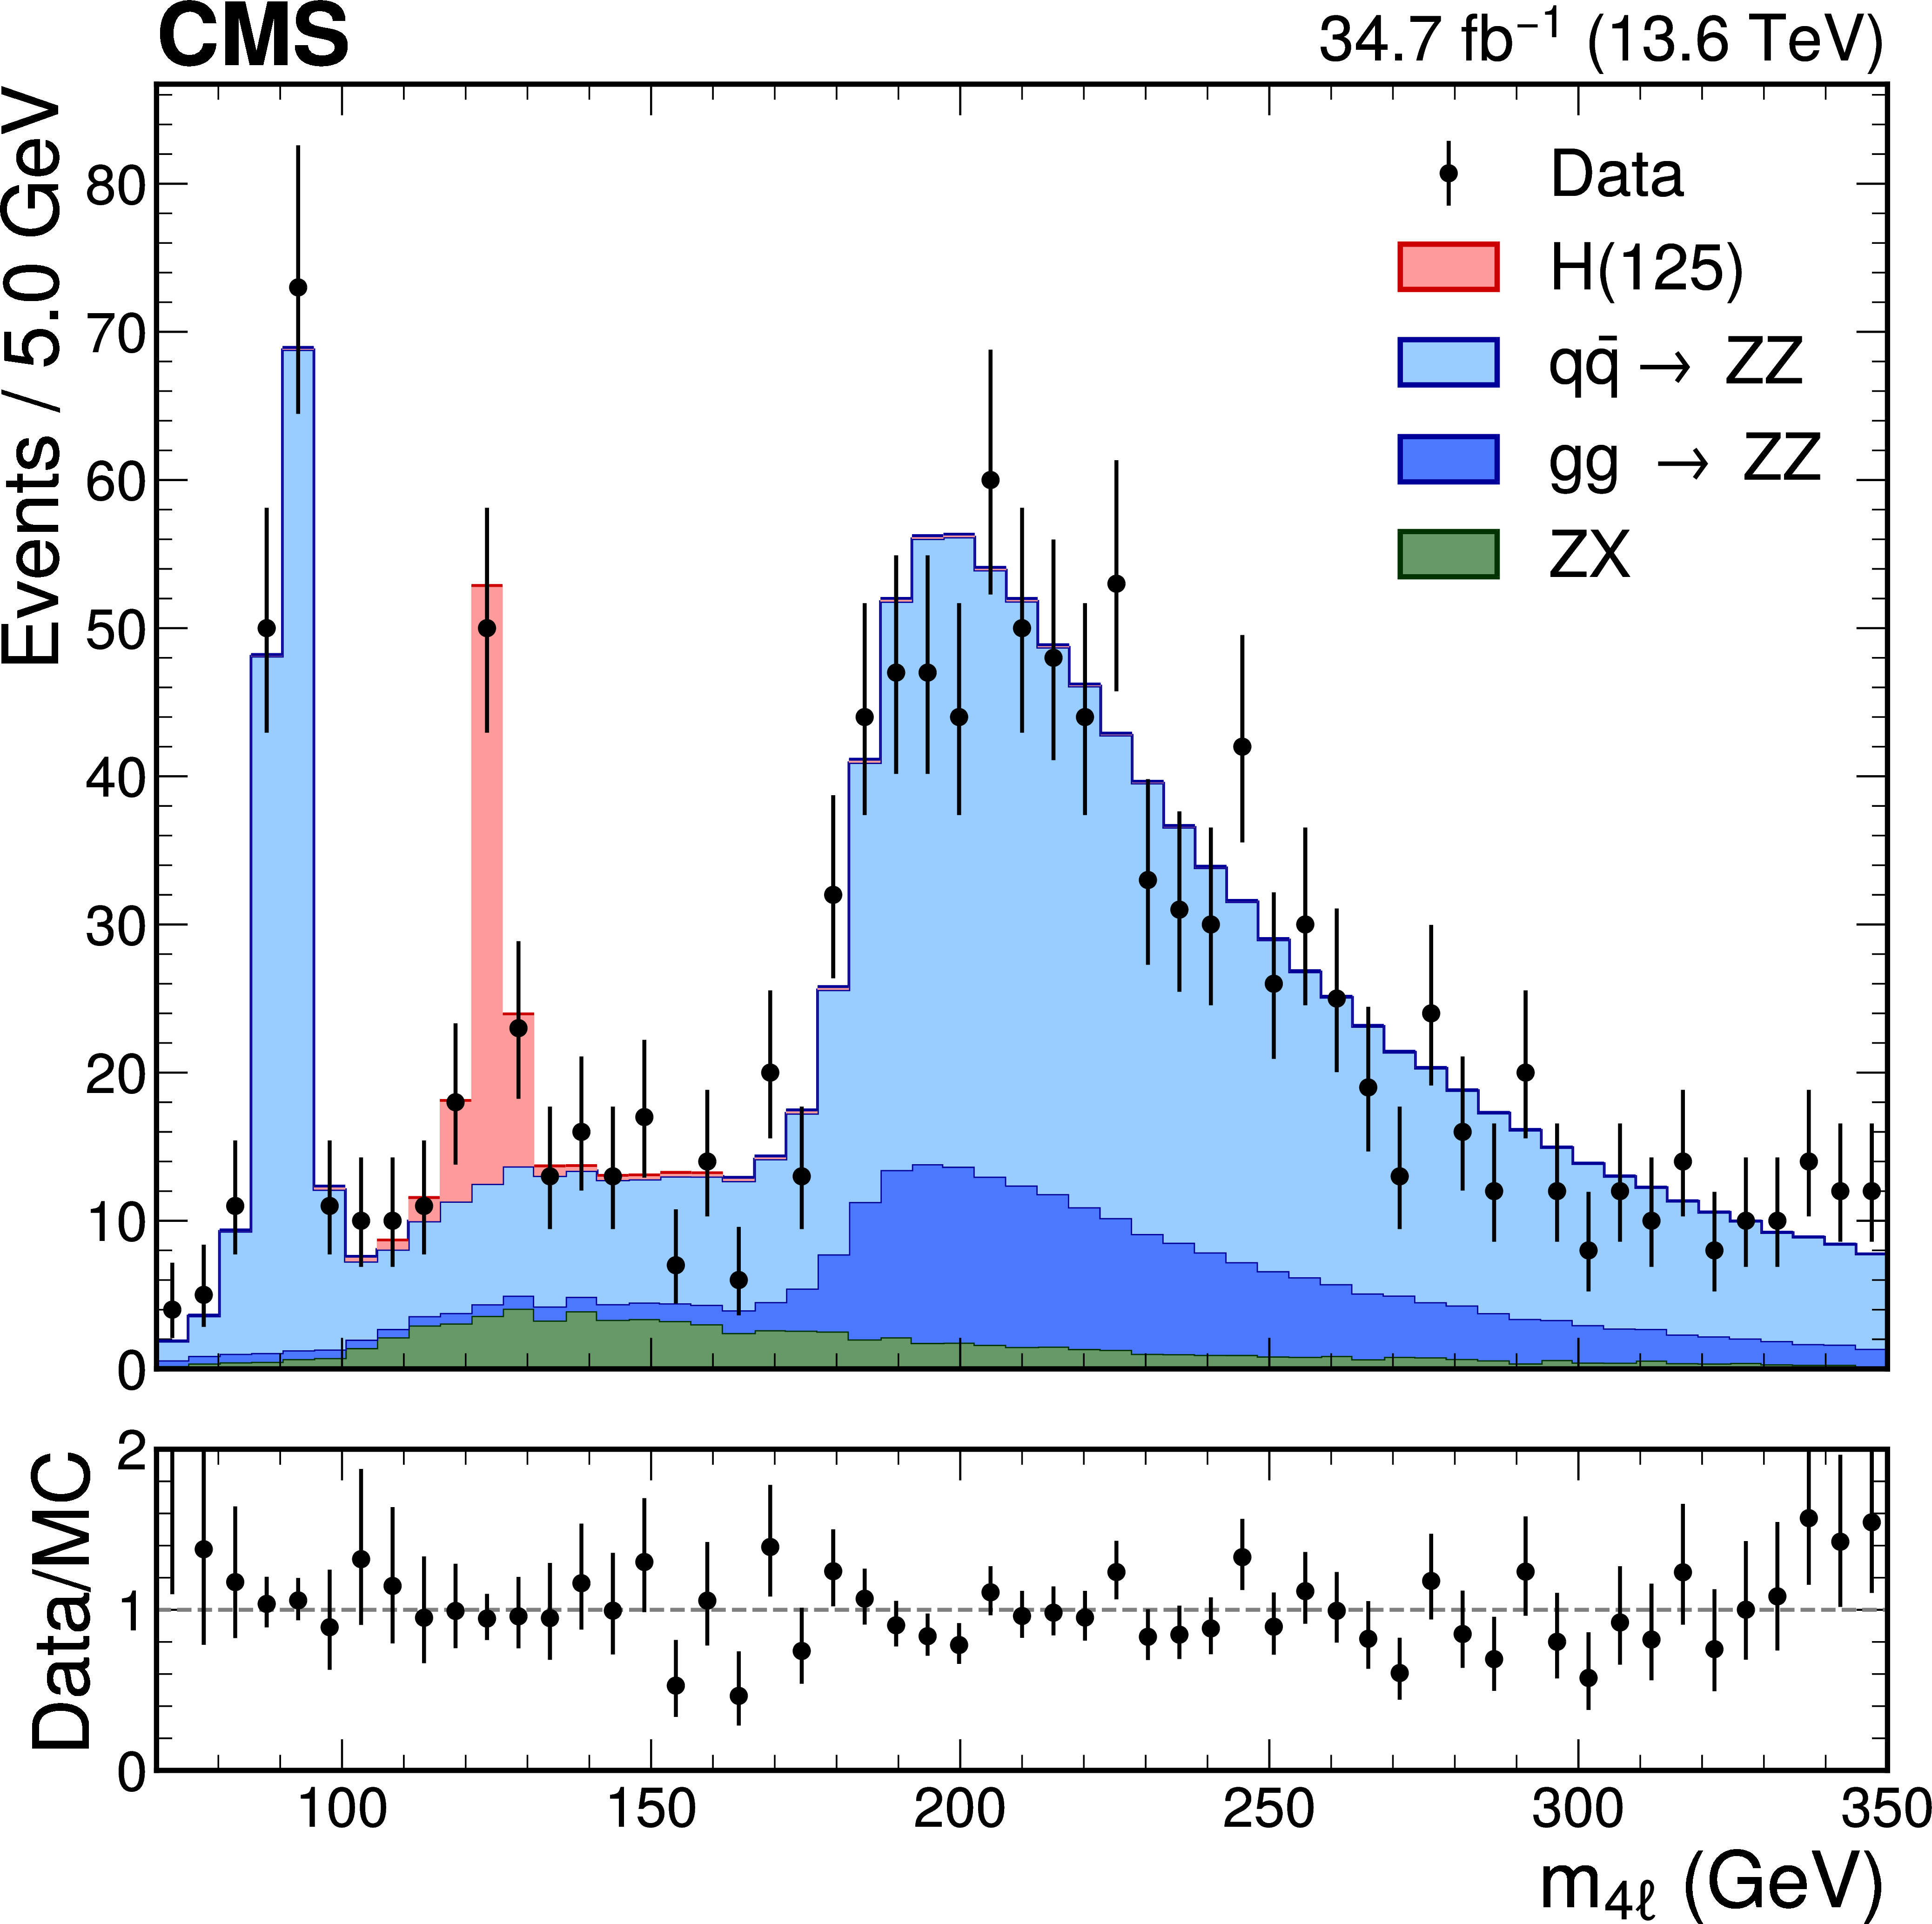
CMS Run 3 observations of the Higgs boson
Taken from CMS-PAS-HIG-23-014
Taken from CERN-EP-2024-336

Slide 11
Higgs boson decay channels observed at the LHC
Higgs boson decay mode | Branching ratio (for m_{h} = 125 GeV)
h⁰ → bb | 0.582
h⁰ → 𝞃⁺ 𝞃 ⁻ | 6.27 x 10⁻²
h⁰ → 𝓵⁺ 𝓵⁻ 𝝂𝝂 (𝓵 = e or 𝞵) | 1.06 x 10⁻²
h⁰ → 𝛄𝛄 | 2.27 x 10⁻³
h⁰ → 𝓵⁺ 𝓵⁻ 𝓵⁺ 𝓵⁻ (𝓵 = e or 𝞵) | 1.24 x 10⁻⁴
h⁰ → Z𝛄 → 𝓵⁺ 𝓵⁻ 𝛄 (𝓵 = e or 𝞵) | 1.03 x 10⁻⁴
h⁰ → 𝞵⁺ 𝞵⁻ | 2.18 x 10⁻⁴
Taken from https://twiki.cern.ch/twiki/bin/view/LHCPhysics/CERNYellowReportPageBR#Branching_Ratios
Remarks:
h⁰ ➞ WW* is observed primarily via the 𝓵⁺ 𝝂 𝓵⁻ 𝝂 (𝓵 = e or 𝞵) final state.
h⁰ ➞ ZZ* is observed primarily via the 𝓵⁺𝓵⁻ 𝓵⁺𝓵⁻ (𝓵 = e or 𝞵) final state.
In the decays to the diboson final state, kinematics dictates that one of the vector bosons is off-shell (i.e., “virtual”) and is thus indicated by a superscript star.

Slide 12
Question: why not search
inclusively for Higgs bosons that decay into a pair of
b-quarks?
Answer: The Standard Model
background is overwhelming.
There are more than 10⁷ times as many b-quark pairs produced in proton-proton collisions as compared to
b-quark pairs that arise from a decaying Higgs boson.
Nevertheless, the observation of
H → bb in the VH channel was confirmed by ATLAS and CMS in 2018!

Slide 13
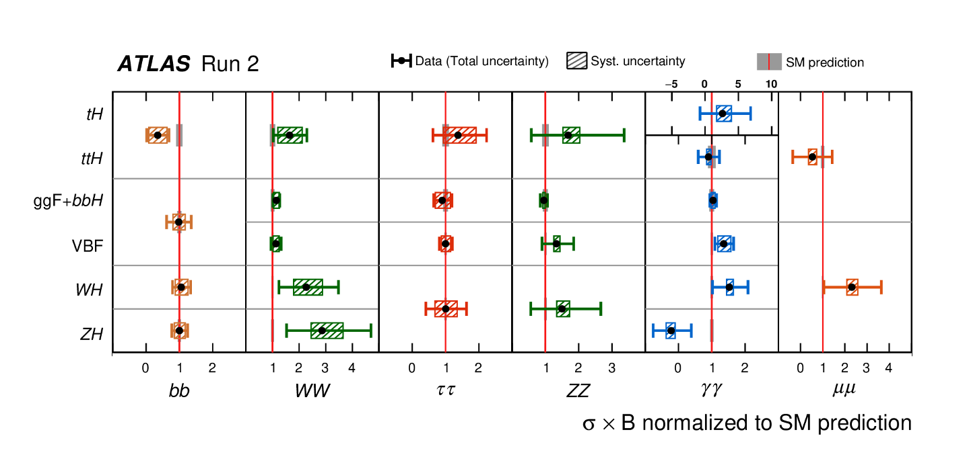
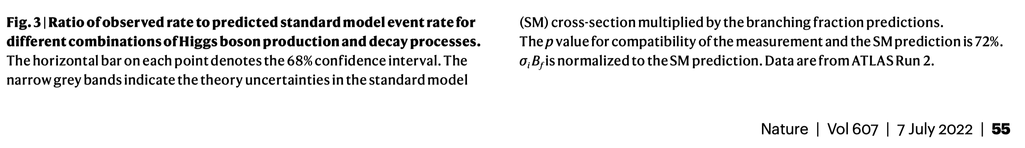
Summary of ATLAS Higgs boson data from Run 2 at the LHC

Slide 14
Reduced Higgs coupling modifiers compared to their corresponding prediction from the Standard Model (SM). The error bars represent 68% CL intervals for the measured parameters. In the lower panel, the ratios of the measured coupling modifiers values to their SM predictions are shown.
[Taken from:
Nature 607 (2022) 60]

Slide 15


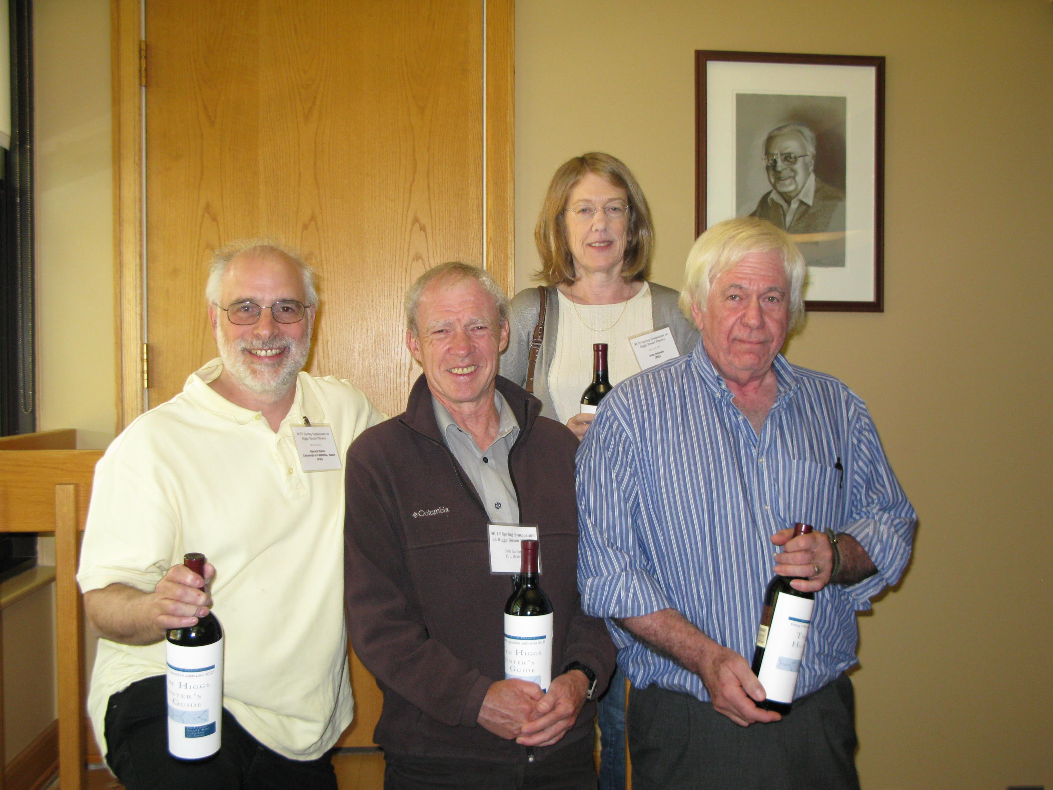
Research program 1: theory and phenomenology of Higgs bosons

Slide 16
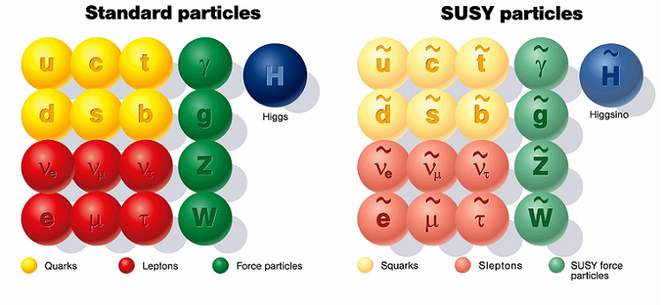
Research program 2: theory and phenomenology of TeV-scale supersymmetry (SUSY)

Slide 17
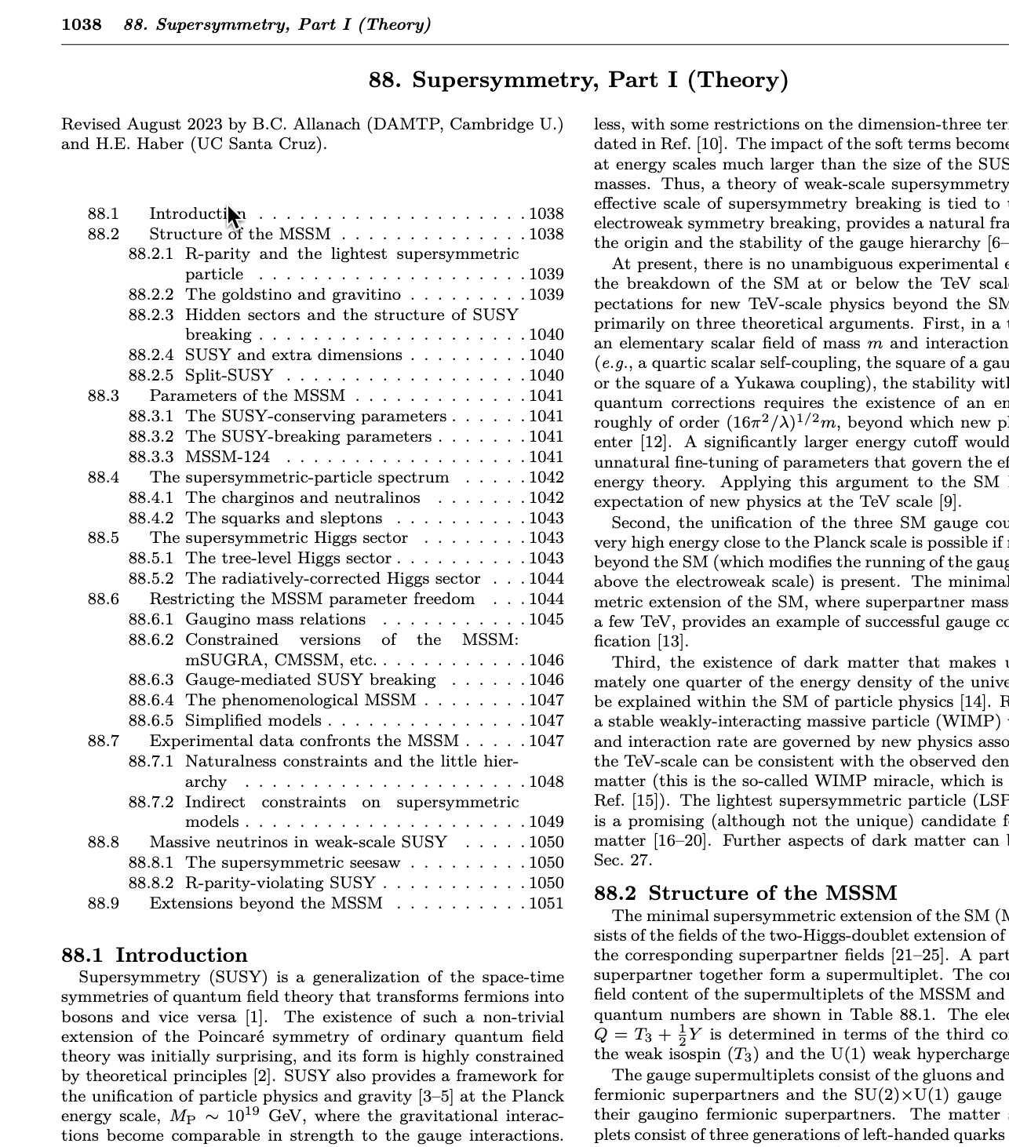
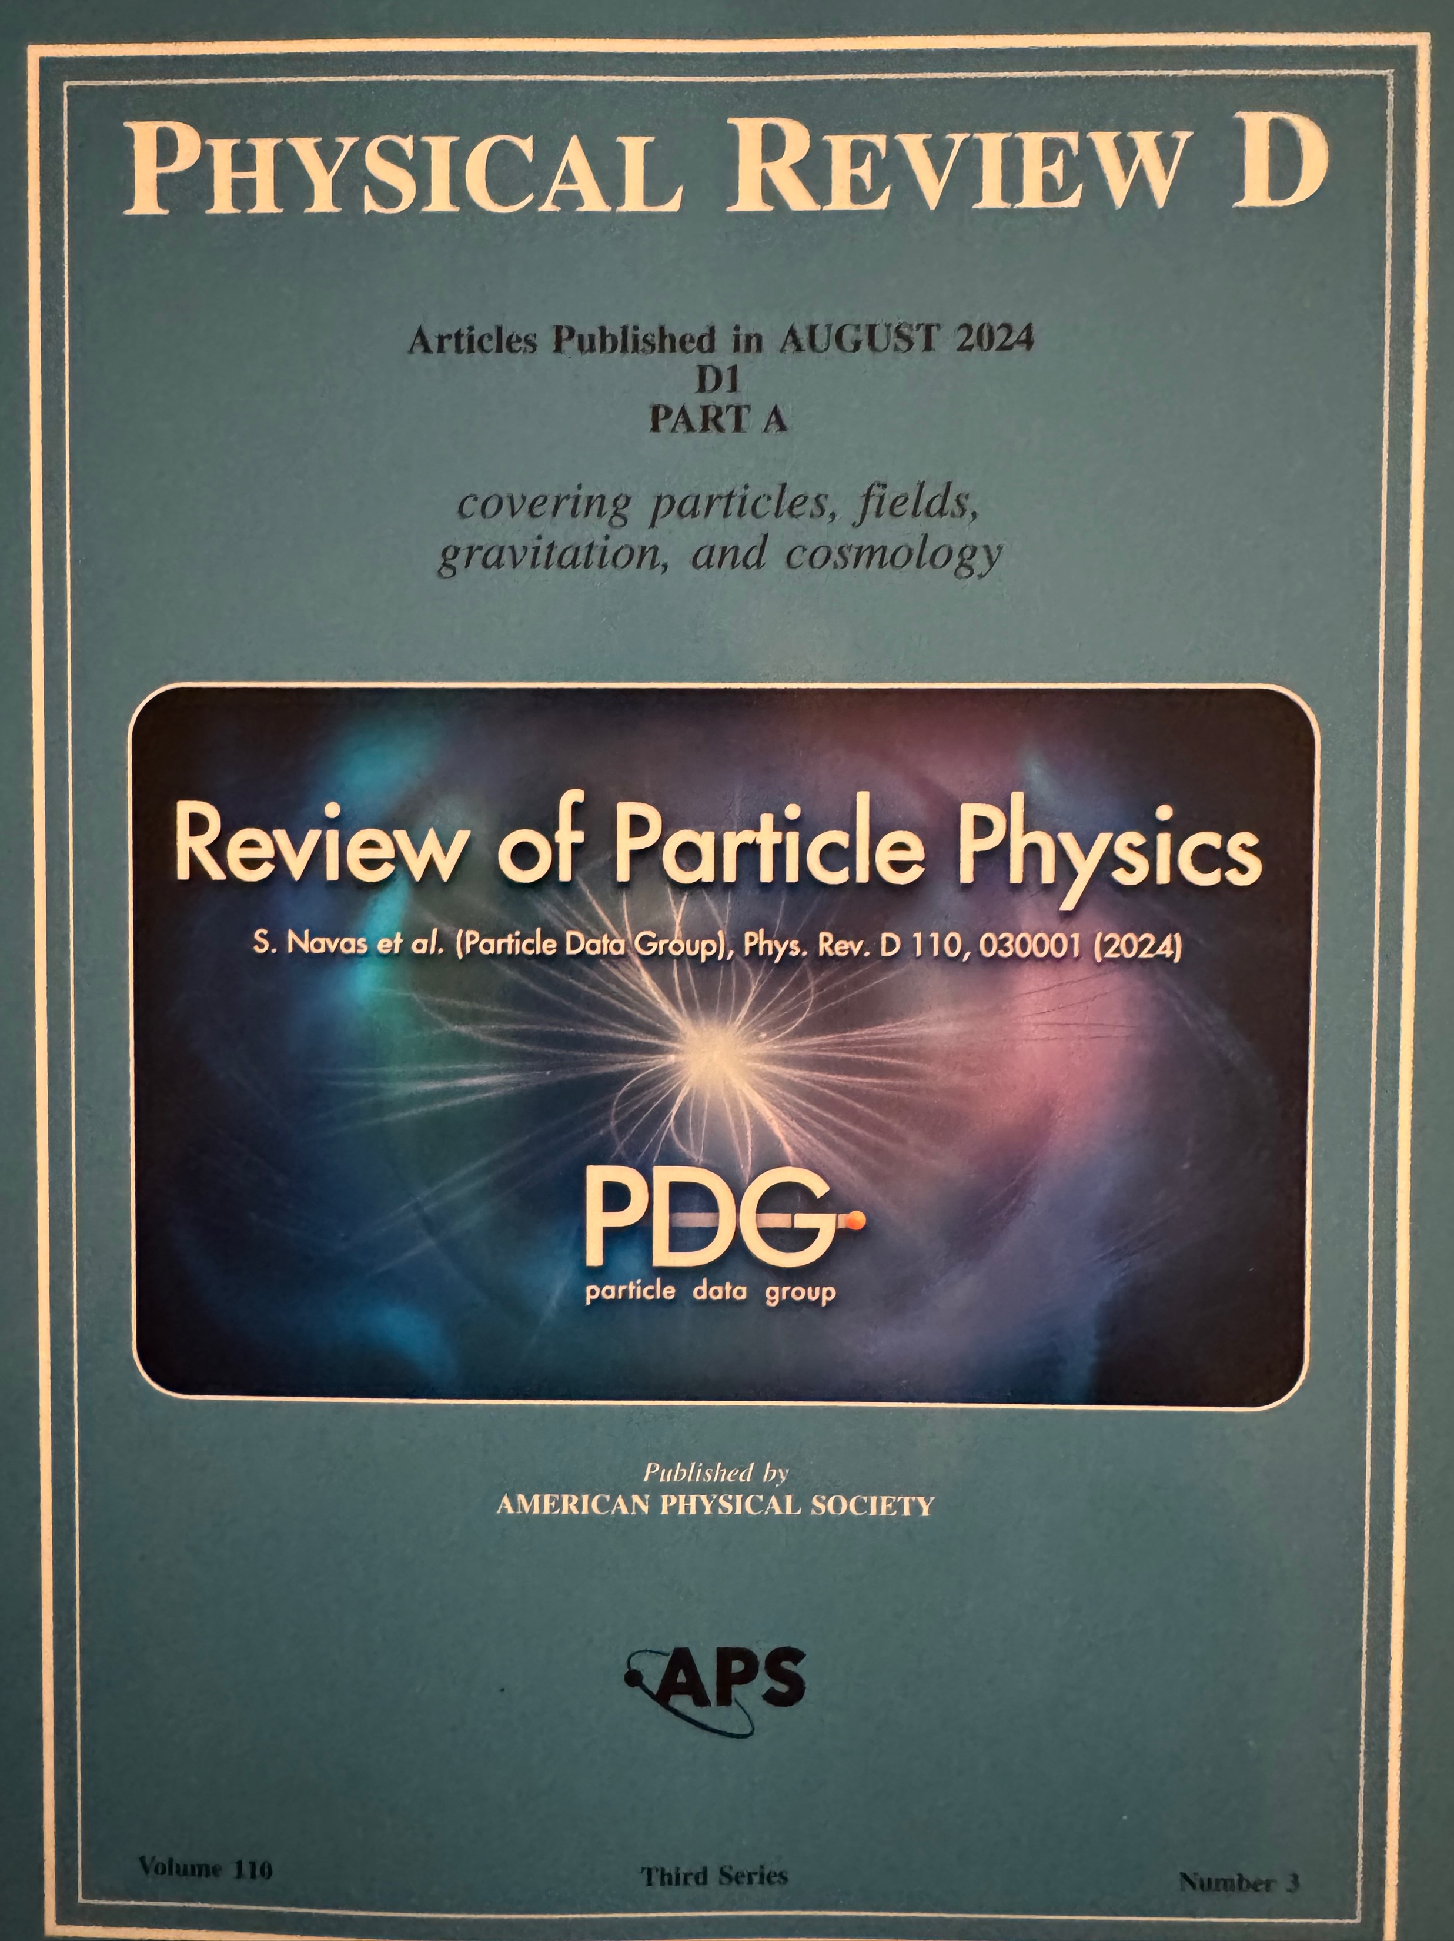
As members of the Particle Data Group, B.C. Allanach and I are co-authors of the biennial Supersymmetry Theory review.
2025 update available at https://pdg.lbl.gov/

Slide 18
Published by Cambridge University Press on June 7, 2023

Slide 19


Slide 20
Research program 3: explorations of the Terascale at the LHC and at future colliders
Studies of non-minimal Higgs sectors
Precision measurements of new physics observables
Distinguishing among different theoretical interpretations of new physics signals
Using a future lepton collider as a precision Higgs factory
Terascale footprints of lepton-number-violation
New sources for CP-violation (Higgs and/or SUSY mediated)

Slide 21
Publications (2024—2026)
Supersymmetry, Part I (Theory)--2025 update
B. Allanach and H.E. Haber, arXiv:2401.03827v3 [hep-ph]
Correlating Resonant Di-Higgs and Tri-Higgs Production to H → VV in the 2HDM
G. Coloretti, A. Crivellin, and H.E. Haber, arXiv:2512.24868 [hep-ph].
Extending the symmetries of the generalized CP-symmetric 2HDM scalar potential to the Yukawa sector
S. Carrolo, H.E. Haber, L. Lourenco and J.P. Silva, Phys. Rev. D 112, 035024 (2025).
RG-stable parameter relations of a scalar field theory in absence of a symmetry
H.E. Haber, and P. Ferreira, Eur. Phys. J. C 85, 541 (2025) [Erratum: 85, 867 (2025)].
Correlating A→γγ with EDMs in the 2HDM in light of the diphoton excesses at 95 GeV and 152 GeV
S. Banik, G. Coloretti, A. Crivellin, and H.E. Haber, Phys. Rev. D 111, 075021 (2025).
Explicit form for the most general Lorentz transformation revisited
H.E. Haber, Symmetry 2024, 16, 1155.
Classes of complete dark photon models constrained by Z-Physics
M. Bento, H.E. Haber, and J.P. Silva, Phys. Lett. B 850, 138501 (2024).

Slide 22
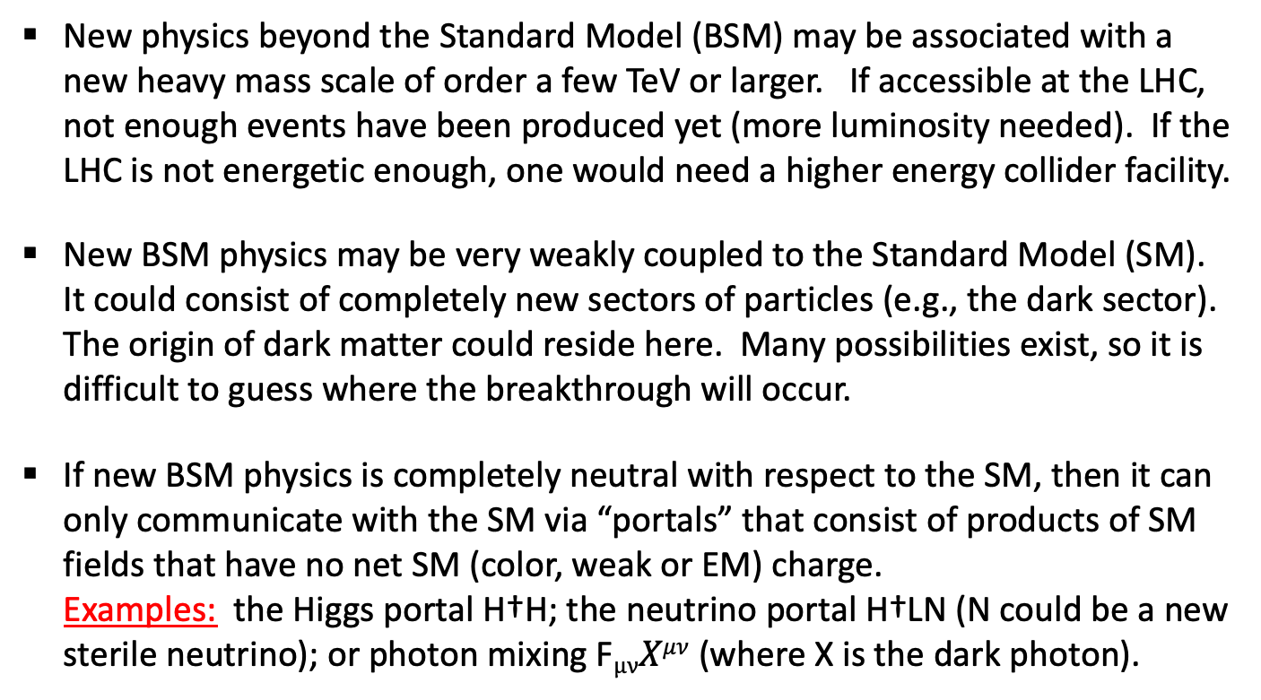
Major thrusts in phenomenological particle physics today
What lies beyond the Standard Model
and why haven’t we seen it yet?
New physics beyond the Standard Model (BSM) may be associated with a new heavy mass scale of order a few TeV or larger. If accessible at the LHC, not enough events have been produced yet (more luminosity needed). If the LHC is not energetic enough, one would need a higher energy collider facility.
New BSM physics may be very weakly coupled to the Standard Model (SM). It could consist of completely new sectors of particles (e.g., the dark sector). The origin of dark matter could reside here. Many possibilities exist, so it is difficult to guess where the breakthrough will occur.
If new BSM physics is completely neutral with respect to the SM, then it can only communicate with the SM via “portals” that consist of products of SM fields that have no net SM (color, weak or EM) charge.
Examples: the Higgs portal H†H; the neutrino portal H†LN (N could be a new
sterile neutrino); or photon mixing F$μνXμν$ (where X is the dark photon).

Slide 23
Should we expect an extended Higgs sector beyond the SM?
The fermion and gauge boson sectors of the SM are not of minimal form (“who ordered that?”). So, why should the spin-0 (scalar) sector be minimal?
Adding new scalar states can alleviate the metastability of the vacuum, allowing the Higgs-sector-extended SM to be valid all the way up to the Planck scale.
Extended Higgs sectors can provide a dark matter candidate.
Extended Higgs sectors can provide new sources of CP violation (which may be useful in baryogenesis).
Models of physics beyond the SM often require additional scalar Higgs states. E.g., two Higgs doublets are required in the minimal supersymmetric extension of the SM (MSSM).

Slide 24
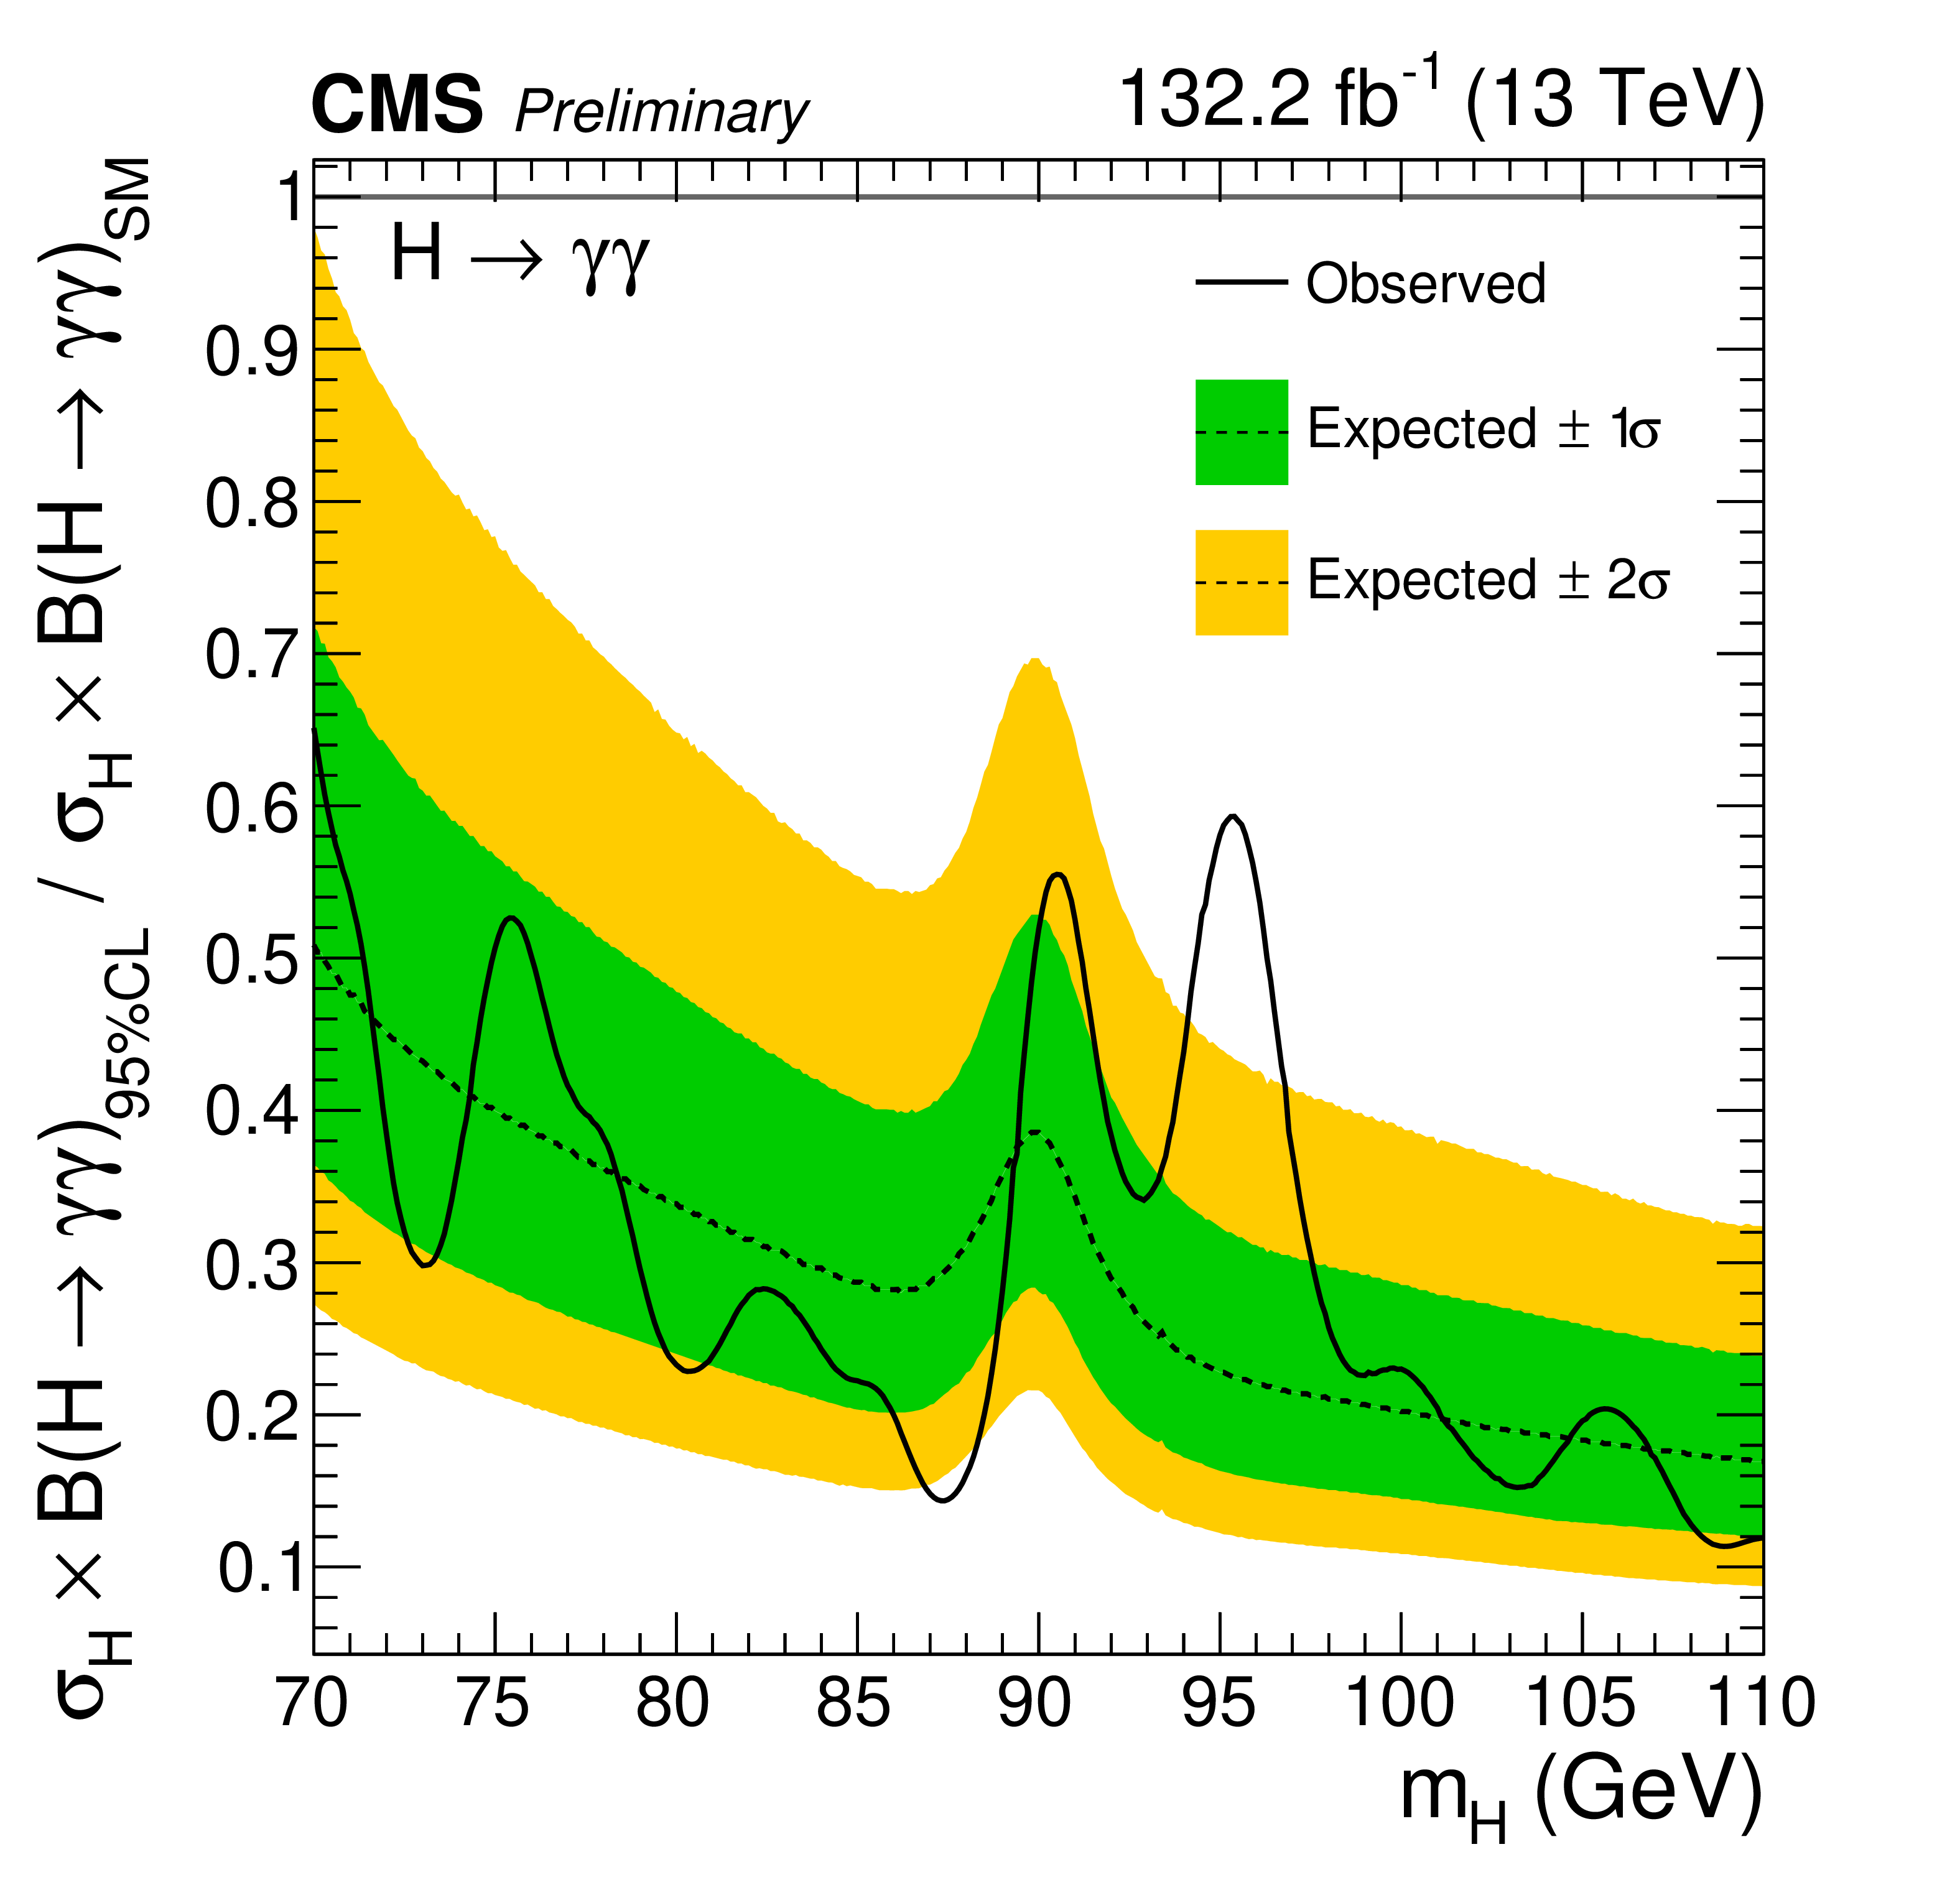
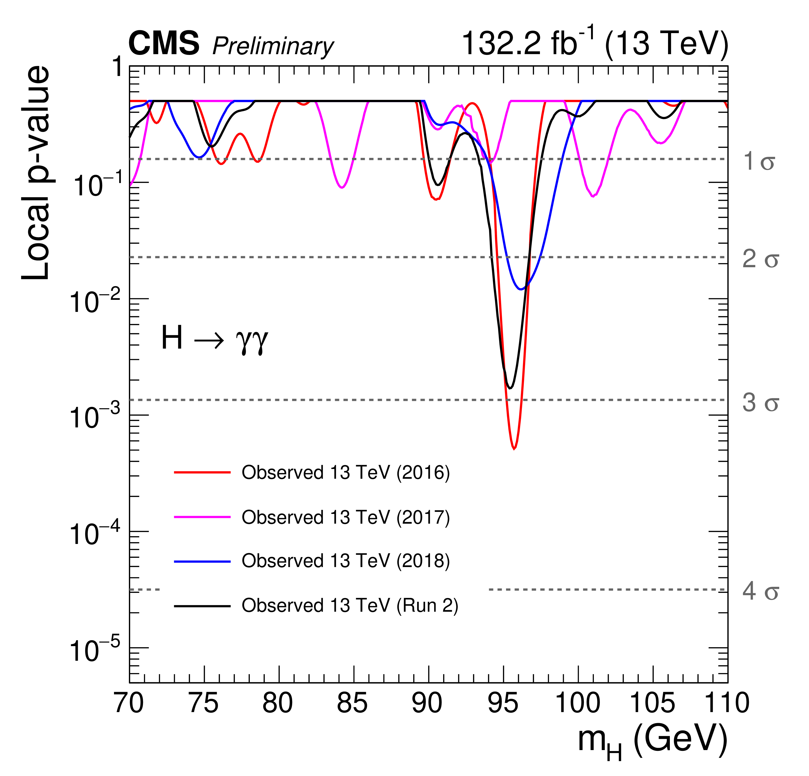
Evidence for a new Higgs scalar ?
Expected and observed exclusion limits (95% CL, in the asymptotic approximation) on the product of the production cross section and branching fraction into two photons for an additional SM-like Higgs boson, from the analysis of the combined data from 2016, 2017, and 2018. The inner and outer bands indicate the regions containing the distribution of limits located within ±1 and 2σ, respectively, of the expectation under the background-only hypothesis.
The observed local p-values for an additional SM-like Higgs boson as a function of m_{H}, from the analysis of the data from 2016, 2017, 2018, and their combination. Taken from CMS-PAS-HIG-20-002 (20 March 2023).

Slide 25
Why is the observed Higgs boson SM-like?
There is no extended Higgs sector.
All other scalars (apart from the SM-like Higgs boson) are very heavy
  This is the decoupling limit.
A neutral scalar field with the tree-level properties of the SM Higgs boson is an approximate mass eigenstate (due to suppressed mixing with other neutral scalar fields of the extended Higgs sector).
  This is the Higgs field alignment limit.
  The other physical scalars of the model may or may not be significantly heavier than the SM Higgs boson. That is, the decoupling limit is a special case of the Higgs field alignment limit.

Slide 26
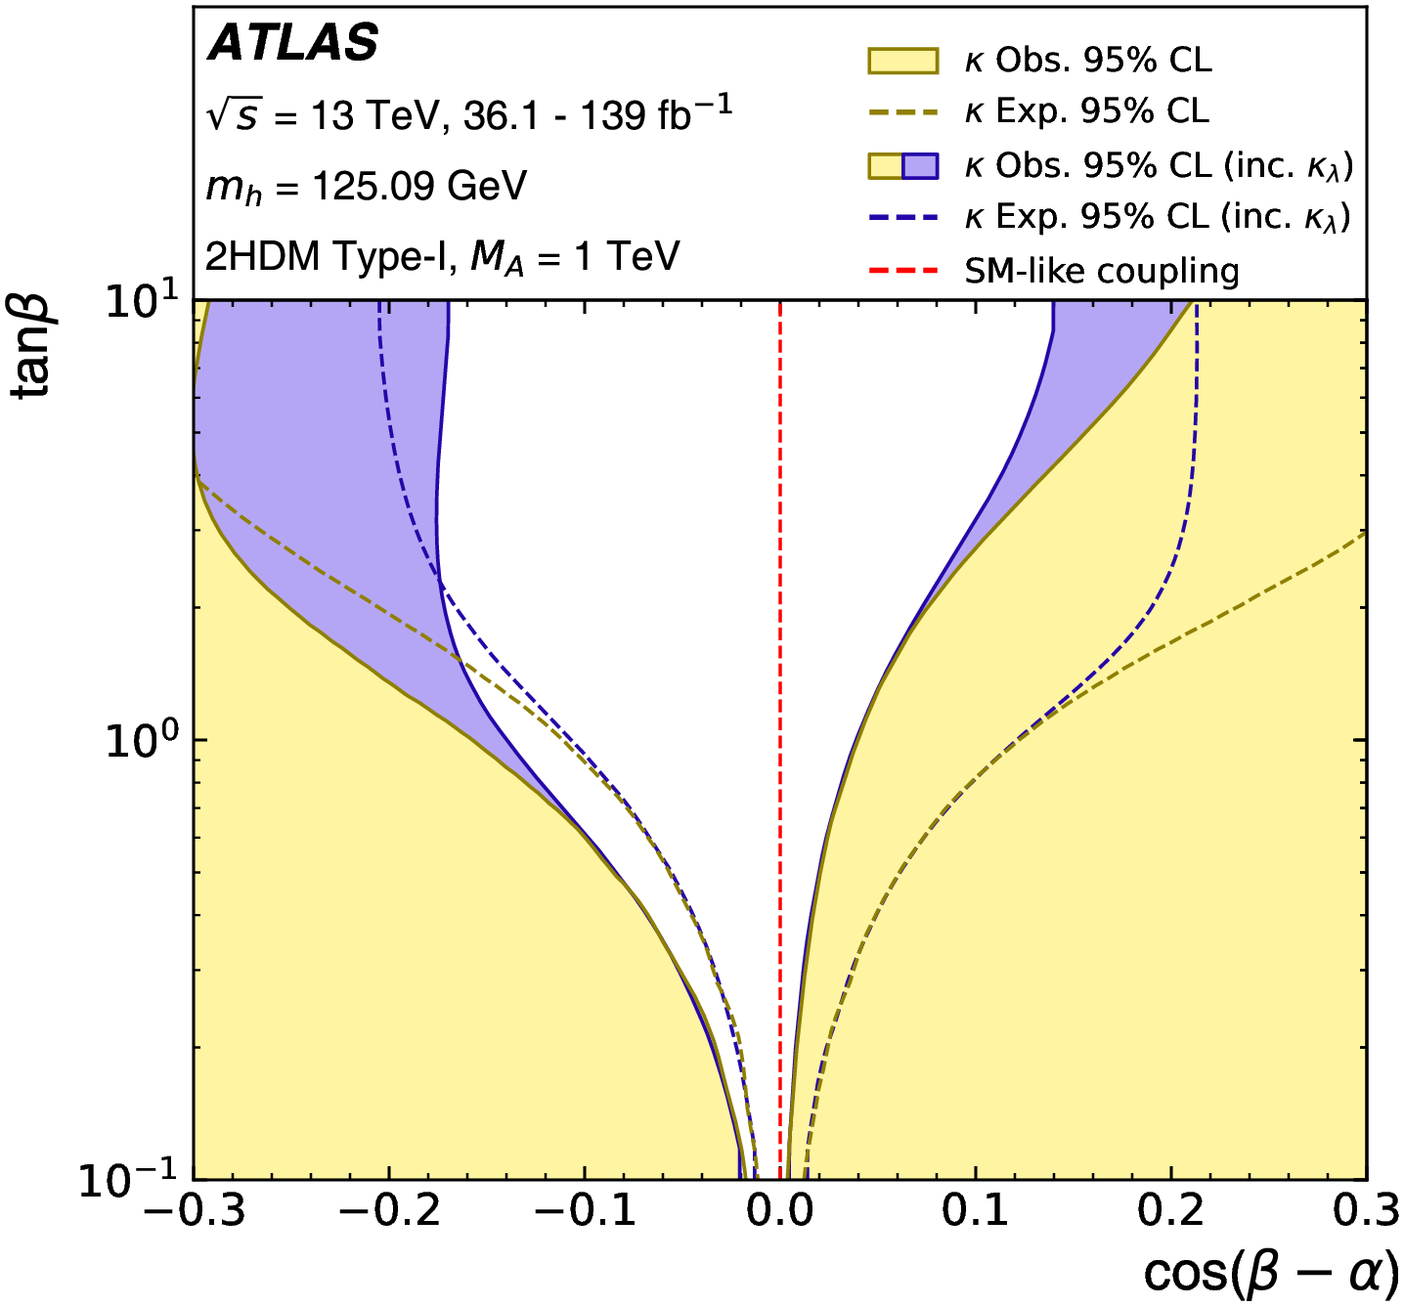
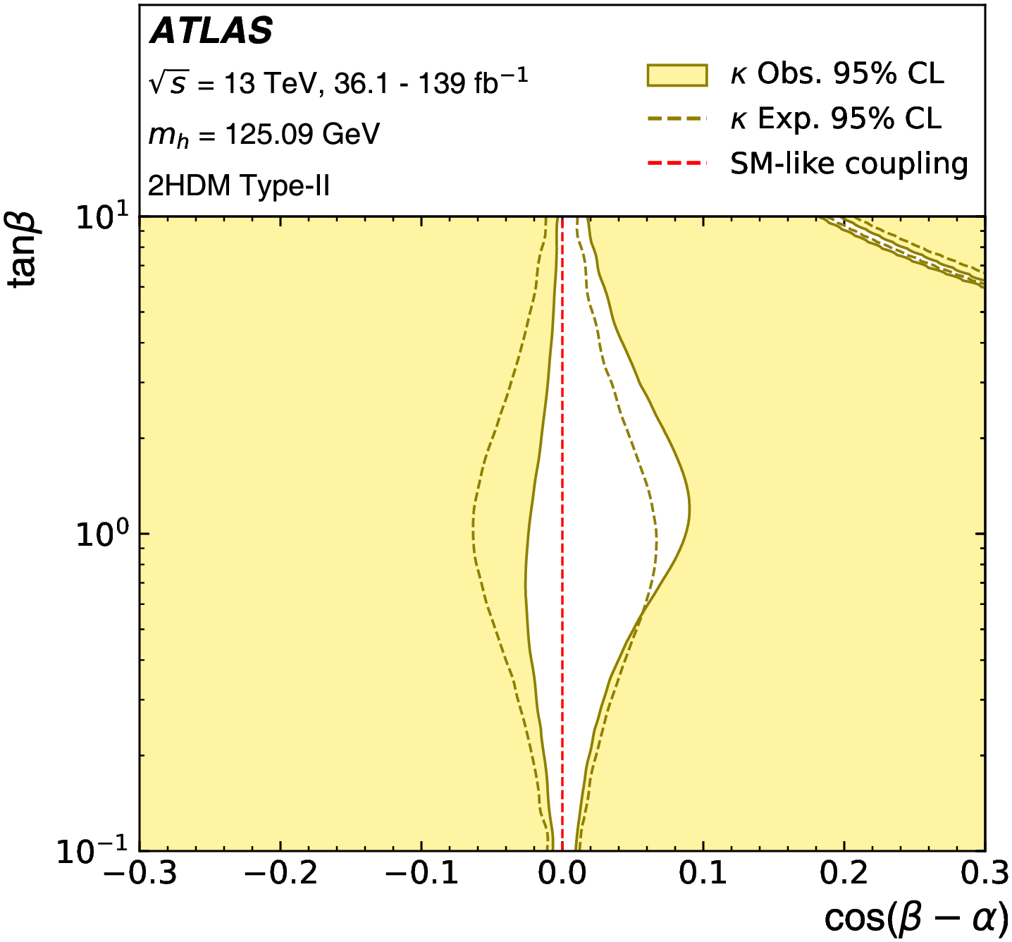
Experimental constraints on the two Higgs doublet model (2HDM)
Regions excluded at 95% CL in the κ-framework-based approach by the measured rates of Higgs boson production and decays in the 2HDM with Type-I and Type-II Yukawa
couplings, respectively. The dark yellow dashed lines show the borders of the corresponding expected exclusion regions for the SM hypothesis. Exact Higgs alignment corresponds to cos(𝛽 - 𝛼) = 0. Taken from the ATLAS Collaboration, JHEP 11 (2024) 097.

Slide 27
My most recent Ph.D. students and their projects
2HDM theory and phenomenology (with E. Shahly). Received his Ph.D. in September 2025.
  Neutral Higgs-mediated flavor violation in the lepton sector due to renormalization group running (with S. Gori and E. Shahly). Results to appear on the arXiv later this year.
  One-loop renormalization of the 2HDM in the Higgs basis.
Phenomenological aspects of more general 2HDMs (with J.M. Connell). Received his Ph.D. in June 2024.
  Explored some (local) 2—3𝝈 deviations in LHC searches for new Higgs bosons, with implications for the flavor-aligned 2HDM. Results published in Phys.Rev. D 108, 055031 (2023).
  Examined the structure of lepton flavor-changing neutral currents mediated by neutral Higgs bosons in extended Higgs models. Results to appear on the arXiv later this year.

Slide 28
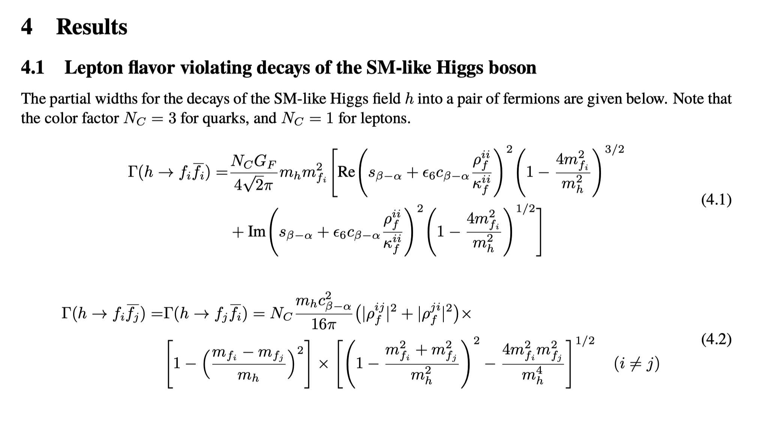
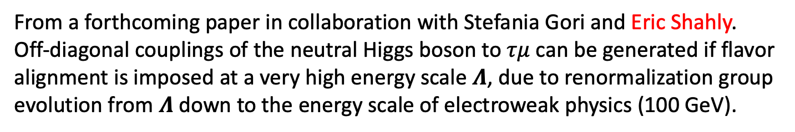
From a forthcoming paper in collaboration with Stefania Gori and Eric Shahly.
Off-diagonal couplings of the neutral Higgs boson to $τμ$can be generated if flavor alignment is imposed at a very high energy scale 𝜦, due to renormalization group evolution from 𝜦 down to the energy scale of electroweak physics (100 GeV).

Slide 29
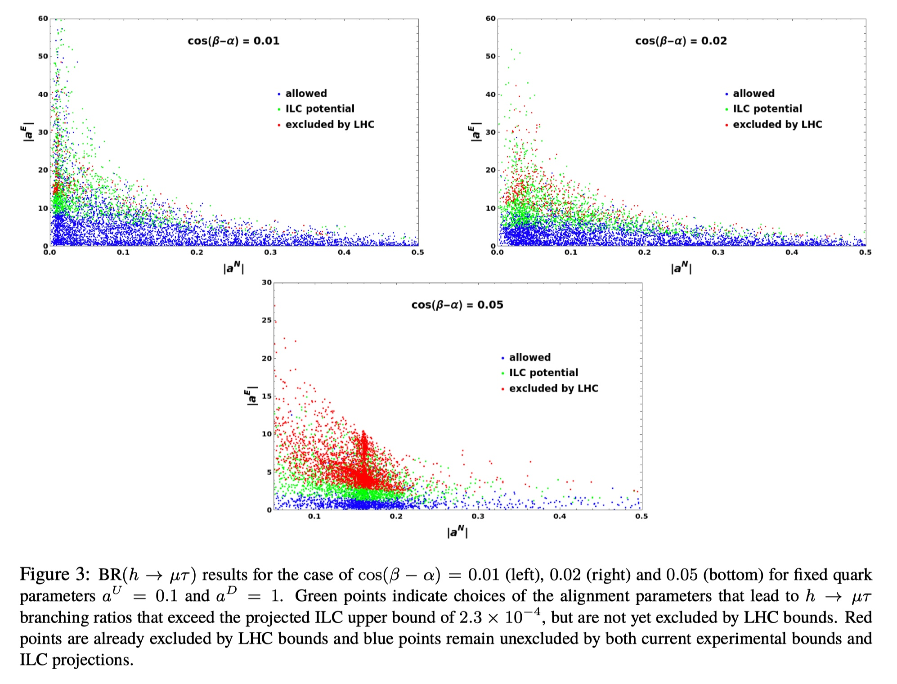

Slide 30
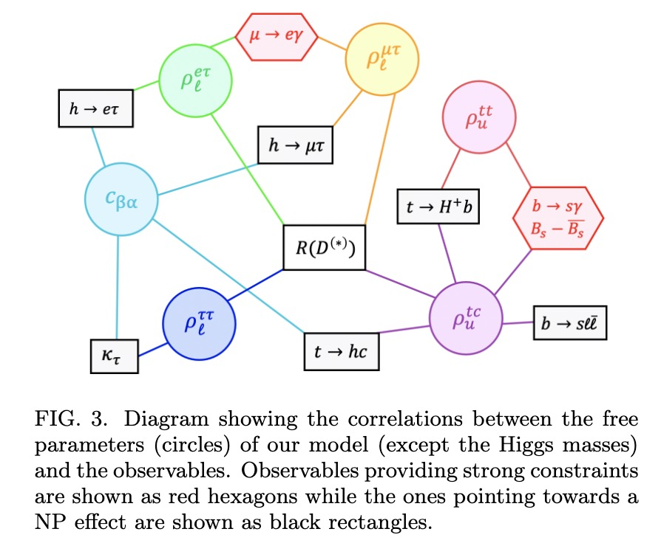
Taken from A. Crivellin and S. Iguro, Phys. Rev. D 110, 015014 (2024).

Slide 31
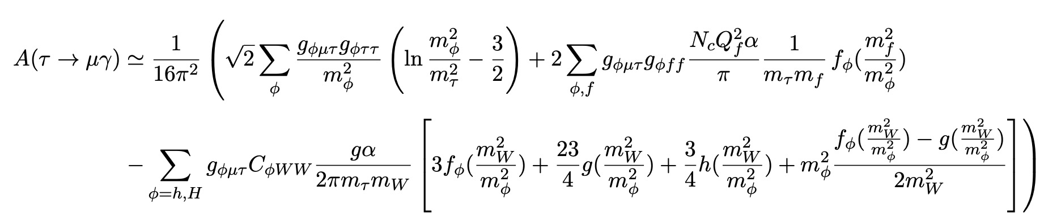
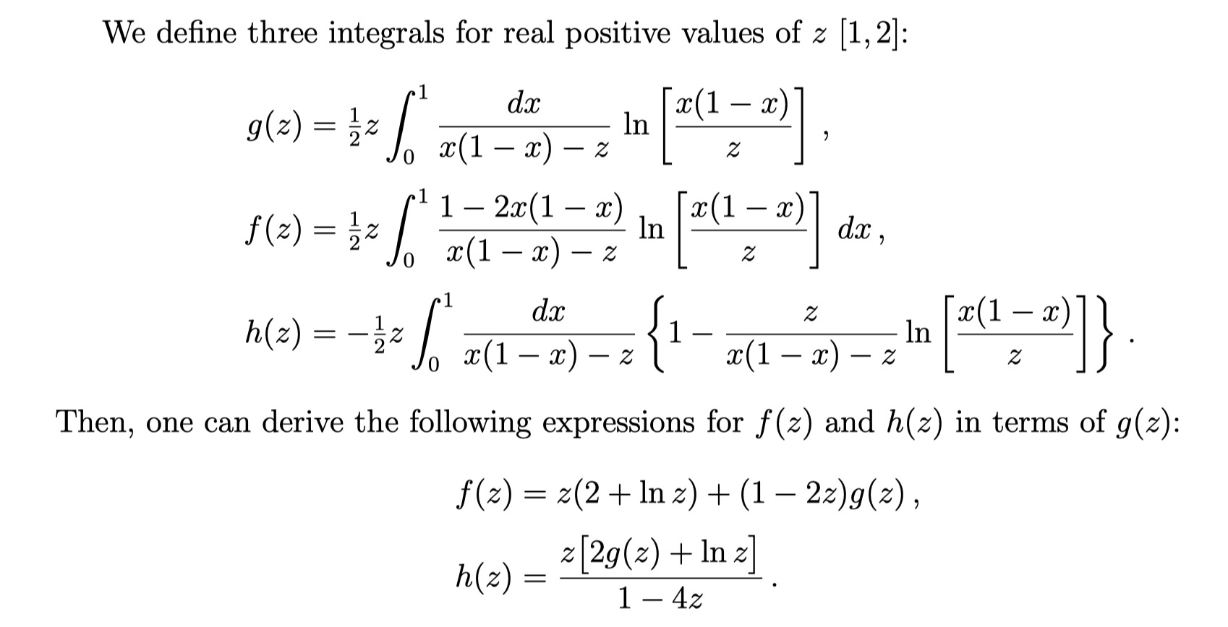
From a forthcoming paper with Joseph Connell. Nondiagonal lepton—Higgs couplings are constrained by many observables. For example, consider 𝜏 ⟶ 𝜇 𝛾.

Slide 32
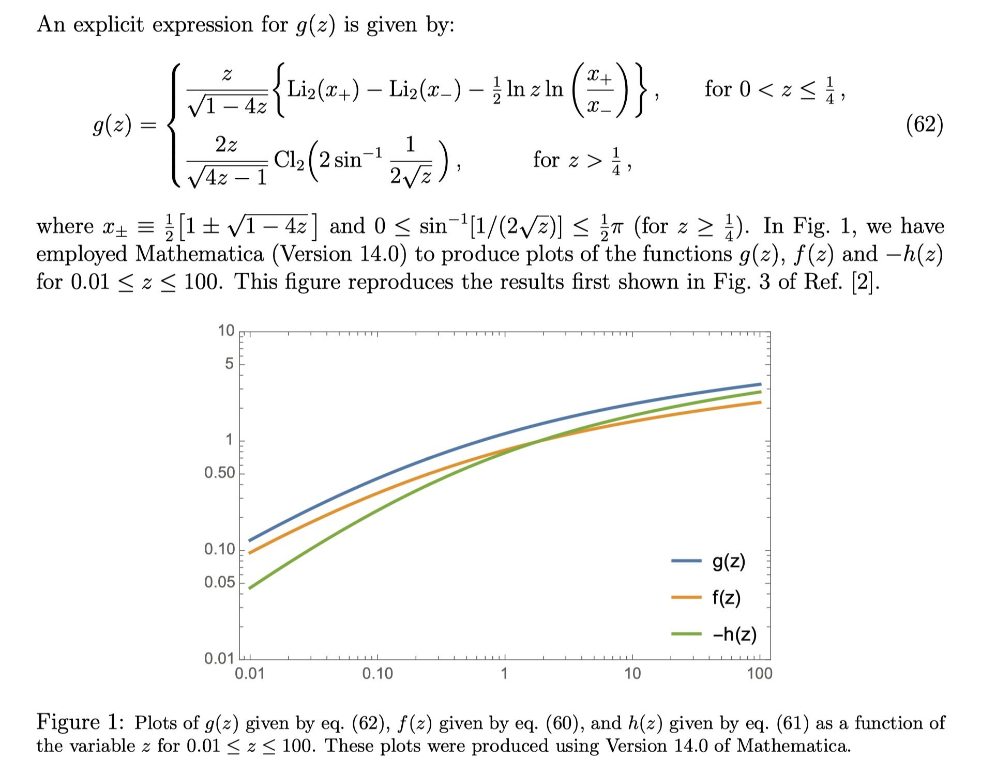

Slide 33
Ongoing and Future Activities
Reassessing the Cheng-Sher ansatz for off-diagonal flavor couplings of neutral Higgs bosons (with Joseph Connell).
Basis-invariant treatment of the 3HDM (with V. Keus).
Further studies of GOOFy “symmetries” and new RG-stable fixed points without a conventional symmetry explanation; extension to the Yukawa sector (with P. Ferreira)
Beyond the S, T, and U oblique parameters in extended electroweak models containing a dark Z boson (with J.P. Silva).
The anapole moment of fundamental particles (with H. Dreiner).
One-loop renormalization in the Higgs basis (with S. Kanemura).

Slide 34
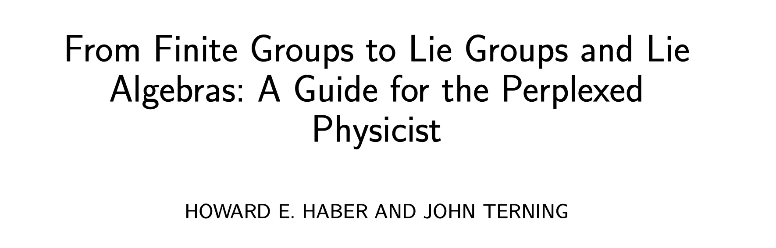
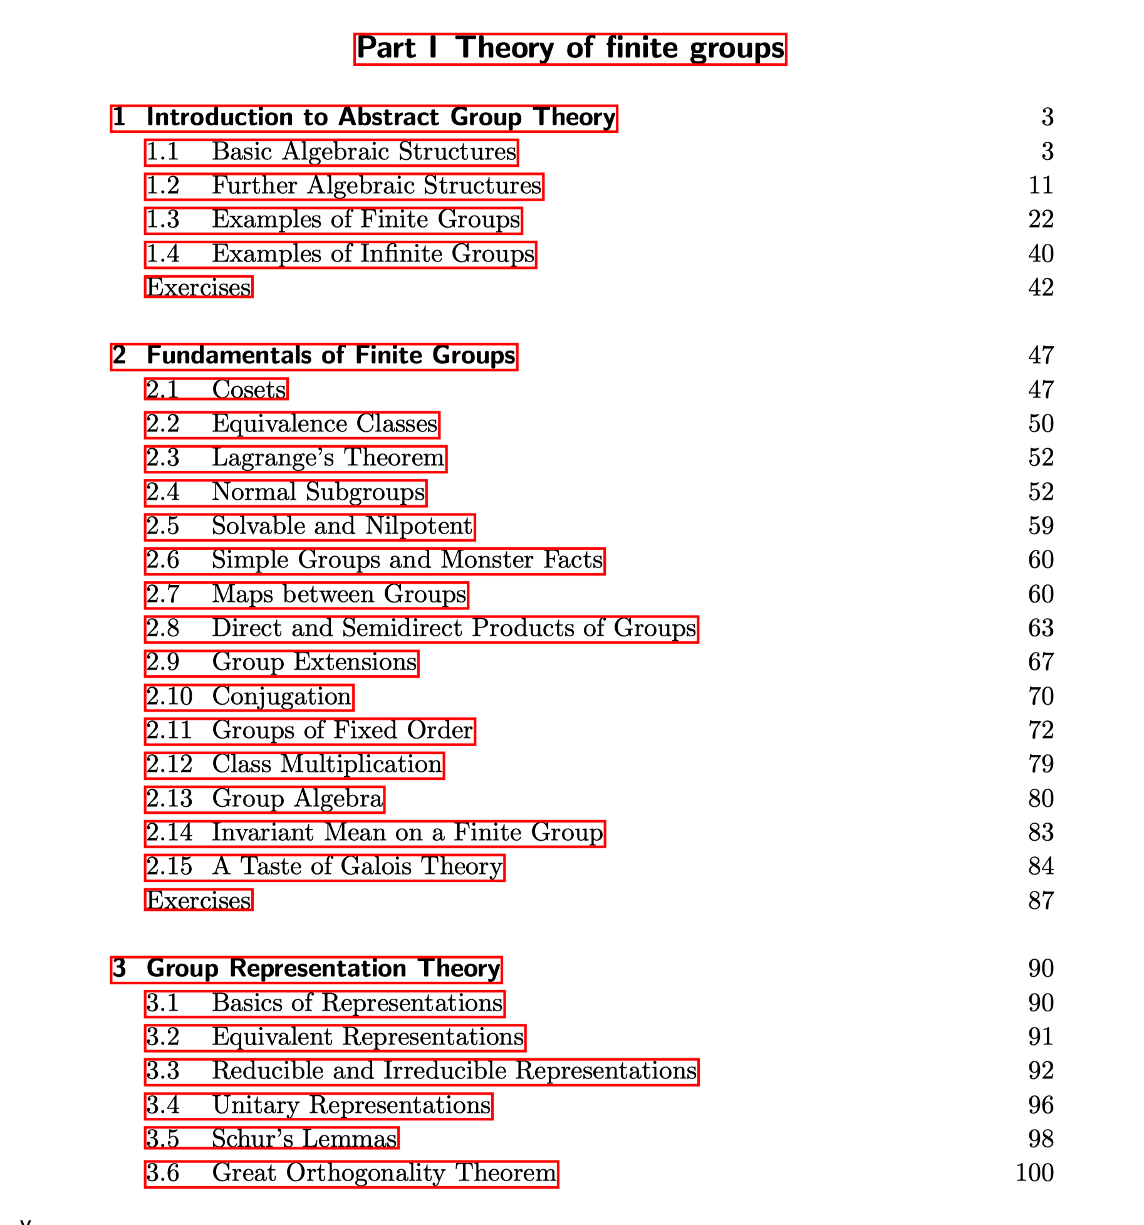
A new book is now being written, based on the Physics 251 course that I have taught many times during my time at UCSC.
I will be teaching this course again in the 2026 spring quarter. A rough draft of the book (currently at 600 pages) will be available to all students attending this course.

