Slide 1


Precision Higgs at Future Colliders
Howard E. Haber
Gunion Fest
UC Davis
March 28, 2014

Slide 2
Timeline of a collaboration
July, 1978—First meeting at Seattle Summer Institute on the
Electroweak Interactions
Lost badly at squash
August, 1981—Second meeting at Seattle Summer Institute
on Grand Unification, Supersymmetry and Supergravity
Attempt to learn SUSY using four-component spinors
(one month before the release of Part 1 of the
Supersymmetry Lectures by Wess and Bagger)
French feast hosted by three star chef Jean Iliopoulos
April 21-23, 1983—Fourth Workshop on Grand Unification
(FWOGU) held in Philadelphia
Jack and I discuss whether it would be useful to provide
a comprehensive study of Higgs bosons in the MSSM

Slide 3
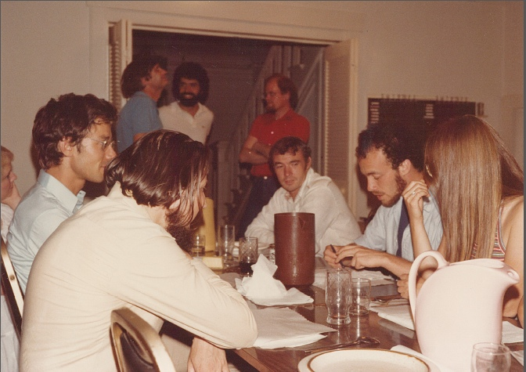
Iliopoulos Feast, SUSY-Workshop in Seattle (August, 1981)

Slide 4
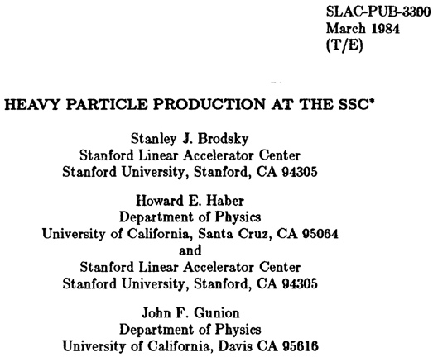
It was thirty years ago today…
My first paper with Jack (and Stan Brodsky), contributed to
a workshop on p-bar p options for the supercollider, at
Argonne in February, 1984
Affectionately
called the
“intrinsic
chevrolet”
paper

Slide 5
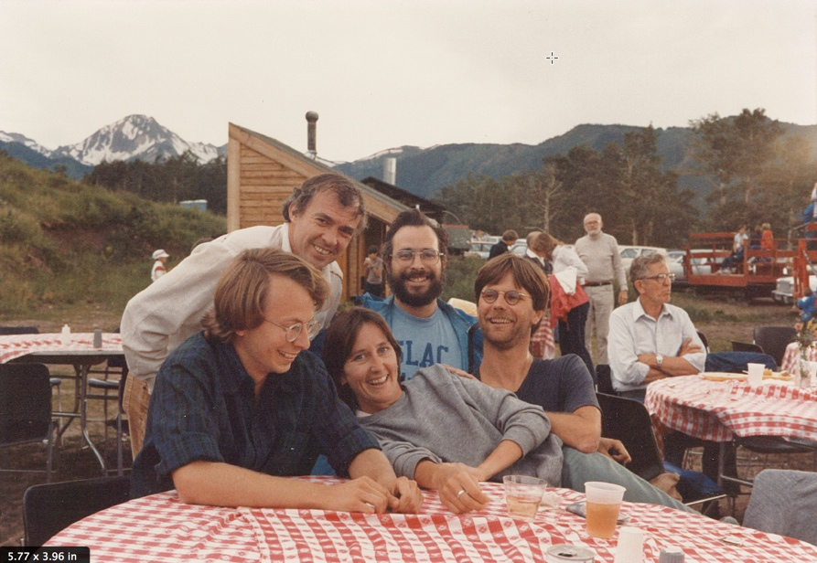
1984---a seminal year
June/July, 1984: Snowmass 1984 Workshop
Collaboration with Jack on SSC physics takes off

Slide 6
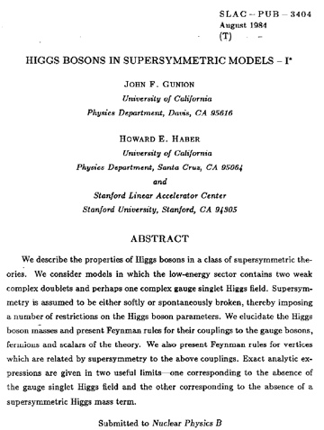
August, 1984:
Our paper on Higgs in
SUSY is completed.
Initially rejected by Nuclear Physics B.
After withdrawing the
paper, the NPB
intervenes and
decides to publish.
Finally appears on July 14, 1986.
Until 2014, remains
our most highly
cited paper…

Slide 7
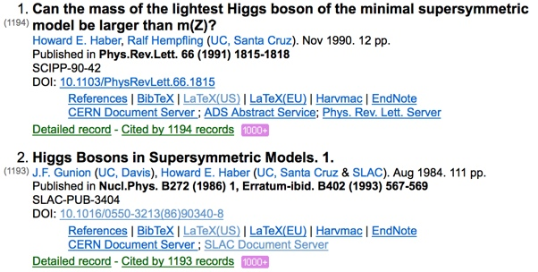
I’m sorry Jack, “Higgs in SUSY 1” just dropped to the
Number 2 spot this past week.

Slide 8

Pursuit of the Higgs boson at future colliders
1988—future e⁺ e⁻ colliders: the next generation
1989—The Higgs Hunter’s Guide
Followed by many enjoyable
collaborations over the next 25 years on Higgs, SUSY, BSM physics at SLC and LEP, Tevatron, LHC, and future collider facilities (ILC,…)

Slide 9
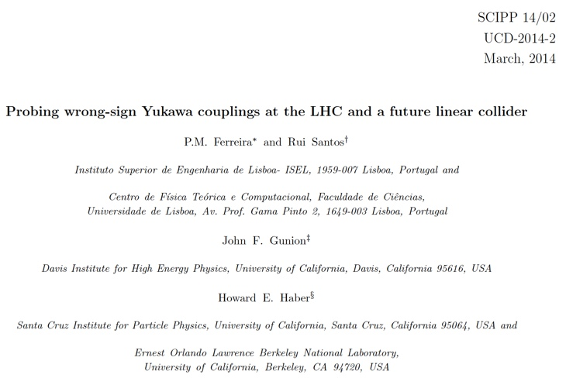
30 years later, the collaboration is alive and well

Slide 10

And we are not yet done…
So, at the celebration of your 70th milestone
birthday, let me convey my gratitude for your
warm friendship and your
generosity in sharing
your ideas and your
dedication to foster
this long and fruitful
collaboration.

Slide 11
Precision Higgs at Future Colliders
Reference: ILC Higgs White Paper,
by D.M. Asner, T. Barklow, C. Calancha,
K. Fujii, N. Graf, H.E. Haber, et al.,
arXiv:1310.0763 [hep-ph], to appear in the
Proceedings of the 2013 Snowmass Community
Study.
See also M.E. Peskin, Estimation of LHC and
ILC Capabilities for Precision Higgs Boson Coupling
Measurements, arXiv:1312.4974 [hep-ph].

Slide 12
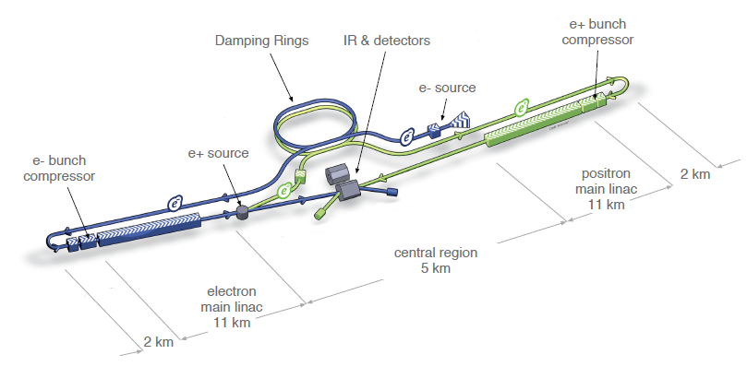
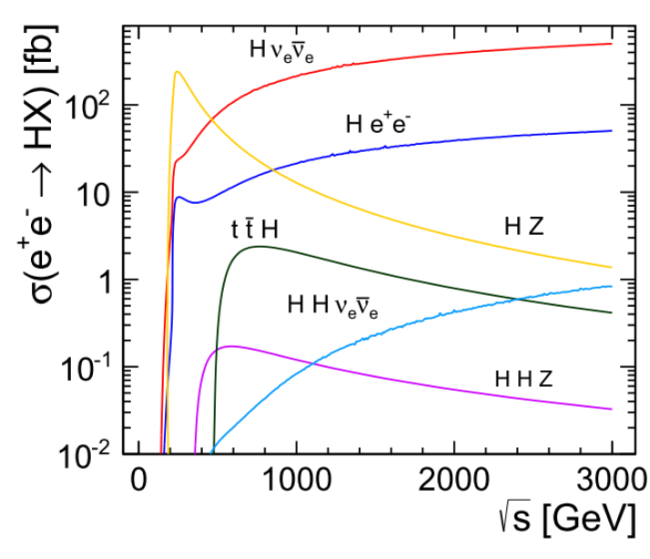

Slide 13
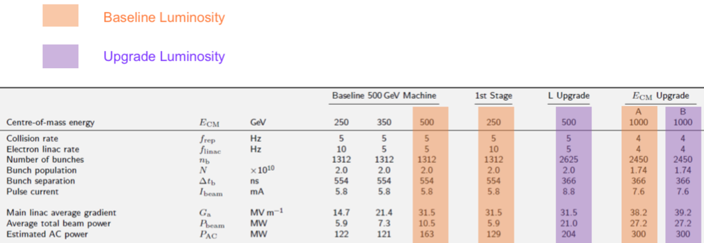
Energy/Luminosity running scenarios
From the ILC Technical Design Report
Luminosity (in units of 10³⁴ cm⁻² s⁻¹)
CM Energy: | 250 GeV | 500 GeV | 1000 GeV
Baseline design | 0.75 | 1.8 | 3.6
Luminosity upgrade | 3.0* | 3.6 | 4.9
*not in ILC TDR; high rep rate operation proposed by Marc Ross and Nick Walker

Slide 14
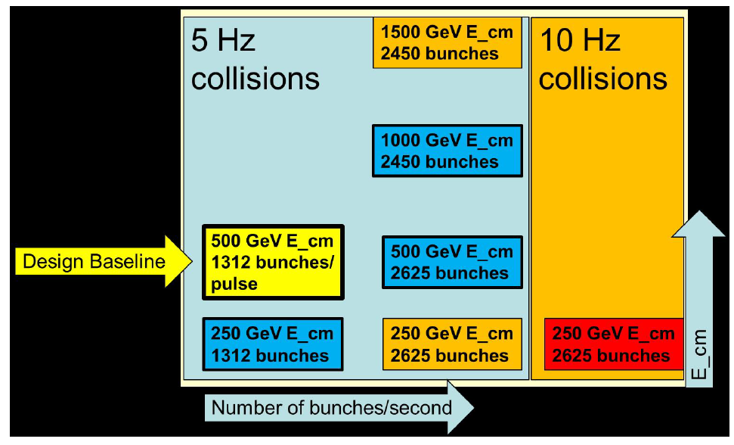
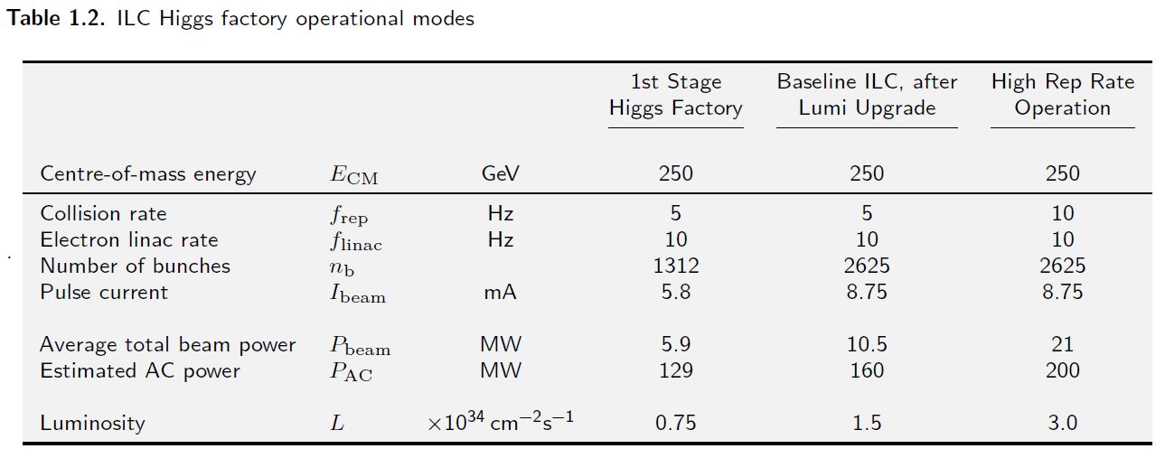
Luminosity Upgrade at E_{cm}=250 GeV

Slide 15
Energy/Luminosity scenarios
Stage # | nickname | E_{cm}(1) (GeV) | Lumi (1) (fb⁻¹) | E_{cm}(2) (GeV) | Lumi (2) (fb⁻¹) | E_{cm}(3) (GeV) | Lumi (3) (fb⁻¹) | Runtime (years)
1 | ILC (250) | 250 | 250 |  |  |  |  | 1.1
2 | ILC (500) | 250 | 250 | 500 | 500 |  |  | 2.0
3 | ILC (1000) | 250 | 250 | 500 | 500 | 1000 | 1000 | 2.9
4 | ILC(LumUp) | 250 | 1150 | 500 | 1600 | 1000 | 2500 | 5.8
At each stage, the accumulated luminosity of a given energy is listed. The
runtimes listed consist of actual elapsed cumulative running time at the
end of each stage. Assuming that the ILC runs for 1/3 of the time, then
the actual time elapsed is equal to the runtime times 3.
Assume that the ILC is run at its baseline luminosity at 250 GeV (stage 1),
then at 500 GeV (stage 2), and finally at 1000 GeV (stage 3)
Then, stage 4 repeats the successive stages 1, 2 and 3 at the upgraded
luminosity.
In real time, this entire program would require 5.8 x 3 = 17.4 years.

Slide 16
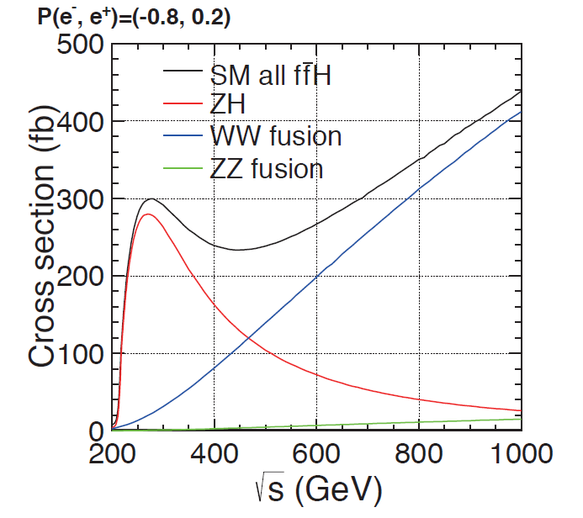
Beam polarization can increase the vector boson fusion
cross section, W⁺W⁻ → H, by as much as a factor of two.
P(e⁻,e⁺)=(0,0)

Slide 17
Simulations: Full simulations performed
with ILD and/or SiD dectector.
Systematic errors:

Slide 18
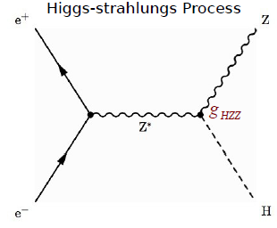
What does the ILC actually measure?
The Z can be reconstructed
in charged lepton and quark
channels.
The H can be “seen” in the
mass spectrum recoiling
against the Z (including the
invisible Higgs decays).
The H can be reconstructed
in its main decay channels.

Slide 19
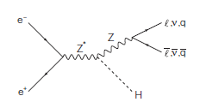
Invisible Higgs Decay
In the SM, an invisible Higgs decay is H → ZZ* →4ν process and its BF is small ~0.1%
If we found sizable invisible Higgs decays, it is clear new physics signal.
The decay products are dark matter candidates.
At the LHC, one can search for invisible Higgs decays by using recoil mass from Z or summing up BFs of observed decay modes with some assumptions.
The upper limit is O(10%).
At the ILC, we can search for invisible Higgs decays using a recoil mass technique with model independent way!
e+e- → ZH
known
measured

Slide 20
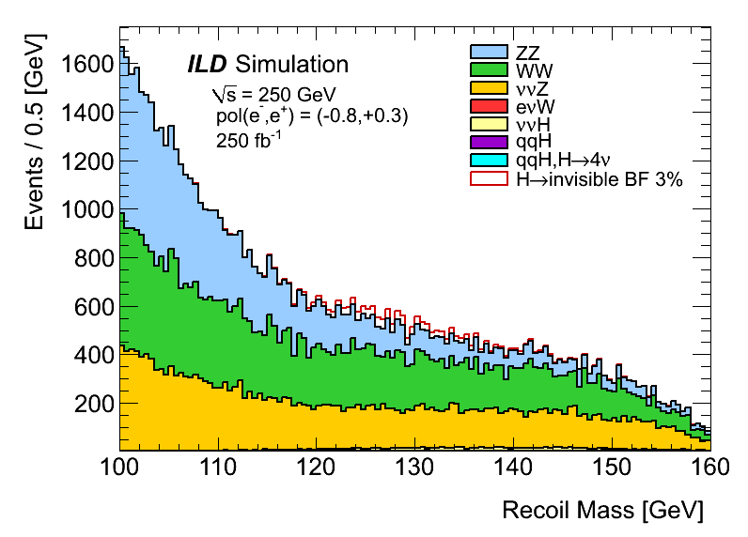
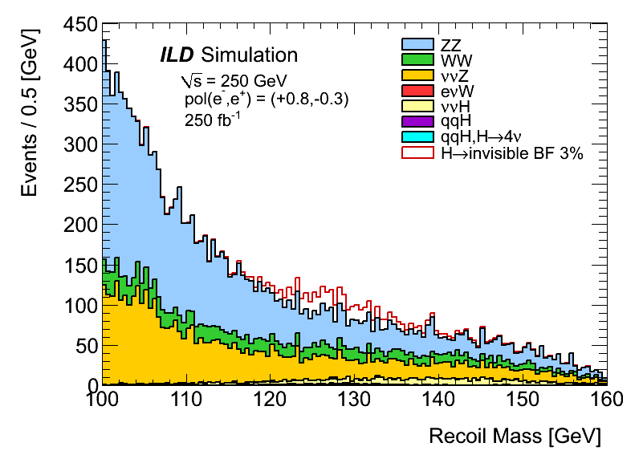
Signal+Background
Polarizations P(e+,e-)=(+30%,-80) [denoted below as “Left”]
=(-30%, +80%) [denoted below as “Right”]
If BF(H→invisible) = 3%
Signal is clearly seen for “Right” polarization
“Left”
“Right”

Slide 22
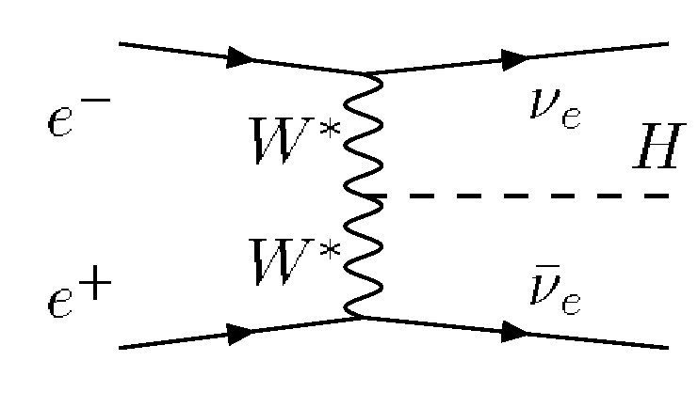
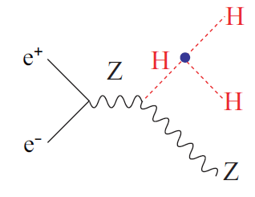
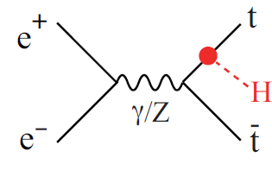

Slide 24
Expected precision for cross section and cross section times
branching ratio at the baseline luminosity and a one year runtime
(i.e. three years in real time) for each energy/luminosity
For invisible decays, the 95% CL upper limit is given.
Note: Mass measurement at E_{CM}=250 GeV yields ΔM_{H}=32 MeV.

Slide 25
Expected accuracies for cross section and cross section times
branching ratio at the upgraded luminosity and a one year runtime (i.e. three years in real time) for each energy/luminosity
For invisible decays, the 95% CL upper limit is given.
Note: Mass measurement at E_{CM}=250 GeV yields ΔM_{H}=15 MeV.

Slide 26
Model-independent determinations of
Higgs couplings
Example--consider the following four
independent measurements:

Slide 29
Summary of expected accuracies Δg_{i}/g_{i} and Γ_{T} for model
independent determinations of the Higgs boson couplings
The theory errors are ΔF_{i}/F_{i}=0.5%. For the invisible branching ratio,
the numbers quoted are 95% confidence upper limits.

Slide 30
Model-independent determinations of
Higgs cross sections and branching ratios

Slide 31
Summary of expected accuracies for the three cross sections and eight branching ratios obtained from an
eleven parameter global fit of all available data.

Slide 32
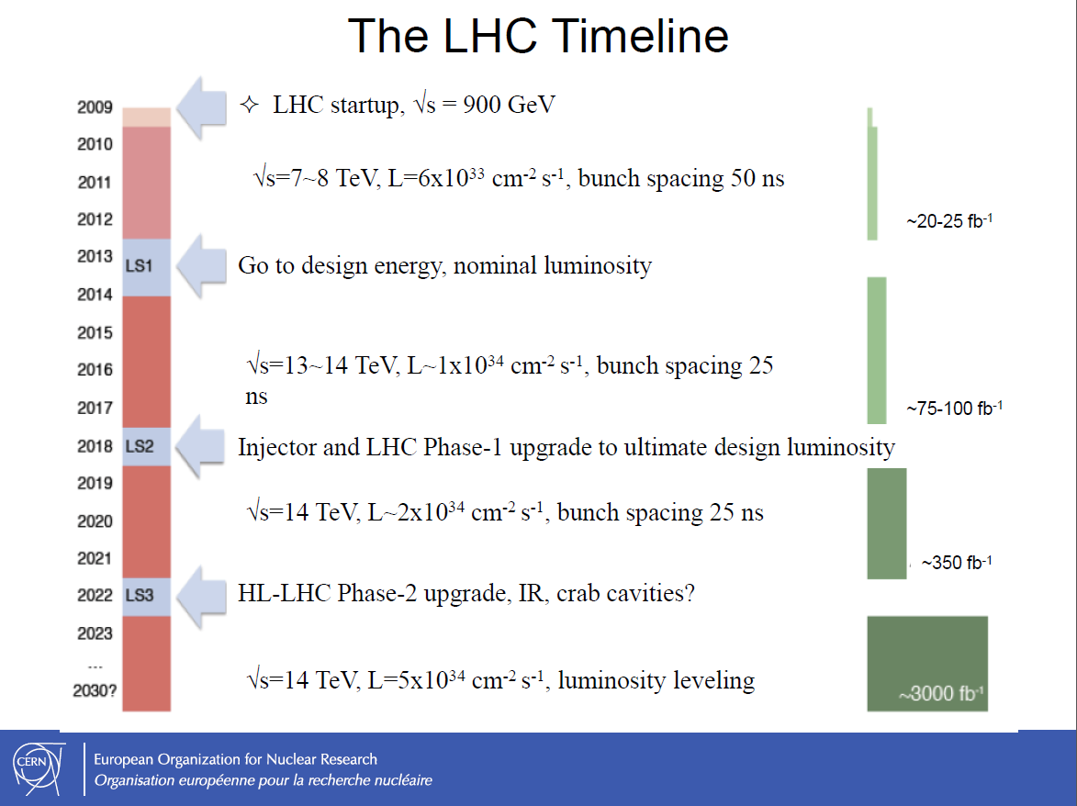

Slide 33
Comparing LHC and ILC Projected Precision
ATLAS and CMS have provided projections for the ultimate accuracies of Higgs coupling measurements based on the currently planned six year program (accumulating 300 fb⁻¹ of data) and a proposed high-luminosity ten year program (accumulating 3000 fb⁻¹ of data).
Here, I make use of Michael Peskin’s reinterpretation of the CMS results, which are less conservative than the ATLAS numbers. Since ATLAS does not provide projections for the measurement of the hbb coupling, Peskin only employs the CMS numbers in his analysis.

Slide 34
CMS quotes a pessimistic and optimistic scenario:
CMS-1: current systematic and theoretical uncertainties
are employed.
CMS-2: theoretical errors are reduced by a factor of two
and systematic errors are assumed to decrease
as the square root of the integrated luminosity.
In comparing with ILC precision estimates, Peskin
improves the ILC Higgs White paper numbers by
imposing the constraint:
based on anticipated measured upper limits for BR’s of
exotic Higgs decay modes.

Slide 35
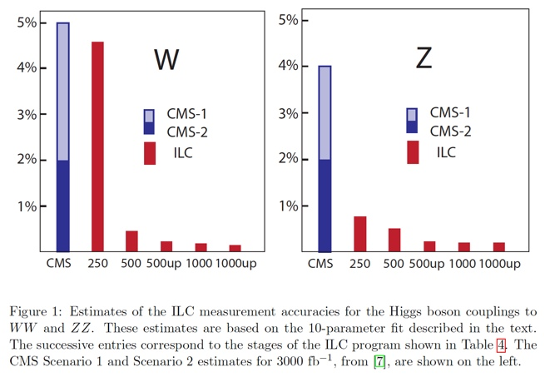

Slide 36
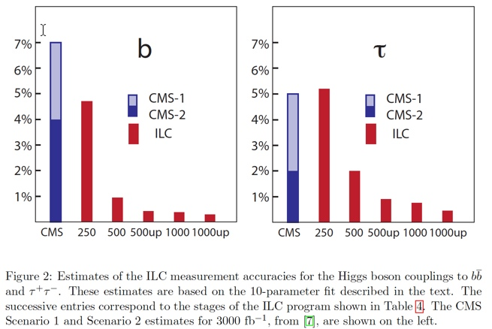

Slide 37
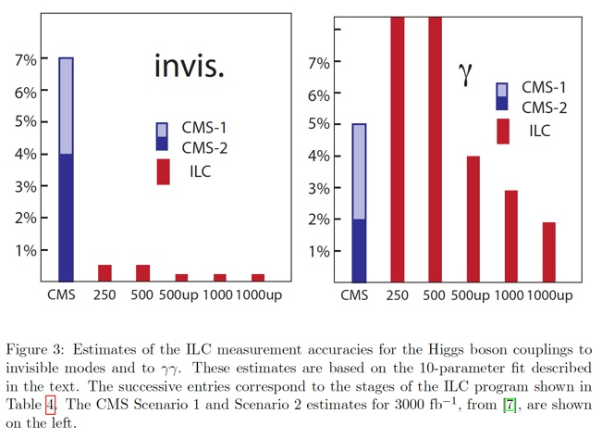

Slide 38
Peskin notes that by combining one
LHC observable, namely
as projected by ATLAS in their high
luminosity LHC analysis, with the
ILC precision measurement of the
ZZH coupling, one is able to obtain
a very precise determination of the
γγH coupling.

Slide 39
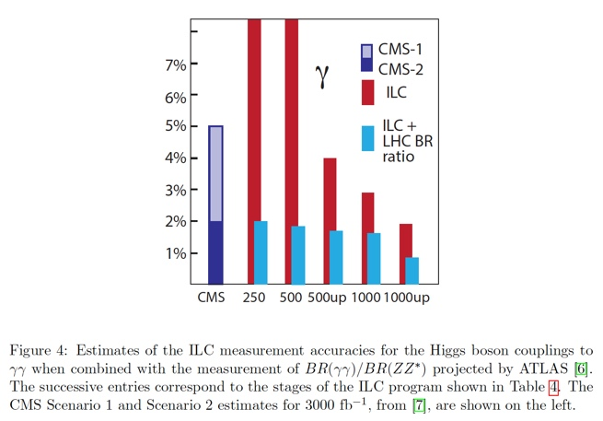

Slide 40
The Bottom Line
The ILC will provide the next significant step in
the precision study of Higgs boson properties.
LHC precision measurements in the 5—10%
range will be brought down to the 1% level.
The ILC is able to provide a model-independent
determination of Higgs couplings via the
measurement of σ_{ZH}, in addition to measuring
σ x Br in numerous channels. (In contrast, LHC
only can measure σ x Br).
Together with the LHC Higgs data, the ILC will
provide critical measurements that can probe
new physics beyond the Standard Model and
provide important clues as to what may lie ahead.

Slide 41
Back-up slides

Slide 42
Summary of expected accuracies Δg_{i}/g_{i} and Γ_{T} using
the model-dependent seven parameter HXSWG benchmark parameterization, assuming all theory
errors are 0.5%

