Slide 1

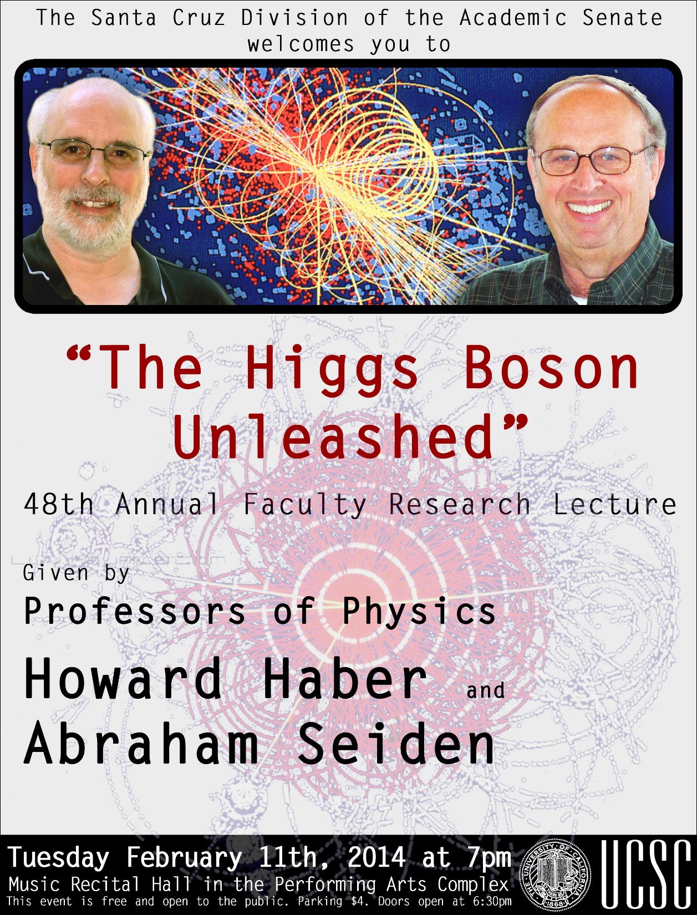

Slide 2
Part I: The Higgs Boson—A Theoretical Journey
The search for the fundamental particles and forces of nature
Revolutions of 20th century physics: relativity and quantum theory
Quantum fields and waves/particles
A quantum view of the vacuum
Role of symmetry in physics
The remarkable Higgs mechanism
Generating mass for the fundamental particles
Introducing the Higgs boson
A theorist invents a new fundamental particle
Hunting the Higgs boson
End of an era or a new beginning?

Slide 3
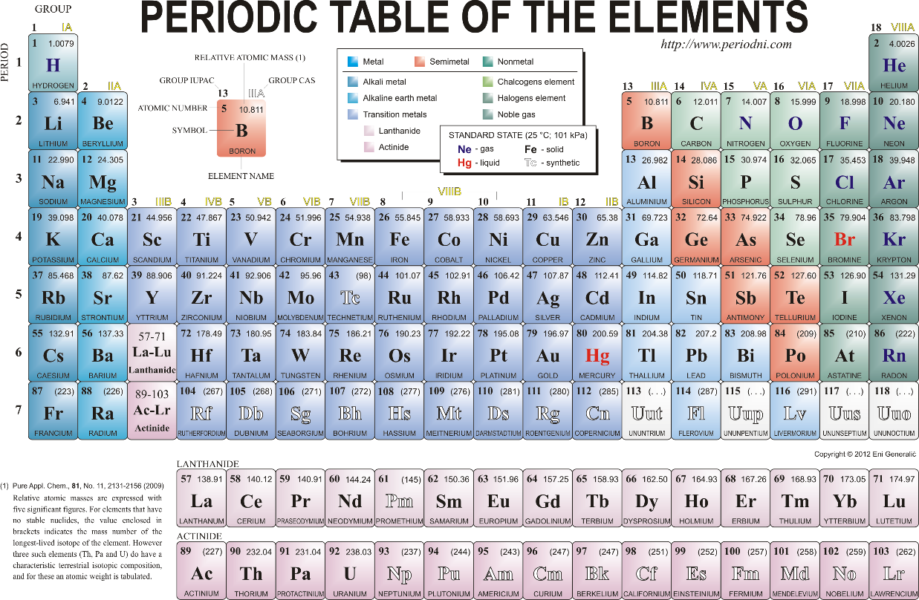
The search for fundamental particles and forces of nature
More than 25 centuries ago, the Ionian Greeks argued (based on philosophy) that the apparent complexity of the universe could be understood in terms of a few simple underlying laws. Similar developments also occurred in India around the same time period.
Democritus coined the term átomos around the year 450 BC.
The scientific theory of the atom arose in the 19th century culminating in the periodic table of elements (Mendeleev).
The final experimental confirmation
of the atomic theory only took
place in the 20th century.
The discoveries of the 20th century
revealed that atoms were not
truly fundamental particles but were
composed of smaller constituents.

Slide 4
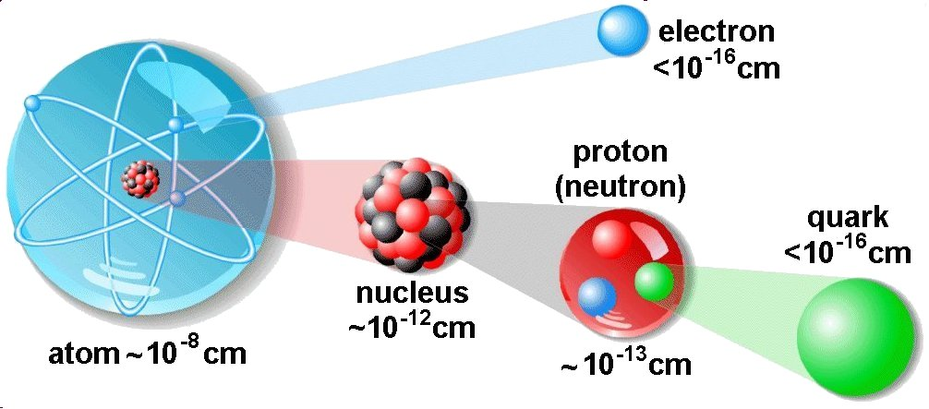

Slide 5
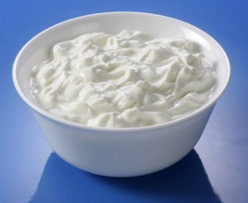
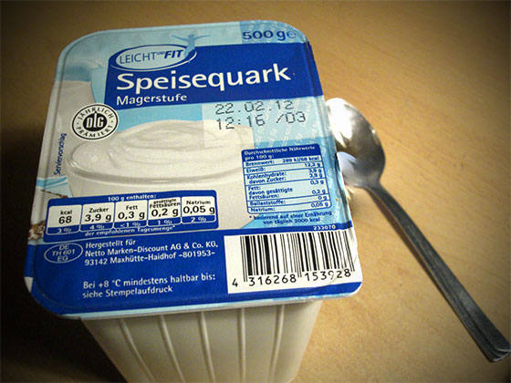
Quarks
Invented by theorists Murray Gell-Mann and George Zweig in 1964.
At the time of its invention only three types of quarks (u,d,s) were required to
describe all known strongly-interacting sub-atomic particles.
Gell-Mann chose the name “quark” inspired by James Joyce.
Three quarks for Muster Mark! Sure he has not got much of a bark And sure any he has it's all beside the mark.
—James Joyce, Finnegans Wake
Although not obviously related to the German
cheese product called quark, it is said that there
was a German commercial slogan in the 1920s: “Drei Quark für eine Mark.”
(Indeed, James Joyce was known for multilingual puns.)

Slide 6
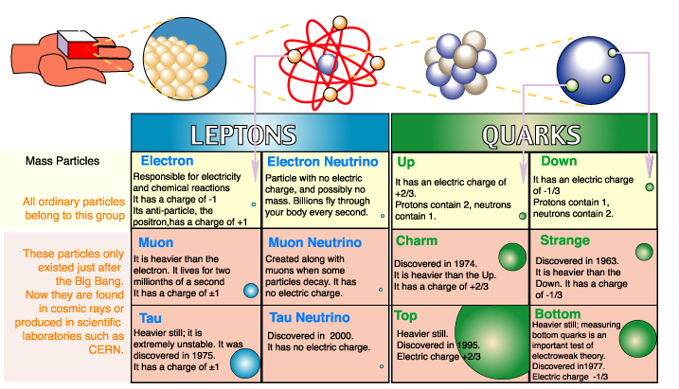

Slide 7
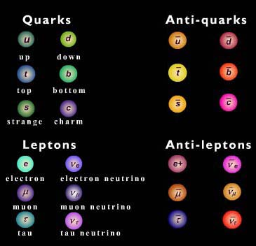
Anti-particles
The theoretical physicist Paul Dirac
proposed the existence of antimatter
in 1928 based on an interpretation of
his relativistic quantum theory of the
electron. The anti-electron (now
called the positron) was subsequently
discovered in an experiment by
Carl Anderson in 1932.
An anti-particle has the same mass as a
particle but has the opposite electric charge.
An anti-particle that collides with a particle
can annihilate it, resulting in pure radiation.

Slide 8
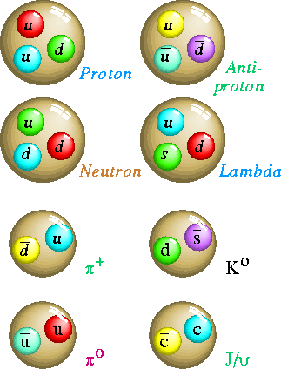
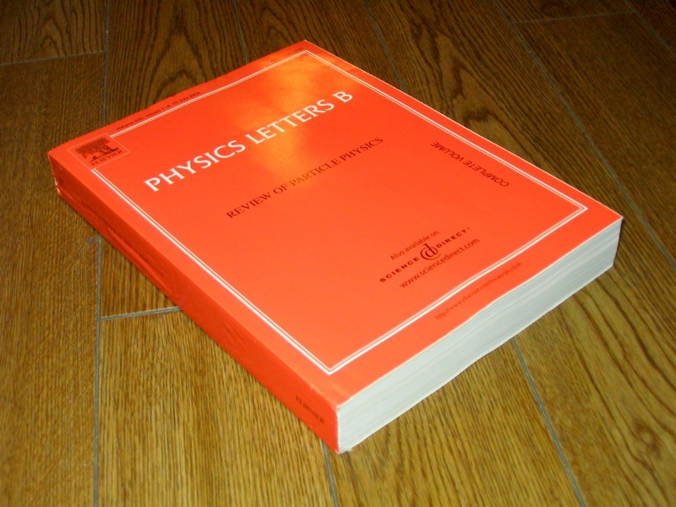
A zoo of new sub-atomic particles
A very thick book (updated every other year) is needed to describe the properties of all the observed sub-atomic particles.

Slide 9
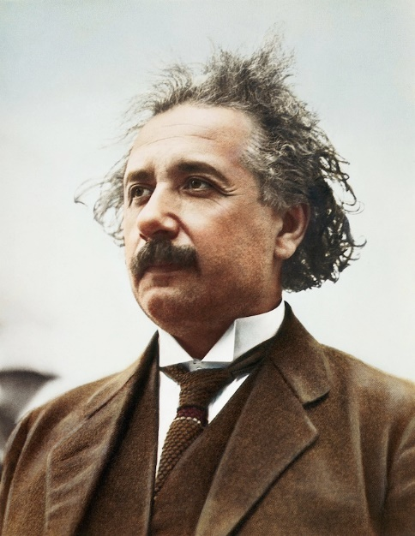
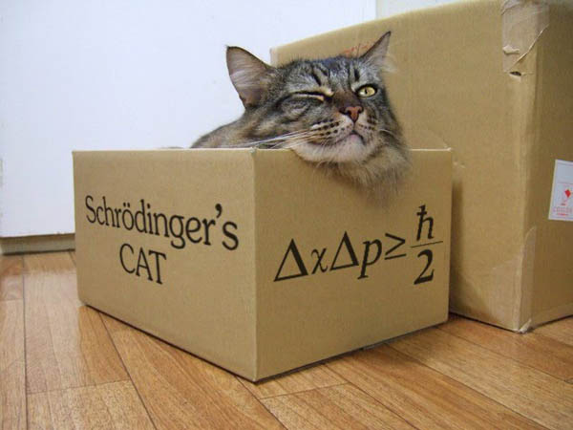
Revolutionary ideas of 20th century physics
Relativity (Einstein)
The speed of light is the ultimate speed limit.
E=mc² (that is, energy can be converted into matter and vice versa).
Quantum theory (Heisenberg, Schrodinger, …)
Electromagnetic waves come in a smallest unit
(“the quantum”) with particle properties.
A particle can be interpreted as the smallest unit of a wave,
and thus can exhibit wave-like properties.
Heisenberg’s Uncertainty principle allows for quantum “fluctuations”.
To probe shorter distance scales in the sub-atomic world requires probes
of higher energy. Hence the need for more powerful colliders.

Slide 10
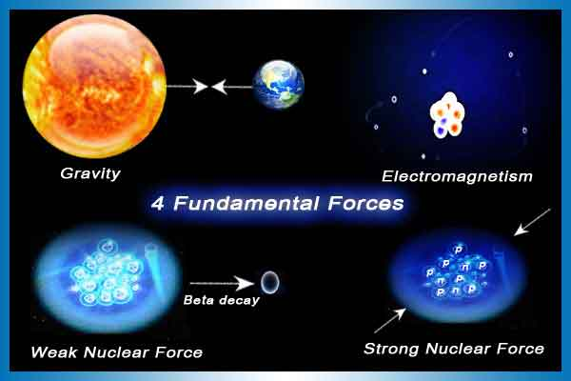
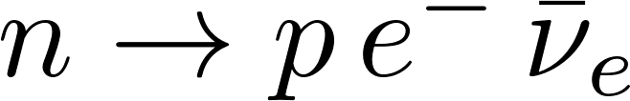
The fundamental forces of nature
Isaac Newton
introduced the
theory of gravity
in 1687, which was refined by
Einstein in 1915.
Electric and magnetic
forces were unified by
electromagnetic theory
of James Clerk Maxwell
in 1865.
Governs nuclear
fusion (origin of
solar energy) and
certain radioactive
decays (e.g.,
).
Responsible for holding
the atomic nucleus
together.
A puzzle in beta decay led Wolfgang Pauli in 1930 to invent a new particle—the neutrino,
a particle that interacted so weakly that it took 26 years to discover it in the laboratory.

Slide 11
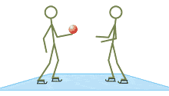



How are fundamental forces transmitted?
Forces cannot be transmitted instantaneously (Einstein’s relativity).
Quantum mechanics and relativity provide a consistent framework for the mechanism of transmission of forces (through “virtual particle exchange”).
The ice skaters metaphor
Electromagnetic repulsion of two
electrons (via exchange of a photon)
Each of the four fundamental forces are mediated by particles
(quanta of radiation).

Slide 12
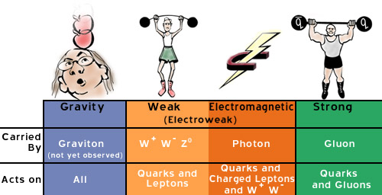
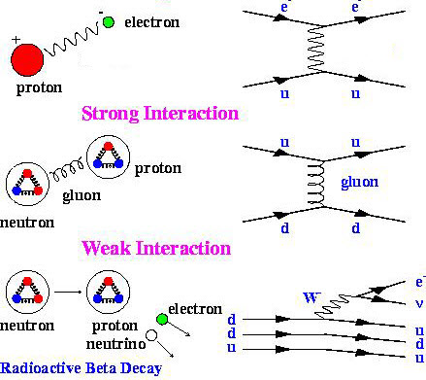
The fundamental forces in action
(represented in Feynman diagrams)
Electromagnetic Interaction
photon
photon
The gravitational force between two quarks inside
the proton is utterly negligible (roughly 10 ⁻ ⁴¹
relative to the electromagnetic force).
Thus, we focus only on the other three forces, which
have significant effects on sub-atomic phenomena.

Slide 13
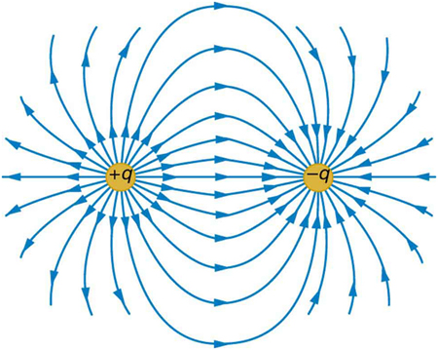
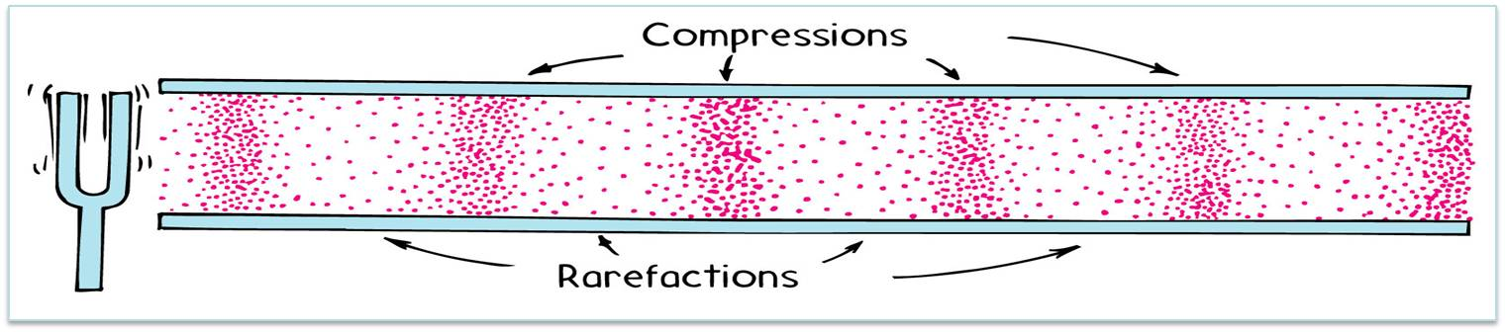
An aside: fields and waves
A field is a quantity that varies over space and time.
Example: the electric force field due to a pair of
charges (of opposite sign). The arrow indicates
the force experienced at a given point in space
by a positive test charge.
A disturbance can propagate from one point to another. For example, consider a field that consists of the air density at any point in space. A sound wave corresponds to a periodic variation of the density field along the direction of propagation.

Slide 14
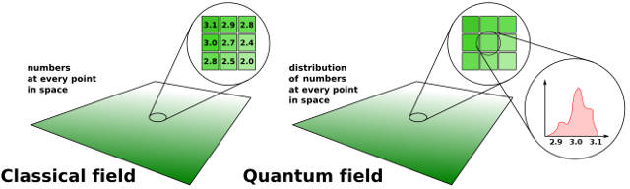
Quantum fields and waves/particles
The unification of quantum mechanics and Einstein relativity led to the development of quantum field theory, which describes the behavior of the fundamental fields and forces (excluding gravity).
For each fundamental particle, there is an associated quantum field. Disturbing that quantum field creates a wave. The minimal disturbance (one “quantum”) has particle-like properties.

Slide 15
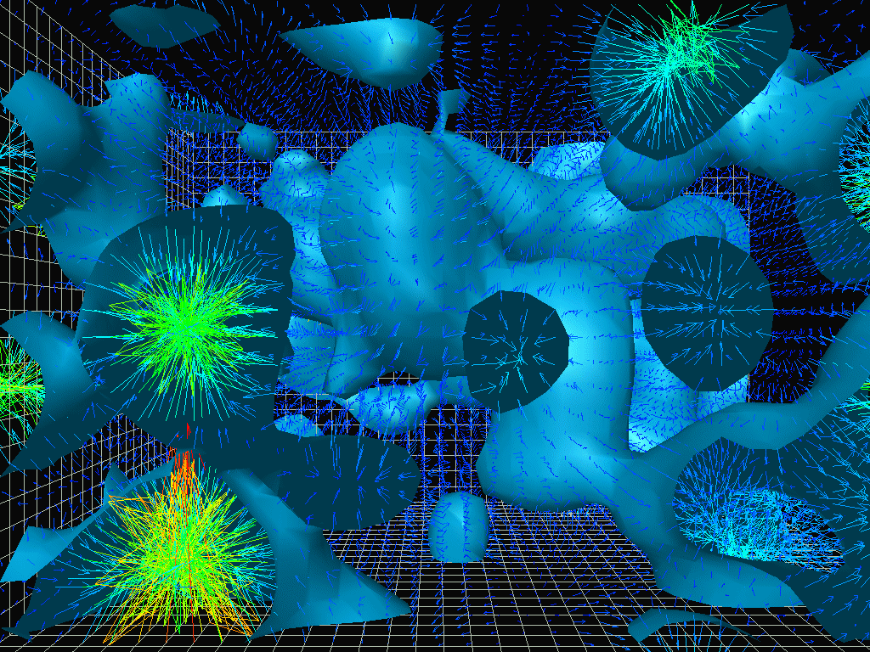

The quantum vacuum
In classical physics, the vacuum is
the lowest energy state
possible—complete emptiness.
In quantum physics, random
quantum field oscillations fluctuate
in and out of existence within
the lowest energy state of the
quantum vacuum.
Pumping energy into the quantum
vacuum can excite the quantum
fields of the vacuum thereby
creating particles.
Field values can be positive or negative—on average they cancel out.

Slide 16
What are the characteristics of a fundamental particle?
Point-like (no discernable size)
Mass
Spin
Charge (electric, weak, strong)
The Earth spins (i.e. rotates about its own axis once every 24 hours). But how does a point-like object spin? This is purely a quantum mechanical effect (and should not be viewed as a physical spinning process). The spin is an intrinsic property of the particle
(like mass and charge). Quantum mechanics dictates that the only allowed values of the spin (in appropriate units) are n/2, where n=0,1,2,3,4,…. Particles with even n and odd n behave quite differently in quantum mechanics, and thus are given special names.
Fermions (n odd): examples—the quarks and leptons have spin ½.
Bosons (n even): examples—the photon, gluon, W⁺, W⁻ and Z all have
spin 1; the graviton has spin 2.

Slide 17
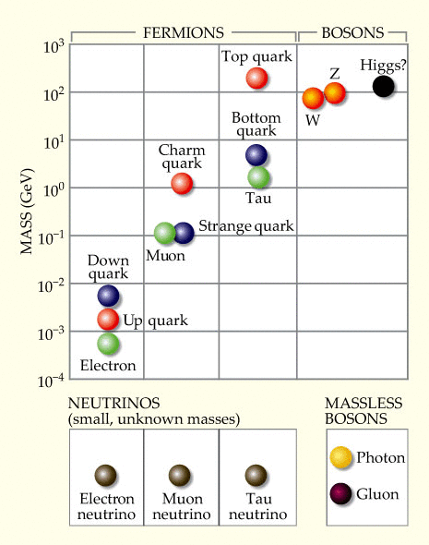
The mass puzzle
What is the origin of the masses of the fundamental
particles?
The Standard Model of Particle Physics based on the
principles of relativity and quantum mechanics has
been remarkably successful in describing sub-atomic
phenomena.
Nevertheless, a naïve implementation of this theory
seemed to imply that all the fundamental particles
should be massless. In contrast, the W⁺, W⁻ and Z
bosons, which mediate the weak interactions, are
roughly 100 times heavier than a proton.

Slide 18


The beauty of symmetry

Slide 19
The role of symmetry in physics
In physics, symmetry plays a very important role. For example, the fact
that the laws of physics do not depend on location or orientation
(“translational and rotational invariance”) places strong constraints
on the form of the equations that describe those physical laws.
A more abstract symmetry principle underlies the laws of electromagnetism.
This symmetry principle guarantee that the photon is massless. A similar
application of this symmetry principle would predict that the W⁺, W⁻ and Z bosons that mediate the weak force should also be massless.
However, if you naively try to “break the symmetry” to allow for massive
W⁺, W⁻ and Z bosons, the resulting theory is mathematically inconsistent.

Slide 20
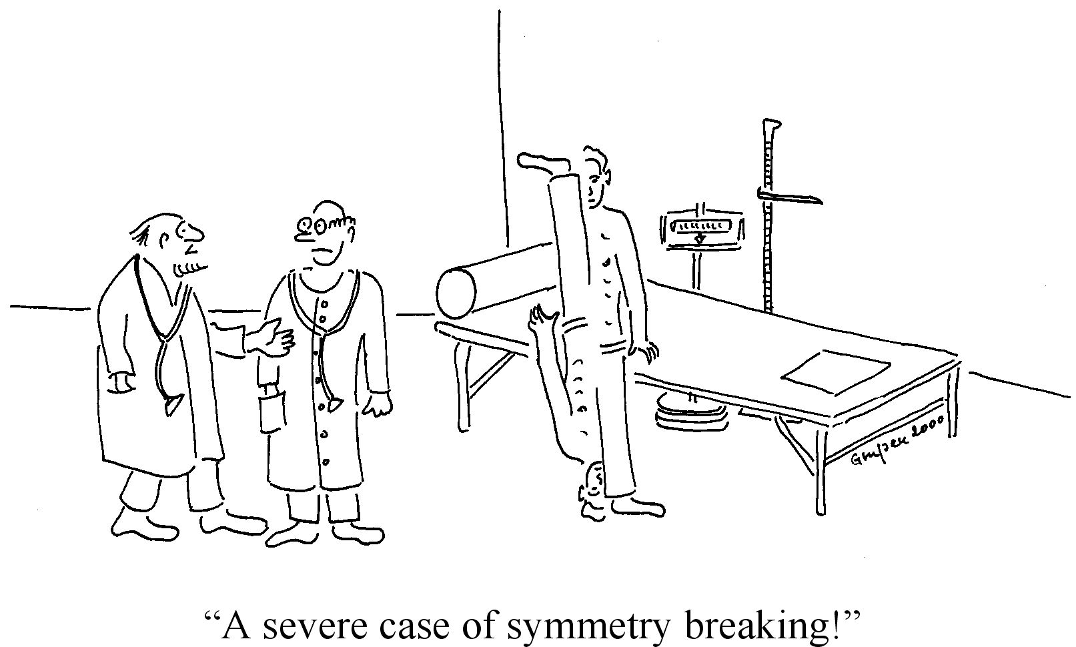

Slide 21
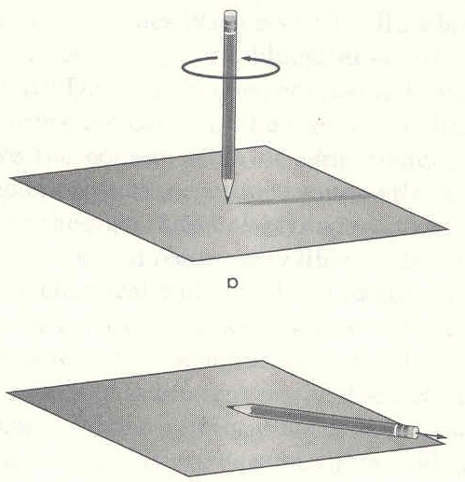
Symmetry-breaking without breaking the symmetry
The rotational symmetry of the pencil around its axis implies that the pencil is equally likely to fall in any direction.
However, perform the experiment once, and the pencil must fall in some direction.
The resulting state of the pencil breaks the rotational symmetry, although the rotational symmetry of the laws that govern the falling pencil remain intact.

Slide 22
The remarkable Higgs mechanism
Key ingredients by Yoichiro Nambu and Philip Anderson.
Adapted to relativistic quantum field theory in 1964 by Robert Brout
and Francois Englert and independently by Peter Higgs. Important
clarifications by Gerald Guralnik, Carl Hagen and Tom Kibble followed.
The history is wonderfully told by Frank Close in The Infinity Puzzle.
The essential idea: Postulate the existence of a spinless quantum field, now called the Higgs field, which (in average) is non-zero in the quantum vacuum. In contrast, other quantum fields (which have nonzero spin) that fluctuate in the quantum vacuum still must average out to zero.
The physical laws which govern the Higgs field respect the symmetry that
require massless W⁺, W⁻ and Z bosons. However, like the fallen pencil, the vacuum state of the Higgs field breaks the symmetry. Since the W⁺, W⁻ and Z reside in the symmetry-broken Higgs vacuum, their masses need not be zero.

Slide 23
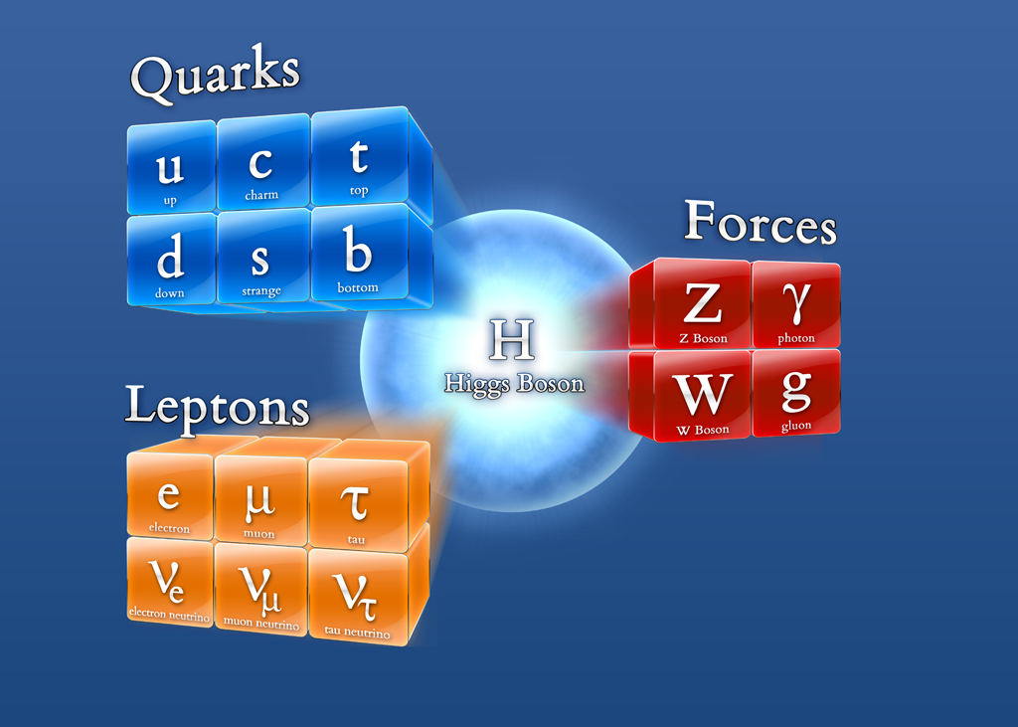
The Standard Model of Particle Physics
The Higgs mechanism provides the only
known mathematically consistent
formulation of the theory of fundamental
particles that accounts for their masses.
The simplest implementation of the Higgs
mechanism (due to Steve Weinberg in 1967
1967 and Abdus Salam in 1968) incorporates
a new spin-0 (scalar) particle called the
Higgs boson.
The Higgs boson is a result of disturbing the Higgs field. The theoretical existence of such
a particle (in the context of the Higgs mechanism) was first proposed by Peter Higgs in 1964.

Slide 24
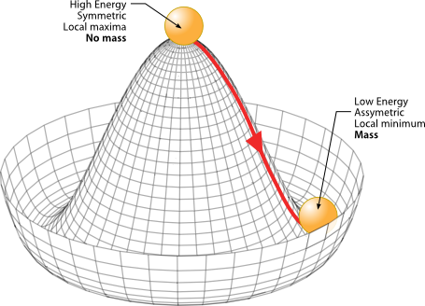
Generating mass for the fundamental particles
In the Standard Model, the abstract symmetry that governs the weak and electromagnetic interactions (called the electroweak symmetry) governs
the dynamics of the quarks, leptons and Higgs fields.
The symmetric point of the Higgs field is
at a Higgs field configuration of higher
energy than the vacuum state. Thus, in
the vacuum, the Higgs field breaks the
electroweak symmetry.
As a result, all Standard Model particles
propagating through the vacuum that
interact with the omnipresent Higgs field
acquire their observed masses.

Slide 25

A video made by Phil Owen (not to be taken literally, but the graphics are cool!)

Slide 26

Warning: Most of your mass does not come from the Higgs mechanism. Your
mass arises from the protons and neutrons contained in the atoms of your body.
Most of this mass arises from the “binding energy” involved in constructing the
proton and neutrons from their constituent quarks (and gluons).

Slide 27
The hunt for the Higgs boson begins
By the end of the 1970s, the Standard Model was firmly established as the theory
of the strong and electroweak interactions. Further experimental confirmation
followed with the discovery of the W⁺, W⁻ and Z in 1983 and the top quark in 1995.
All that was missing was the Higgs boson.
The Standard Model predicts all the properties of the Higgs boson except for its
mass, which is a free parameter. Thus, one had to devise experimental searches
that would apply for all possible masses accessible to your collider.
If the Higgs boson did not turn up in your experiment, then perhaps your collider
was not energetic enough to produce it (remember E=mc²). Time to design
a higher energy collider and continue the search.

Slide 28
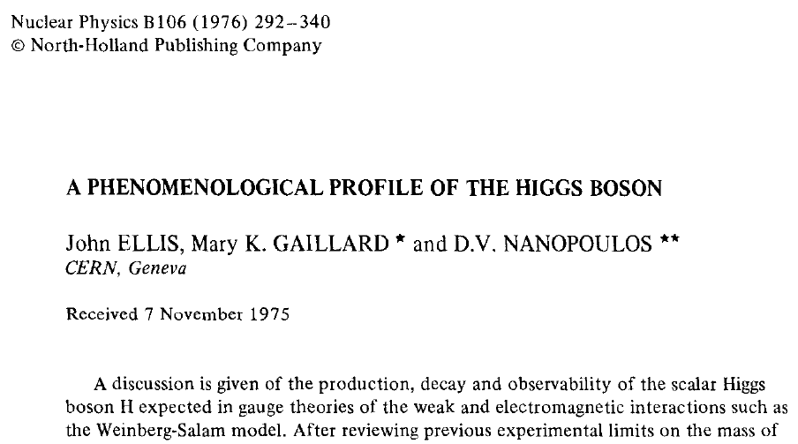
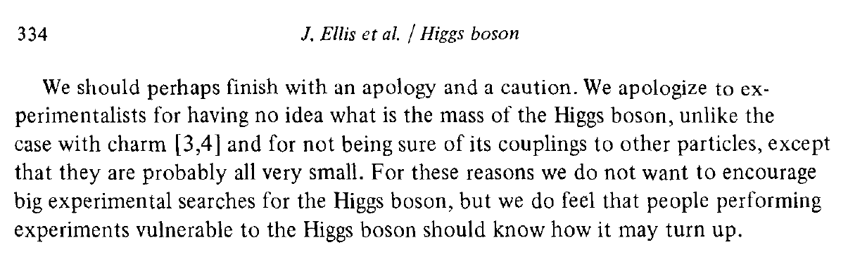
1976: The first comprehensive
study of how to search for the
Higgs boson

Slide 29
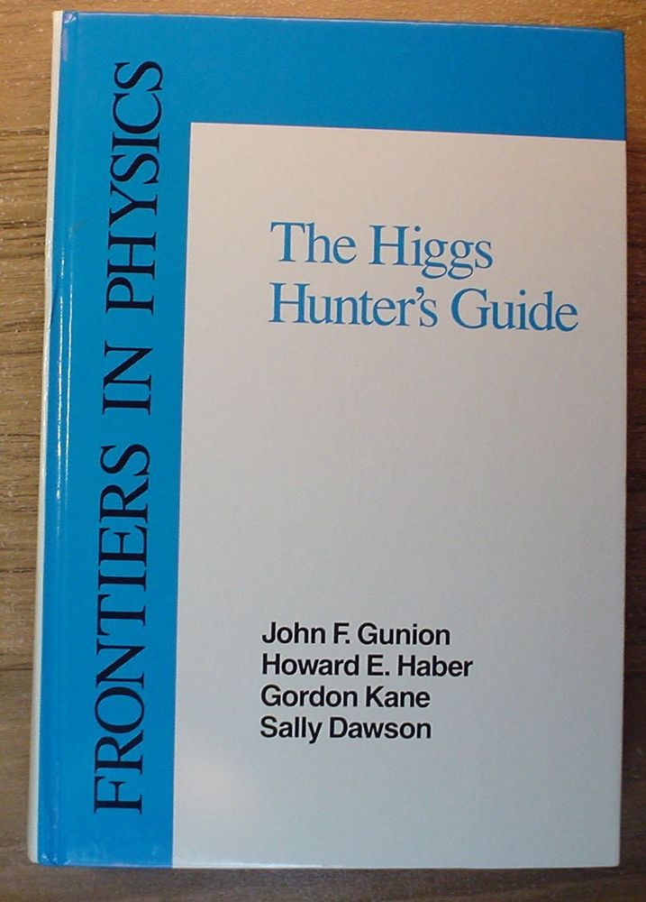
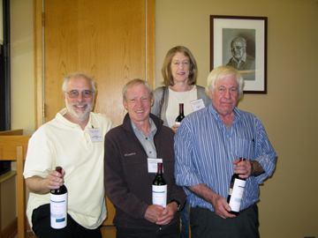
In 1990, the Higgs Hunter’s Guide was published. It
served as the definitive reference, guiding both theorists and experimentalists as the Higgs boson search was extended to more powerful colliders.
At the Symposium on Higgs Boson Physics in Ann Arbor, MI (May, 2010)

Slide 30
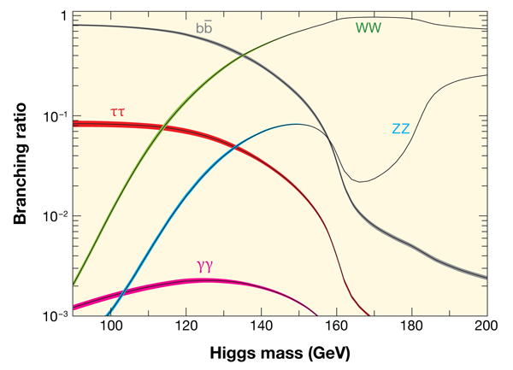
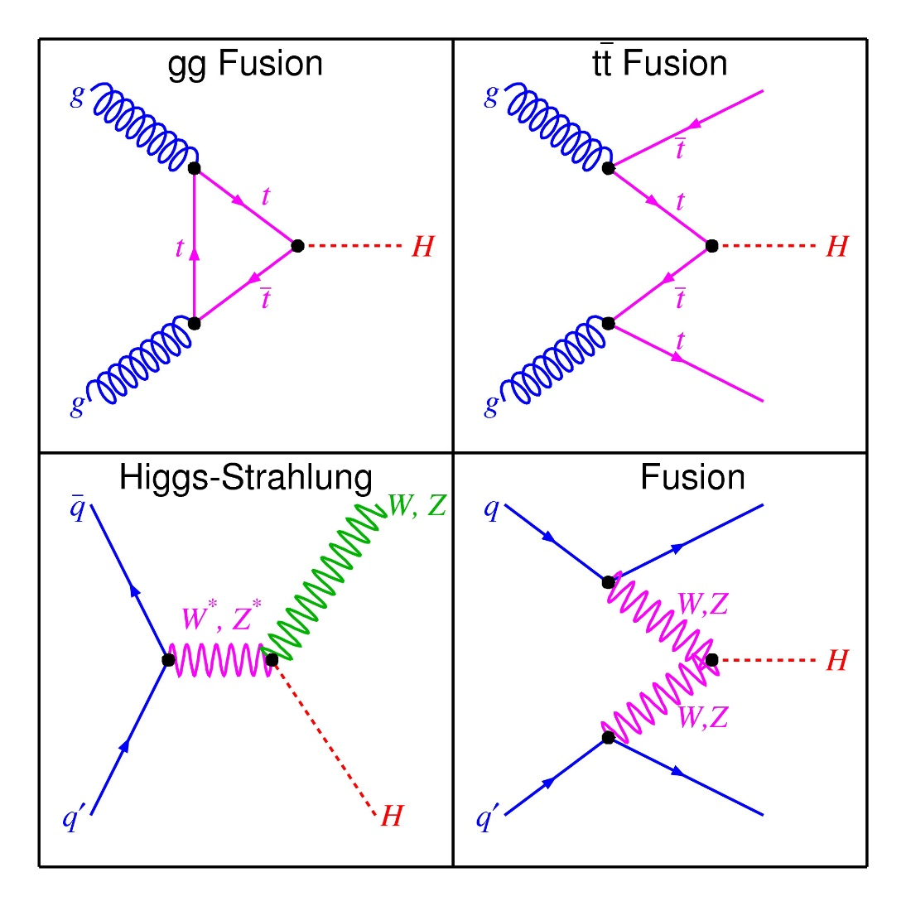
When two protons collide at the Large Hadron Collider, the violent collision of the quark (q) and/or gluon (g) constituents of the two protons can sometimes generate enough energy to create a Higgs boson (H), along with other particles.
Probability for a Higgs boson decay into
various final states as a function of its mass
WW, ZZ

Slide 31
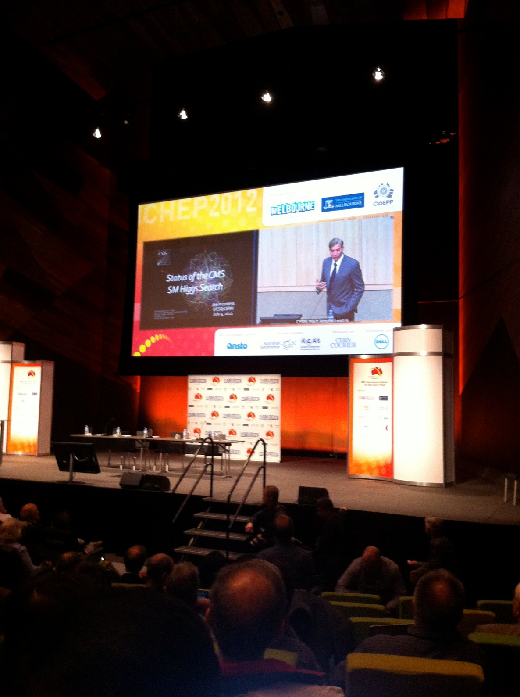
The Discovery of the Higgs boson is announced on July 4, 2012
The CERN update of the
search for the Higgs boson,
simulcast at ICHEP-2012
in Melbourne, Australia

Slide 32
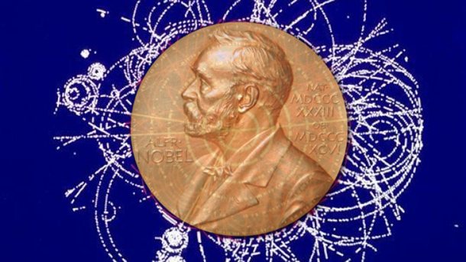
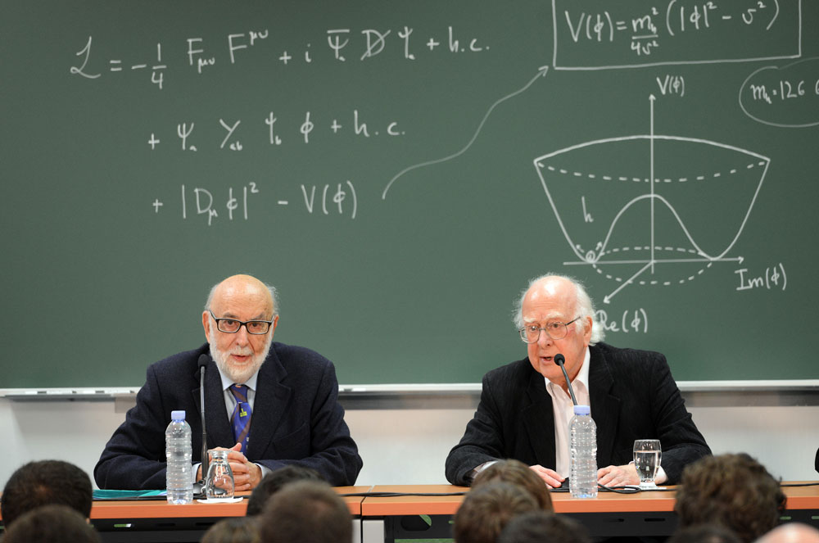
Winners of the 2013 Nobel Prize in Physics
François Englert
and
Peter Higgs

Slide 33
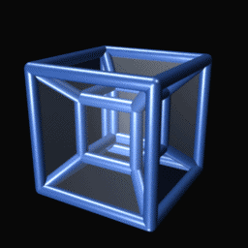
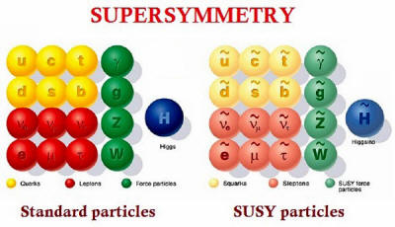
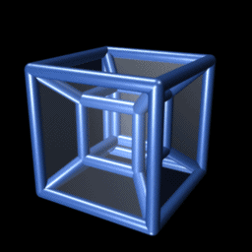
End of an era or a new beginning?
The discovery of the Higgs boson is remarkable in another sense. Just like the
photon and its friends, the Higgs boson mediates a fundamental force. That is,
a new (fifth) fundamental force of nature has been discovered!!
The discovery of the Higgs boson finally completes the Standard Model of particle
physics. Or does it??
The Higgs boson mass is not really a consequence of the Higgs mechanism.
So how does one account for the origin of the Higgs boson mass? This turns
out to be a profound question, whose answer may require new
exotic phenomena (supersymmetry?
extra dimensions?), which if we are
lucky could turn up at the Large
Hadron Collider.

Slide 34

Before handing the baton
over to Abe Seiden, I have to admit that there is an elephant in the room. I have been trying to avoid it, but someone is bound to ask…

Slide 35


Slide 36
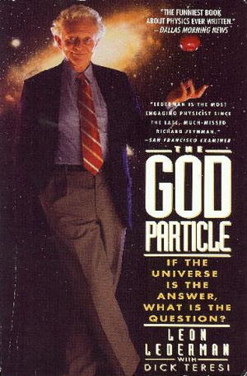
This goes way beyond Angels and Demons. This phrase caught the fancy of the popular press. We have Leon Lederman’s editor to thank
(he thought it would sell more books).
Leon Lederman shared the 1988 Nobel prize for Physics
for the discovery of the mu-neutrino. He also led the
experimental team that discovered the b quark and
served for many years as the director of Fermilab.
He published The God Particle in 1993.

Slide 37

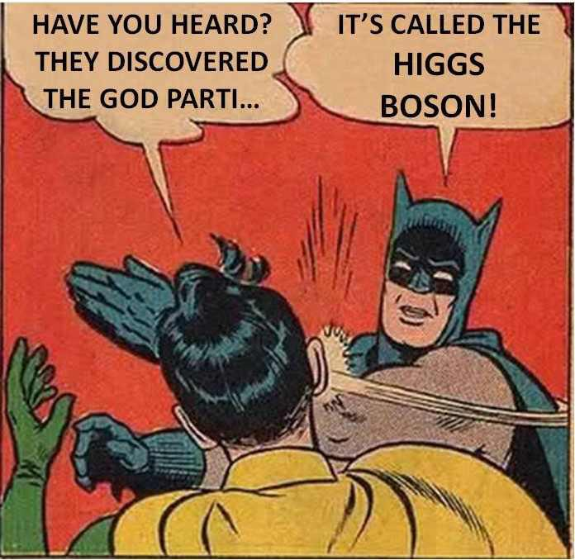
Standard reactions of physicists when the God particle is mentioned

Slide 38
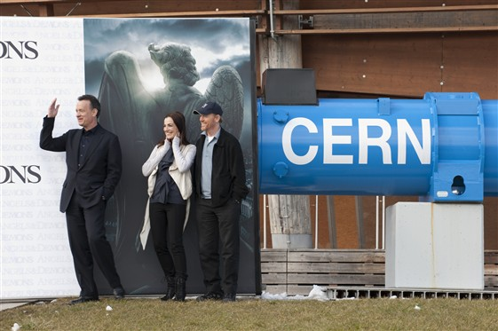
Angels and Demons at CERN. But will there be a Higgs boson?
Part II: Hunting the Higgs Boson!

Slide 39
Importance of Particle Masses
Particle masses and interaction strengths determine much of the behavior of our world. For example the mass of the electron and the value of its electric charge determine the size of atoms and binding energies in atoms and molecules. The small difference in mass between the neutron and proton, combined with the very heavy mass of the particles responsible for the weak nuclear force, control many aspects of how the sun works, allowing it to shine very slowly, so that it shines for billions of years.
But how does the mass come about? The idea, presented in a series of papers in 1964, is that the fundamental particle masses are due to an interaction with a field (now called the Higgs field) that fills all of space.

Slide 40
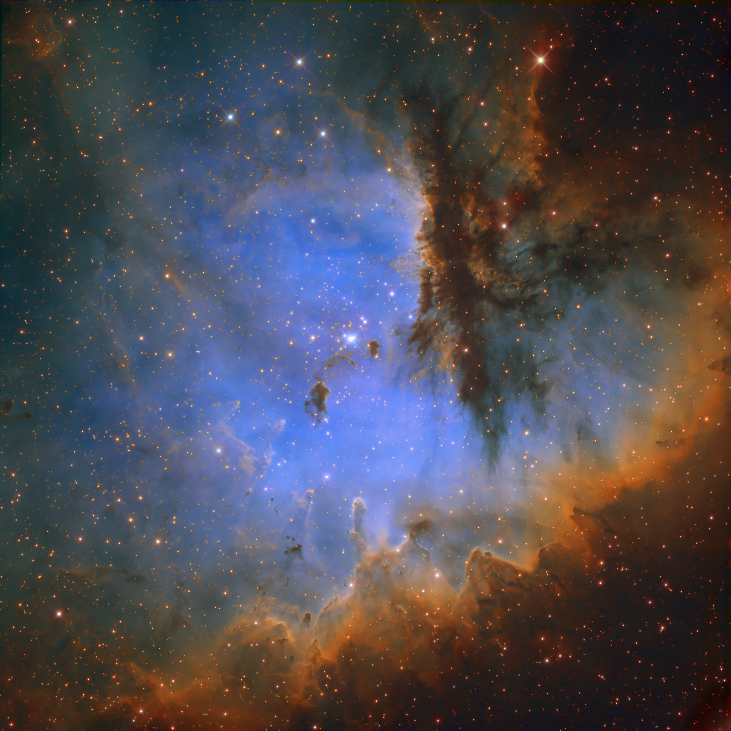
Everywhere we look, using light from objects in the cosmos, we see that particles have the same mass and that their interactions in stars seem to be identical. So we can’t see the Higgs field directly since it doesn’t vary in space and time, it is what we think of as the vacuum.

Slide 41
So Can We Ever Tell if this Idea is Correct?
Since the vacuum is everywhere the same, can we ever tell for sure that the Higgs idea is correct? The answer is yes. It can be verified by excitation of the field, which is manifest as a particle called the Higgs boson – that is actually what we look for. It turns out that the mass of the Higgs boson is not given by the theory, but once its mass is specified all of its other properties are determined. For example its interaction with other particles is determined by the mass of the other particles. This is due to its relation to the Higgs field and the generation of mass. It is unstable and how often it decays to other particles is also specified. So we can plan experiments to look for the particle since its properties are very well specified.

Slide 42
Progress Over Time
However, these experiments turn out to be very difficult. In 1964, when the Higgs boson idea was presented, we had neither the accelerator nor the particle detector and data collection capability up to the task of finding it. The building of a suitable accelerator became possible with the development of powerful superconducting magnets. The accelerator would be large but still within the realm of possibility. The collection of vast amounts of data, as needed to find a small number of Higgs boson events produced in beam collisions, became possible with the enormous advances in computing and data storage coming from industry.

Slide 43
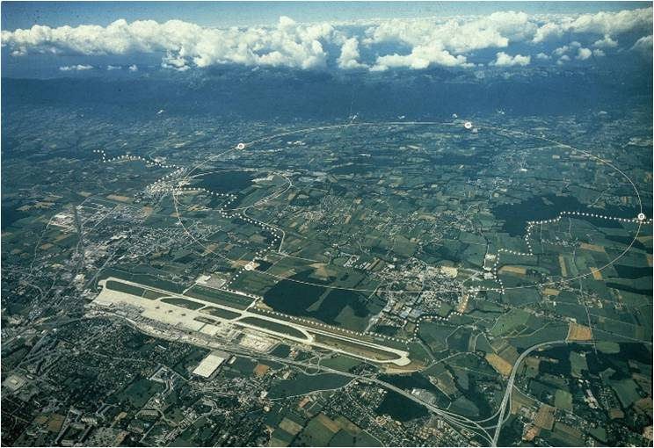
The Accelerator at CERN, 27 km in Circumference: The LHC (proton-proton collider) near Geneva, Switzerland

Slide 44
We Still Need a Particle Detector!
The challenge of building a suitable particle detector remained and a small group of us at UCSC decided to take up this challenge in 1986. The work built on several years of building major detectors for particle physics experiments by the Santa Cruz group, but significant advances were required.
In particular, a suitable sensor was required that could determine the passage of individual particles produced in a collision. Each collision would create very many particles and we wanted to find each one. We had to also show that the sensor could survive the intense radiation from the particles produced by the colliding beams, and we had to develop the electronics to read out signals generated by the passing particles. At the accelerator, collisions would occur every 25 nanoseconds, so the electronics was a large challenge. We also had to prove to the community by simulations that an array of such sensors could in fact provide an excellent and efficient detector of particles.

Slide 45
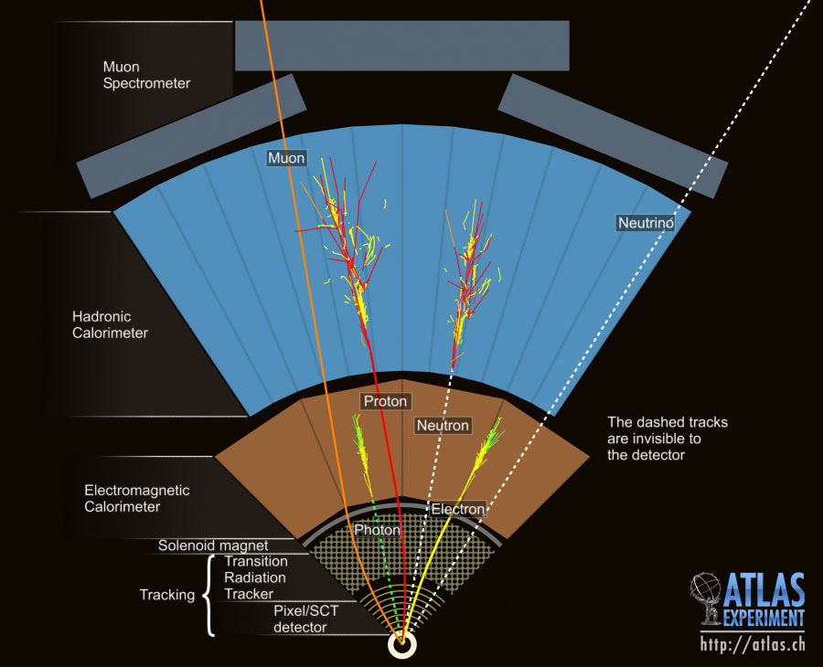
A Detector Organized as “Concentric Shells”,
Each Shell with a Specific Detection Task.

Slide 46
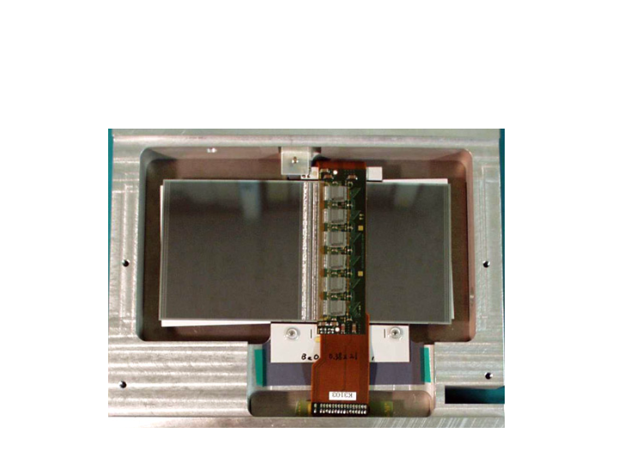
Module Made of Silicon Wafers, Electronics Directly On Top. Each Wafer is Actually 768 Individual Sensors.
12 cm

Slide 47
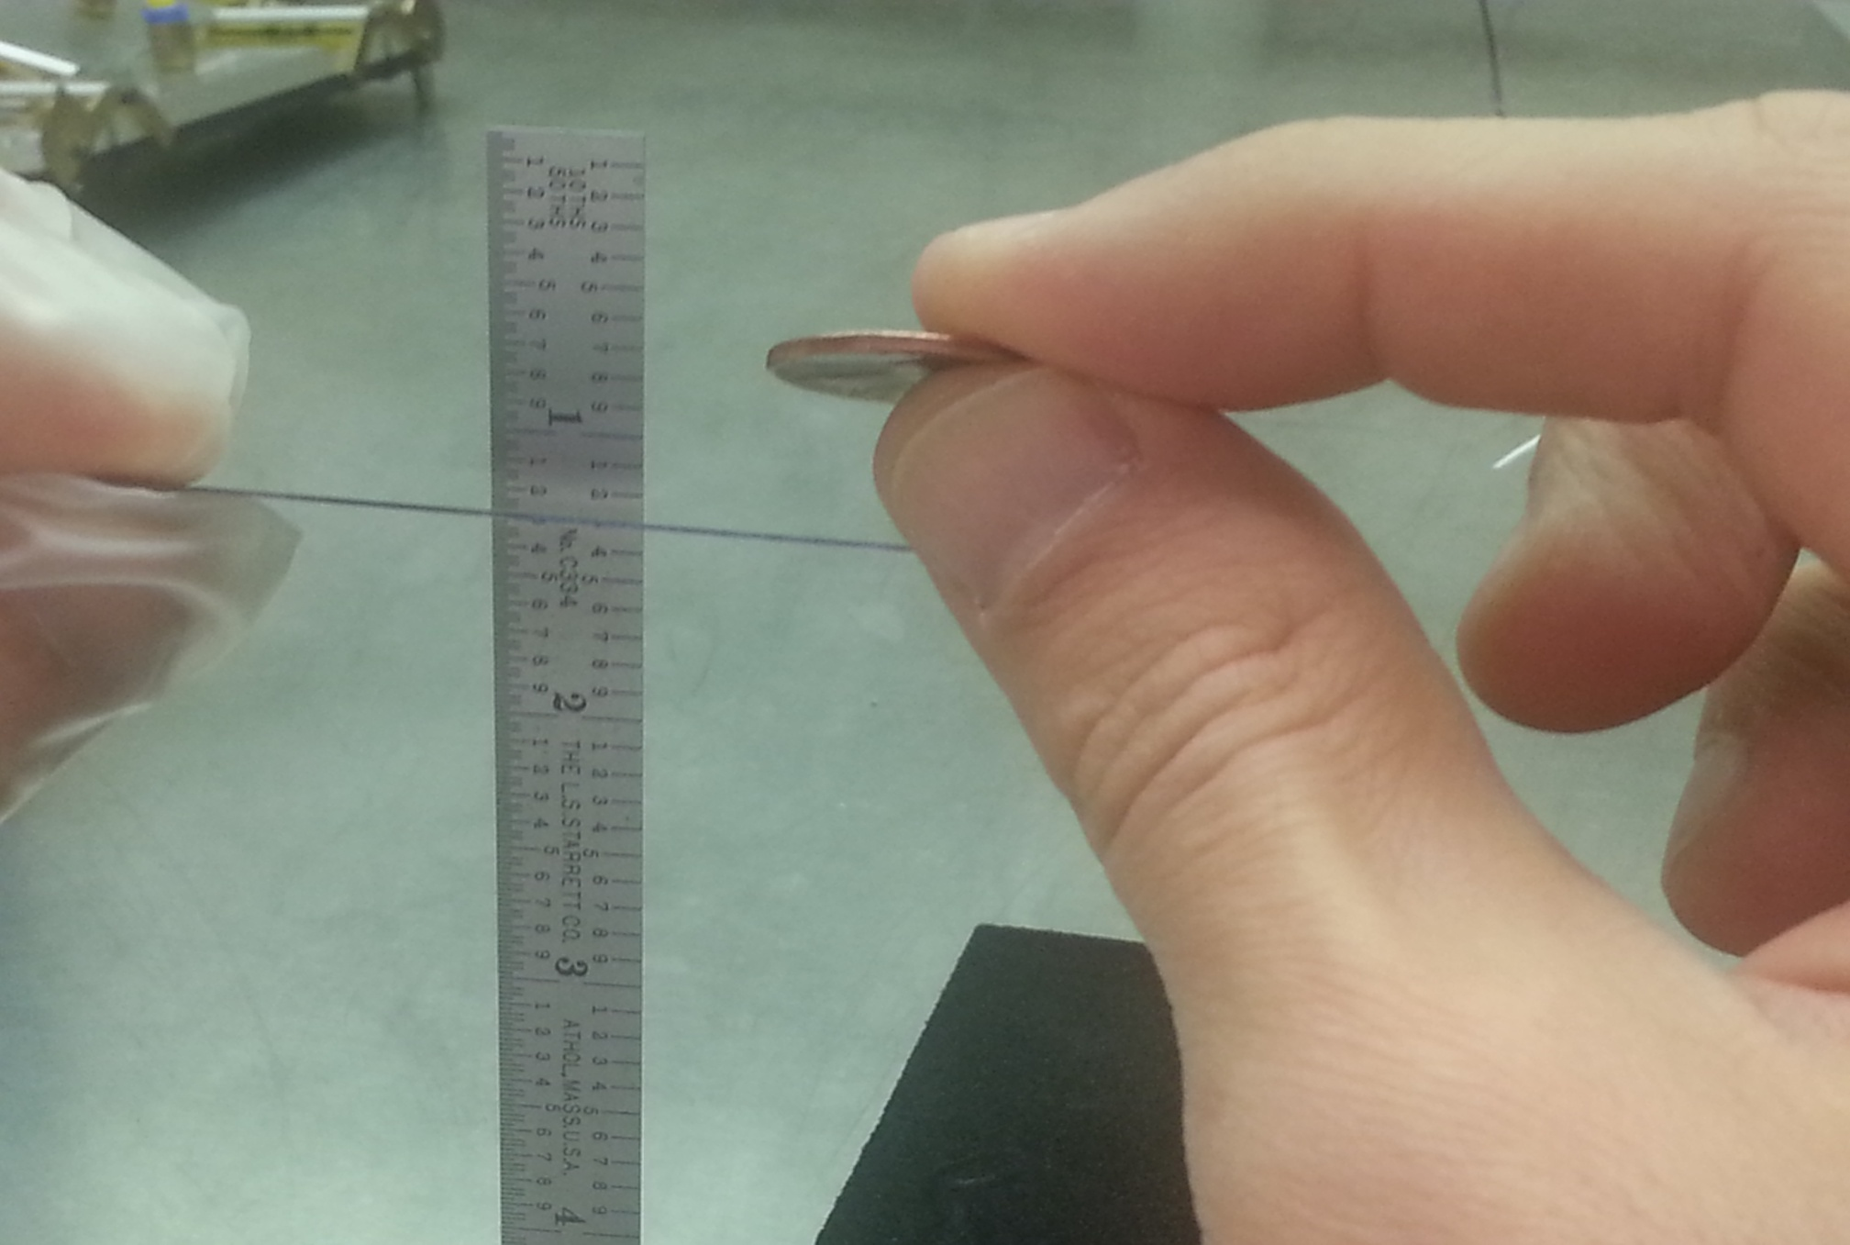
Wafer is Thin Enough to Minimally Disrupt Particles
Passing Through

Slide 48
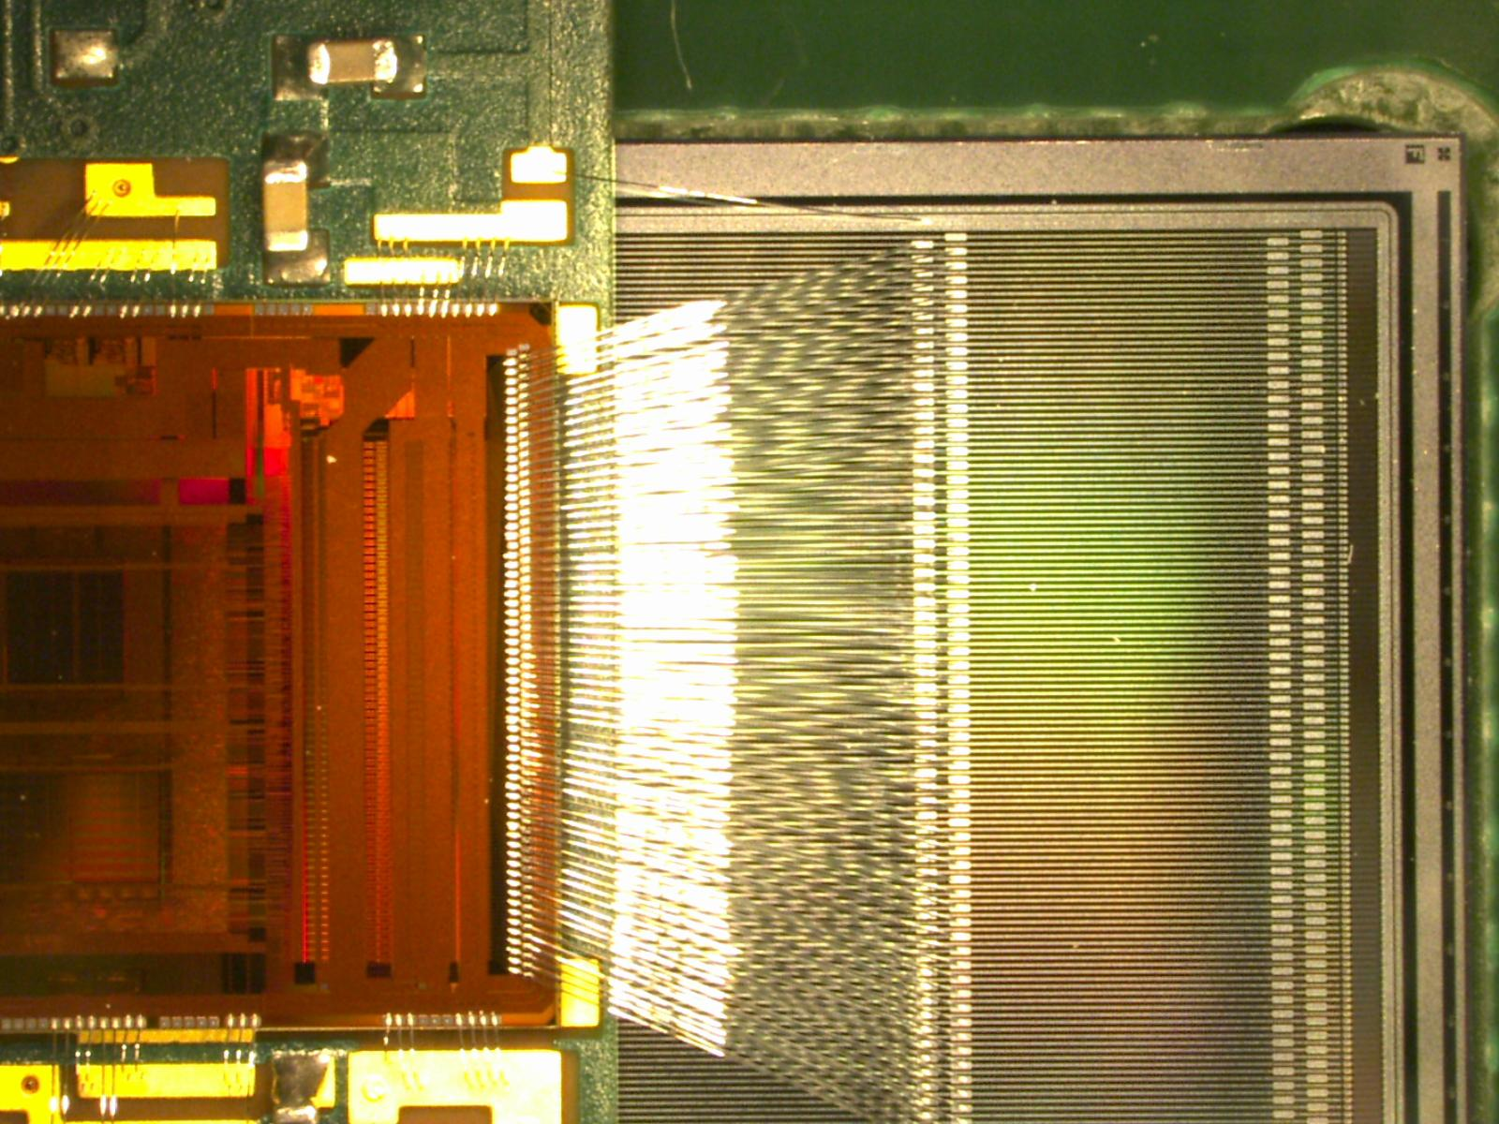
Blow-up of Region of a Silicon Wafer. Spacing
of Sensor Lines about ¼ of Sensor Thickness

Slide 49
Using Our Ideas in a Real Experiment
In 1994 we joined the ATLAS experiment to be built at the CERN accelerator center in Geneva, Switzerland.
An array of silicon sensors would lie at the center of a very large detector (called ATLAS), which would have all of the detection devices needed to figure out what were the underlying particles produced in a given collision. The experiment would have to be very large and an international effort was required to achieve the financial and human resources required to realize the experiment. The accelerator was provided by the CERN laboratory but the experiment would have to be provided by the scientists who wanted to search for the Higgs boson.

Slide 50

ATLAS is a Very Large International Undertaking

Slide 51
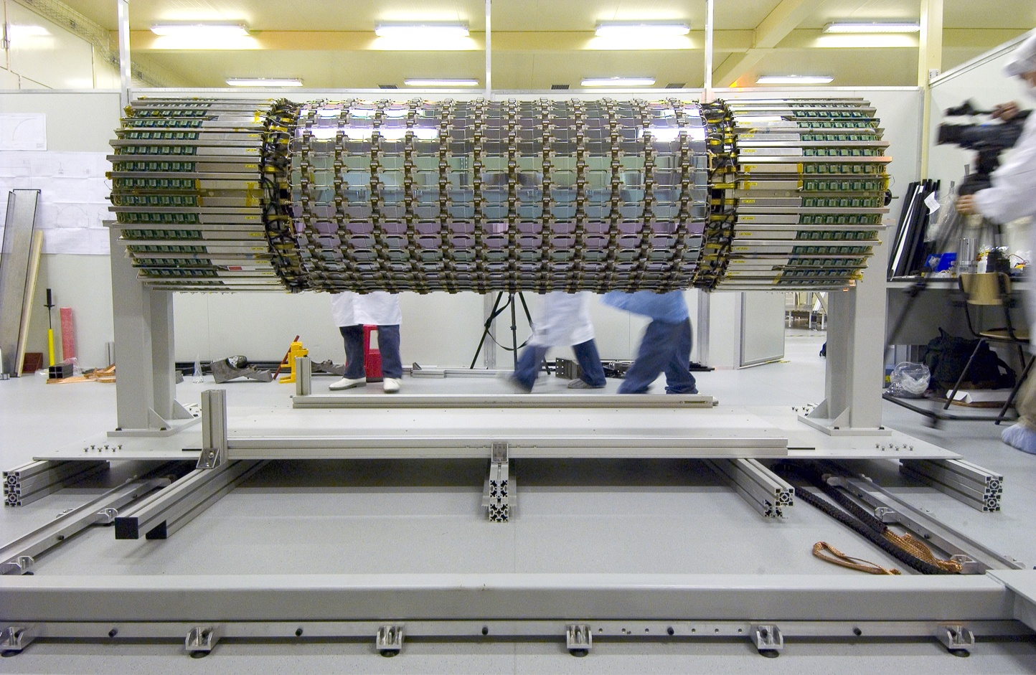
One of Four Barrel Detectors Made of Silicon Strip Sensors

Slide 52
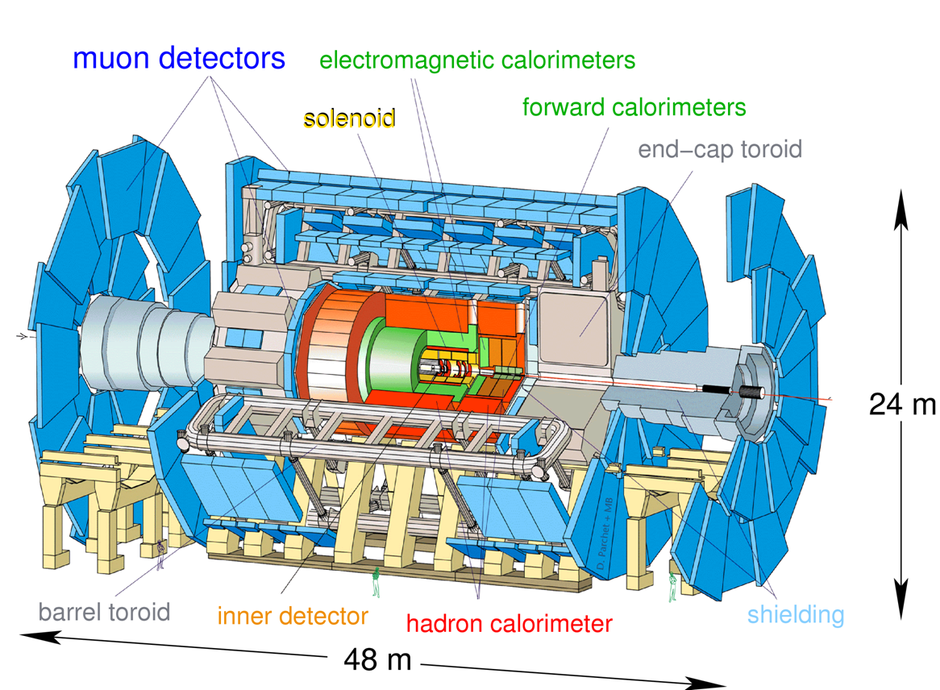
ATLAS Experiment

Slide 53
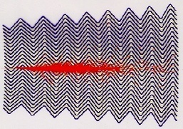
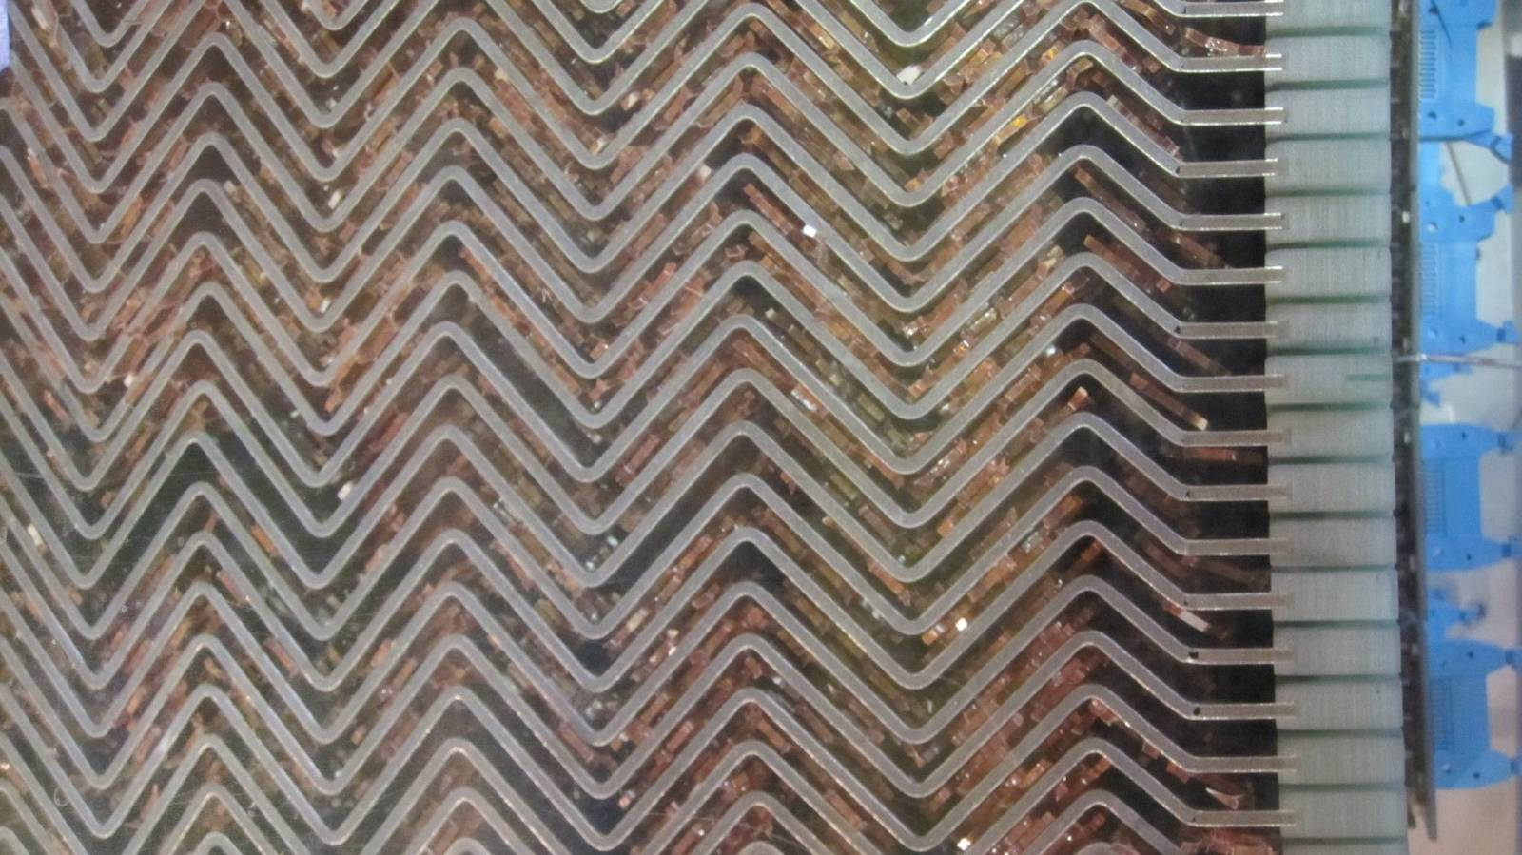

ATLAS Electromagnetic Calorimeter
Calorimeter concept: shower of particles created by lead; ionization in liquid argon between the lead radiators is collected by electrodes. This is the signal used to measure the shower energy.
Lead Radiator Material
Electrodes for Collection of Ionization

Slide 54

Muon Toroids, While ATLAS is Being Assembled

Slide 55

ATLAS Detector Deep Underground

Slide 56

Second Detector Called CMS
Almost all the detection elements for CMS are different from those in ATLAS except for a silicon detector at the center of the experiment.

Slide 58

Novel Lead Tungstate Scintillating Crystals for Electromagnetic Calorimeter: Very dense, about 25cm long, very fast signals. About 76,000 crystals in the CMS detector.

Slide 59
The Detectors are Very Large Devices Filled
With Electronics
Object Approx. Weight (Tons)
Boeing 747 (fully loaded) 500
Space Shuttle (fully loaded) 2,200
ATLAS Detector 7,000
Eiffel Tower (metal only) 7,300
USS John McCain (navy destroyer) 8,300
CMS Detector 14,500

Slide 60
Take Data!
A very large amount of effort was required to build ATLAS: about 10 years of work for construction, involving thousands of people. After calibrating the very complicated detectors and learning how to collect and analyze the data, we were ready to receive the large amounts of data delivered in the second half of 2011 and in 2012. From a very large collection of events, special events of interest are selected for examination based on the particles detected. Plots are then made to see if we have evidence of a new particle in any of the final states of interest. Generally, final states have contributions from processes other than a Higgs boson but these produce smooth distributions in mass. We look for events clustered at a fixed mass indicating contributions from one particle at that mass.

Slide 61


Slide 62


Slide 63




Slide 64


Slide 65
Confirmation!

Slide 66

Search for Higgs Boson Signal Over Broad Mass Range

Slide 67
It is a new type of particle, but is it a Higgs Boson?

Slide 68
What is Next for the Higgs
The accelerator energy is being nearly doubled to increase the rate of Higgs production and also to extend the mass range over which we can search for surprise phenomena. Will startup in about a year.
An additional silicon layer is being added inside all the others and very close to the colliding beams to improve the measurement of charged particle trajectories. It will be installed in a few months.
The accelerator has a program of increasing the number of interactions per second over time. We have to improve the experiment to keep up with the accelerator. We are working on this!
Plan to collect about 500 times the number of Higgs boson decay events to very carefully check the theory!

Slide 69

If you want to know more about the Higgs boson and related subjects, be sure to check out the exciting new documentary film, Particle Fever, coming in mid-March to one of the Nickelodeon Theatres in Santa Cruz for a limited one-week run.
http://particlefever.com

