Slide 1
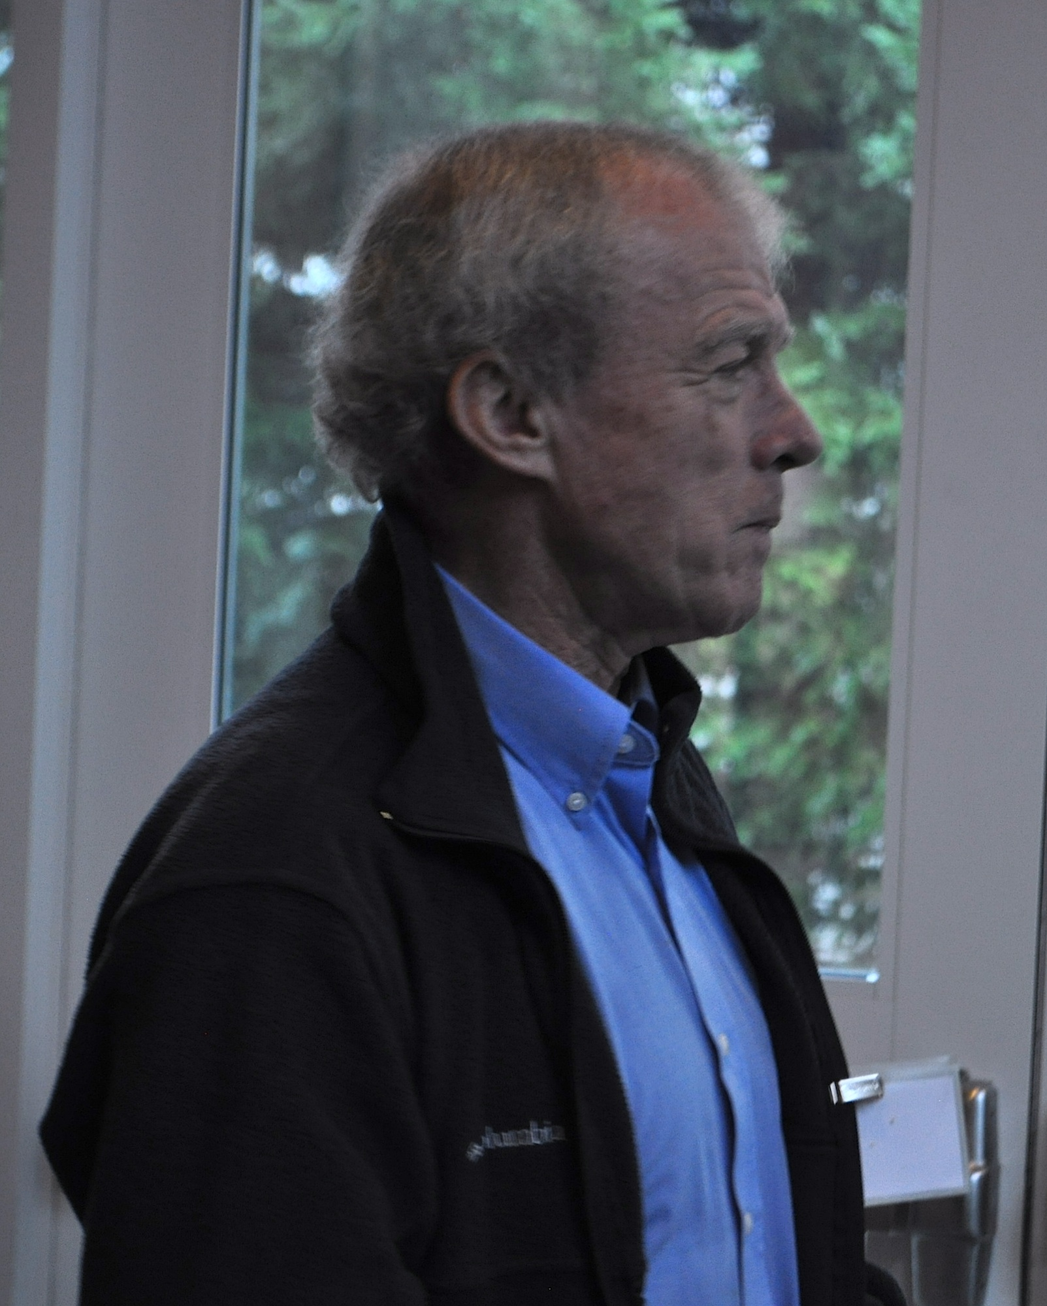
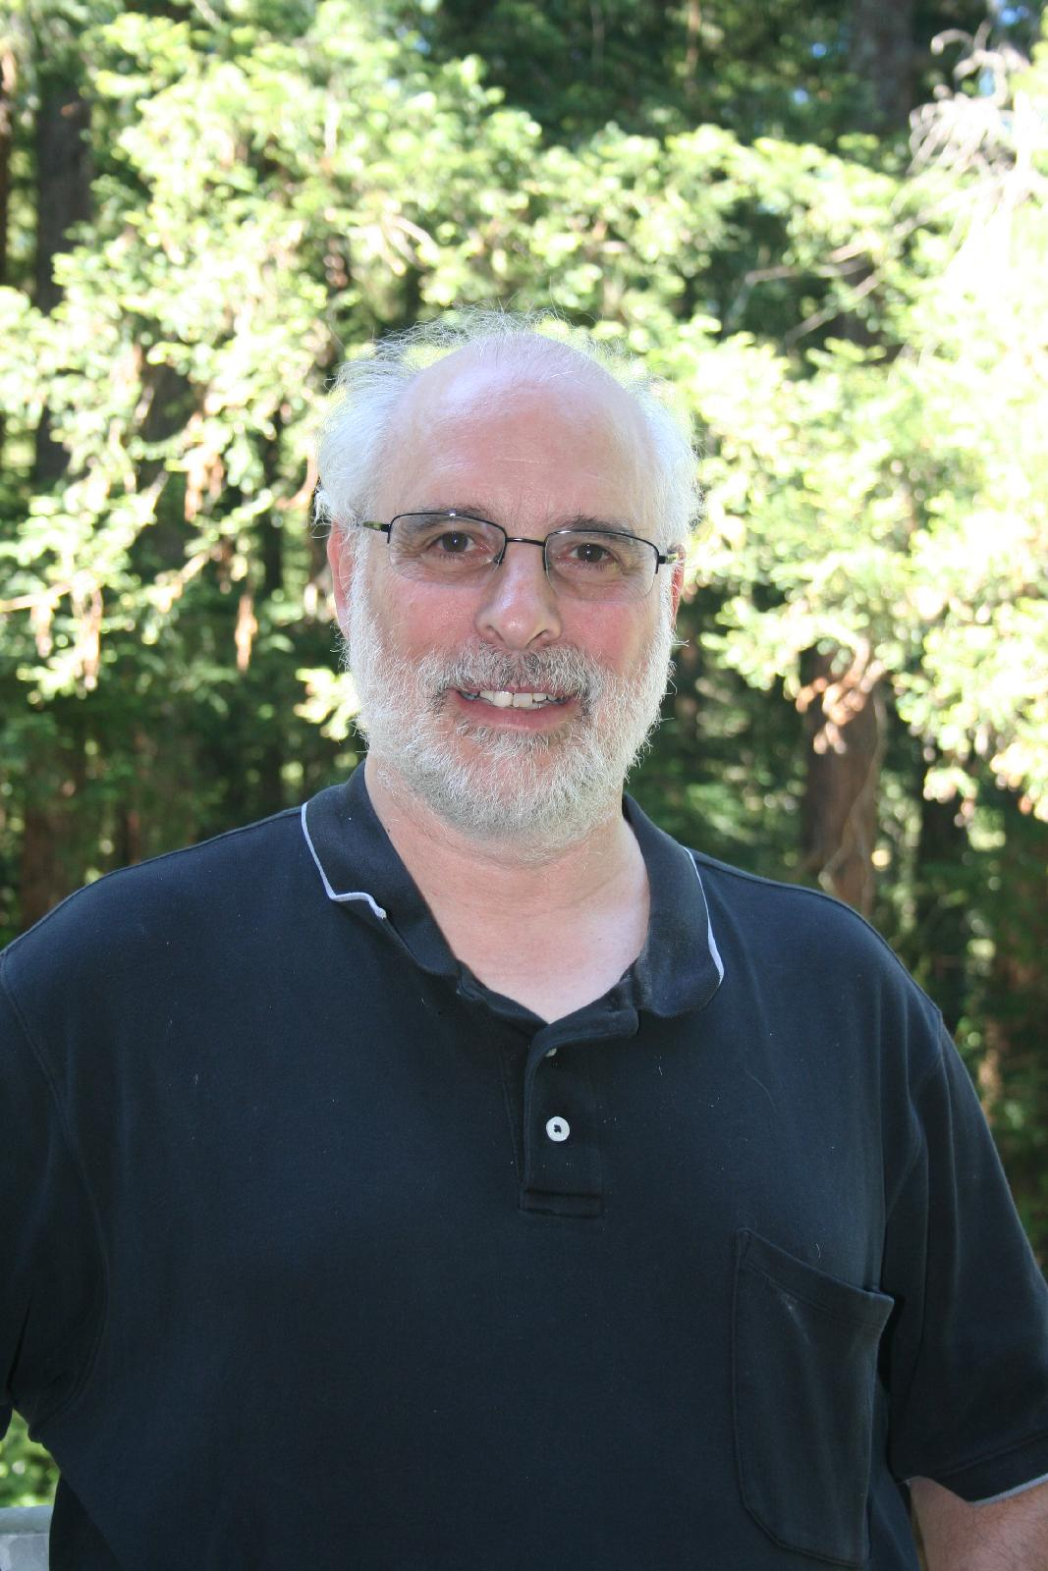
Celebrating
more than
30 years of
friendship and
collaboration
Jack in Santa Cruz (Jan 5, 2013)

Slide 2
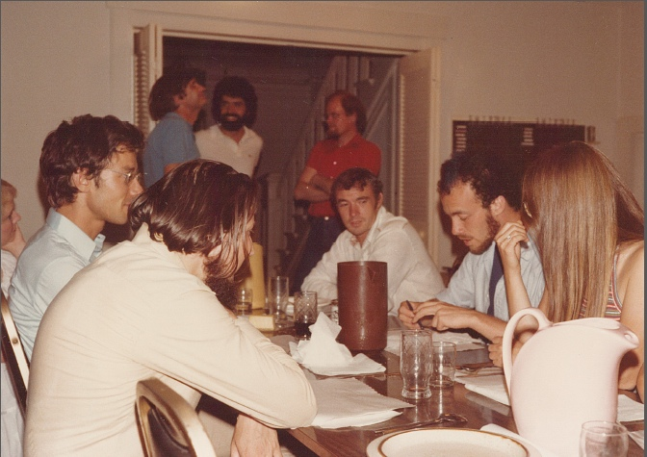
Iliopoulos Feast, SUSY Workshop in Seattle (August, 1981)

Slide 3
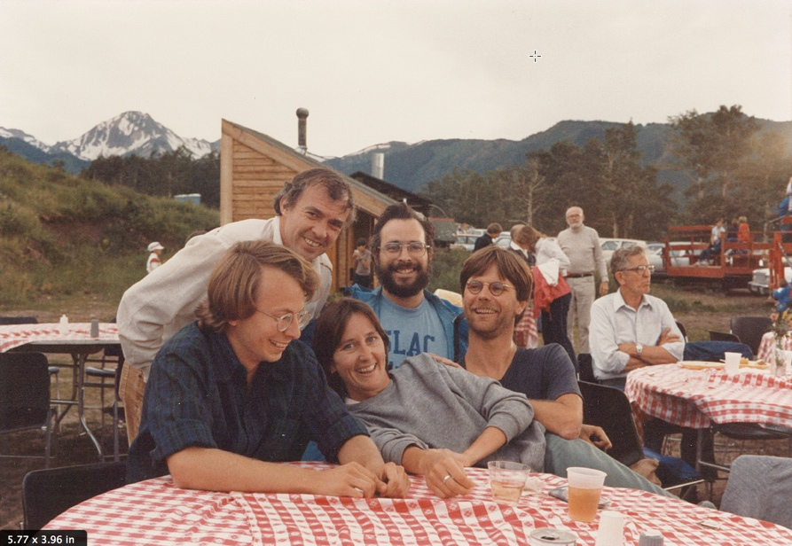
Picnic at Snowmass (July, 1984): genesis of a collaboration

Slide 4
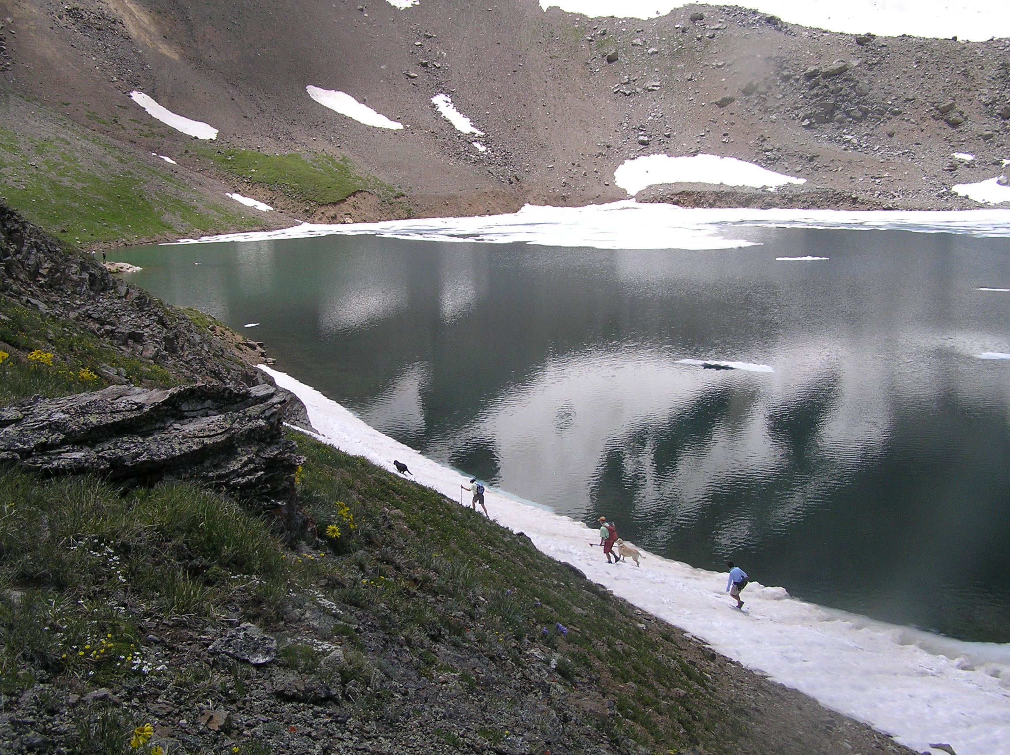
Why is Jack in none of my hiking pictures?

Slide 5
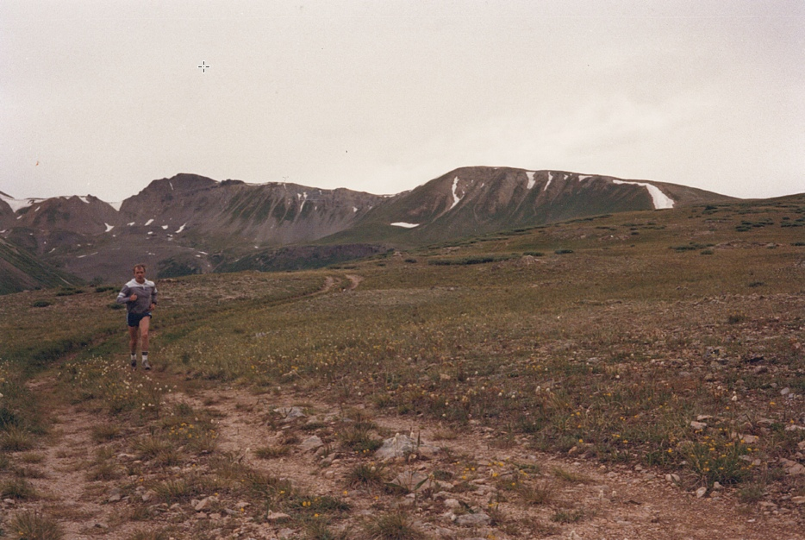
Jack jogging near Independence Pass (July 15, 1988)

Slide 6
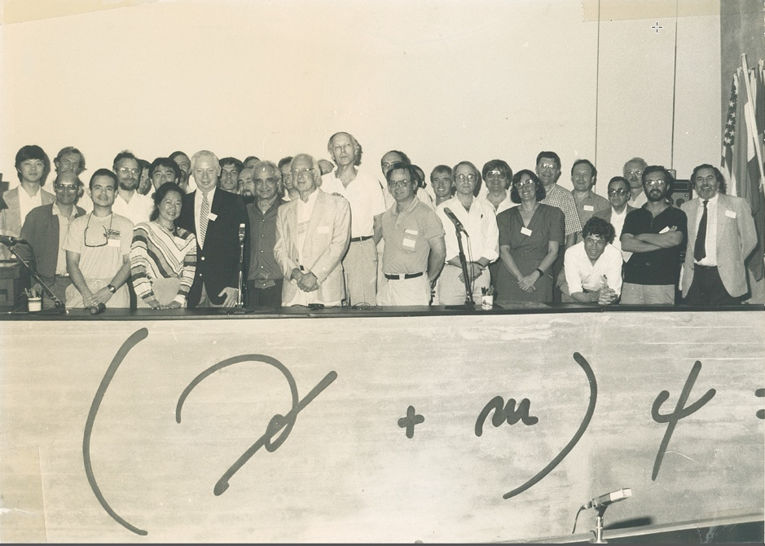
25th anniversary of the Higgs boson in Erice, Italy (July, 1989)

Slide 7
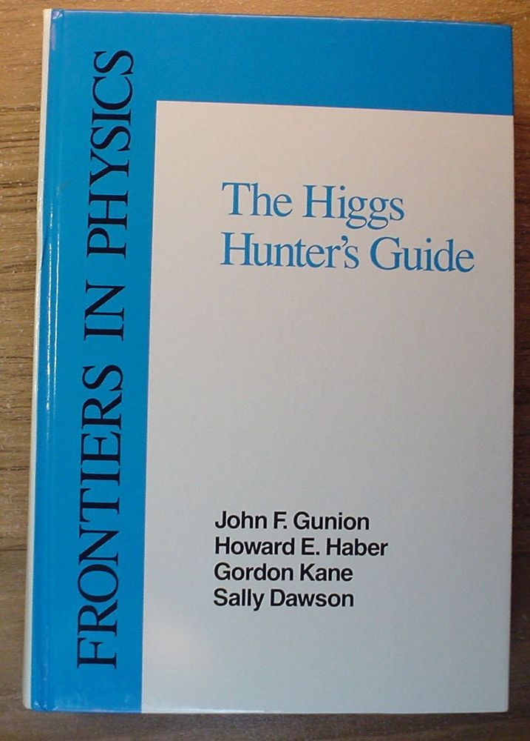
A gift for
Peter Higgs
in 1990

Slide 8
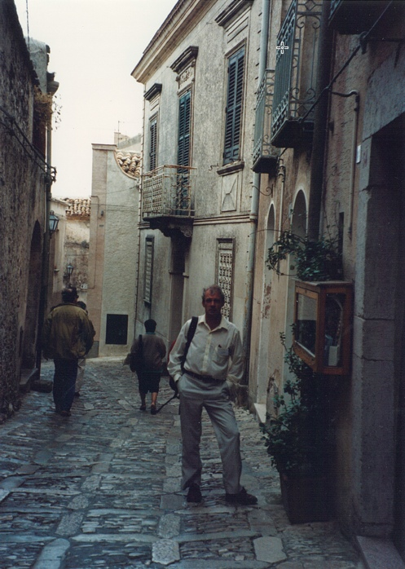
Return to Erice in
October 1992
Laying the groundwork
for a 200 TeV Collider

Slide 9
The SSC was canceled in September 1993.
Thus began the dark ages (i.e. no pictures
of Jack in my collection) for another 11 years…

Slide 10
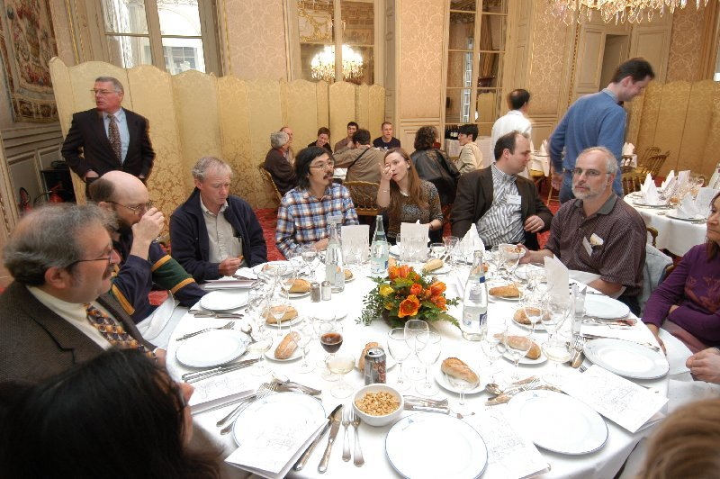
How about the ILC? LCWS 04 in Paris (April 22, 2004)

Slide 11
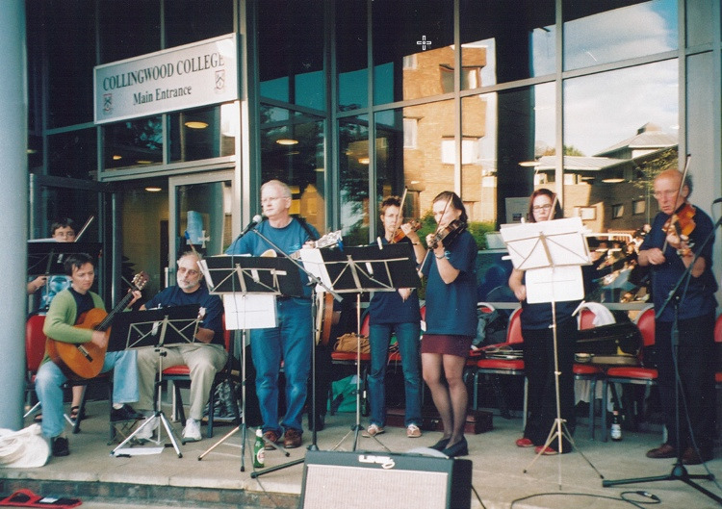
The IPPP Ceilidh Band plays SUSY-2005 (Durham, UK) July 20, 2005

Slide 12
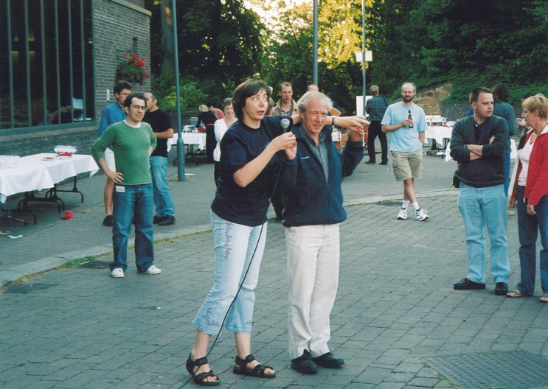
Ruth Gregory gives instruction to the dancers

Slide 13
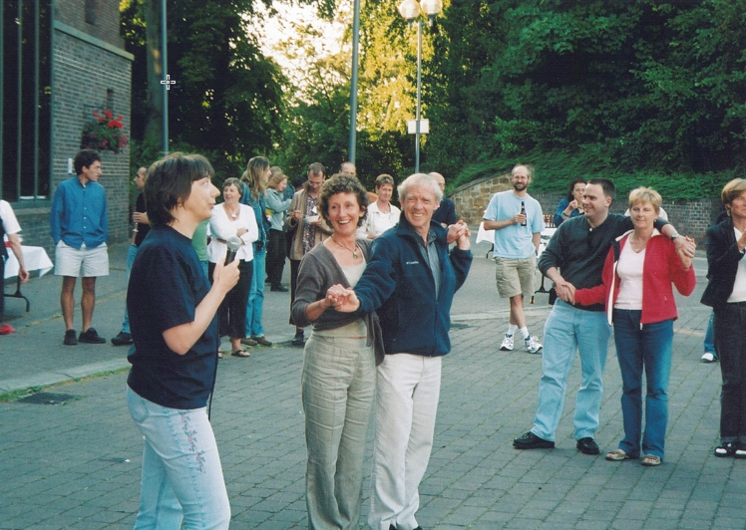
Are you ready Jack?

Slide 14
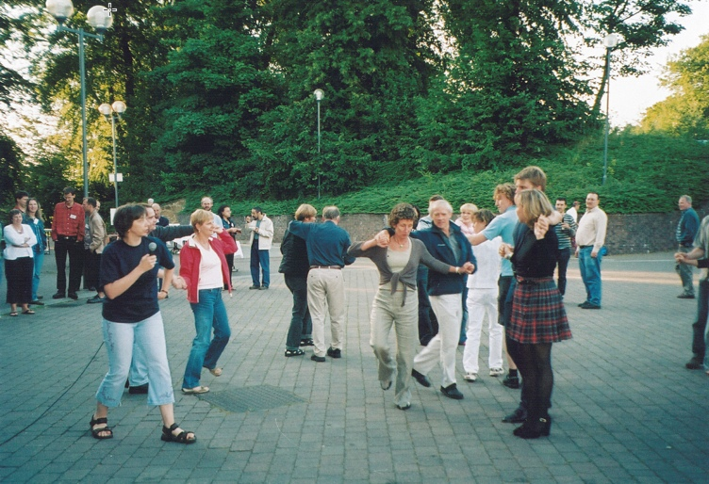
Put on those dancing shoes!!

Slide 15
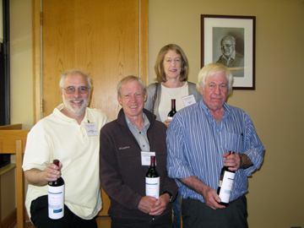
Higgs Hunters at the MCTP Spring Symposium on
Higgs Boson Physics in Ann Arbor, MI (May, 2010)

Slide 16
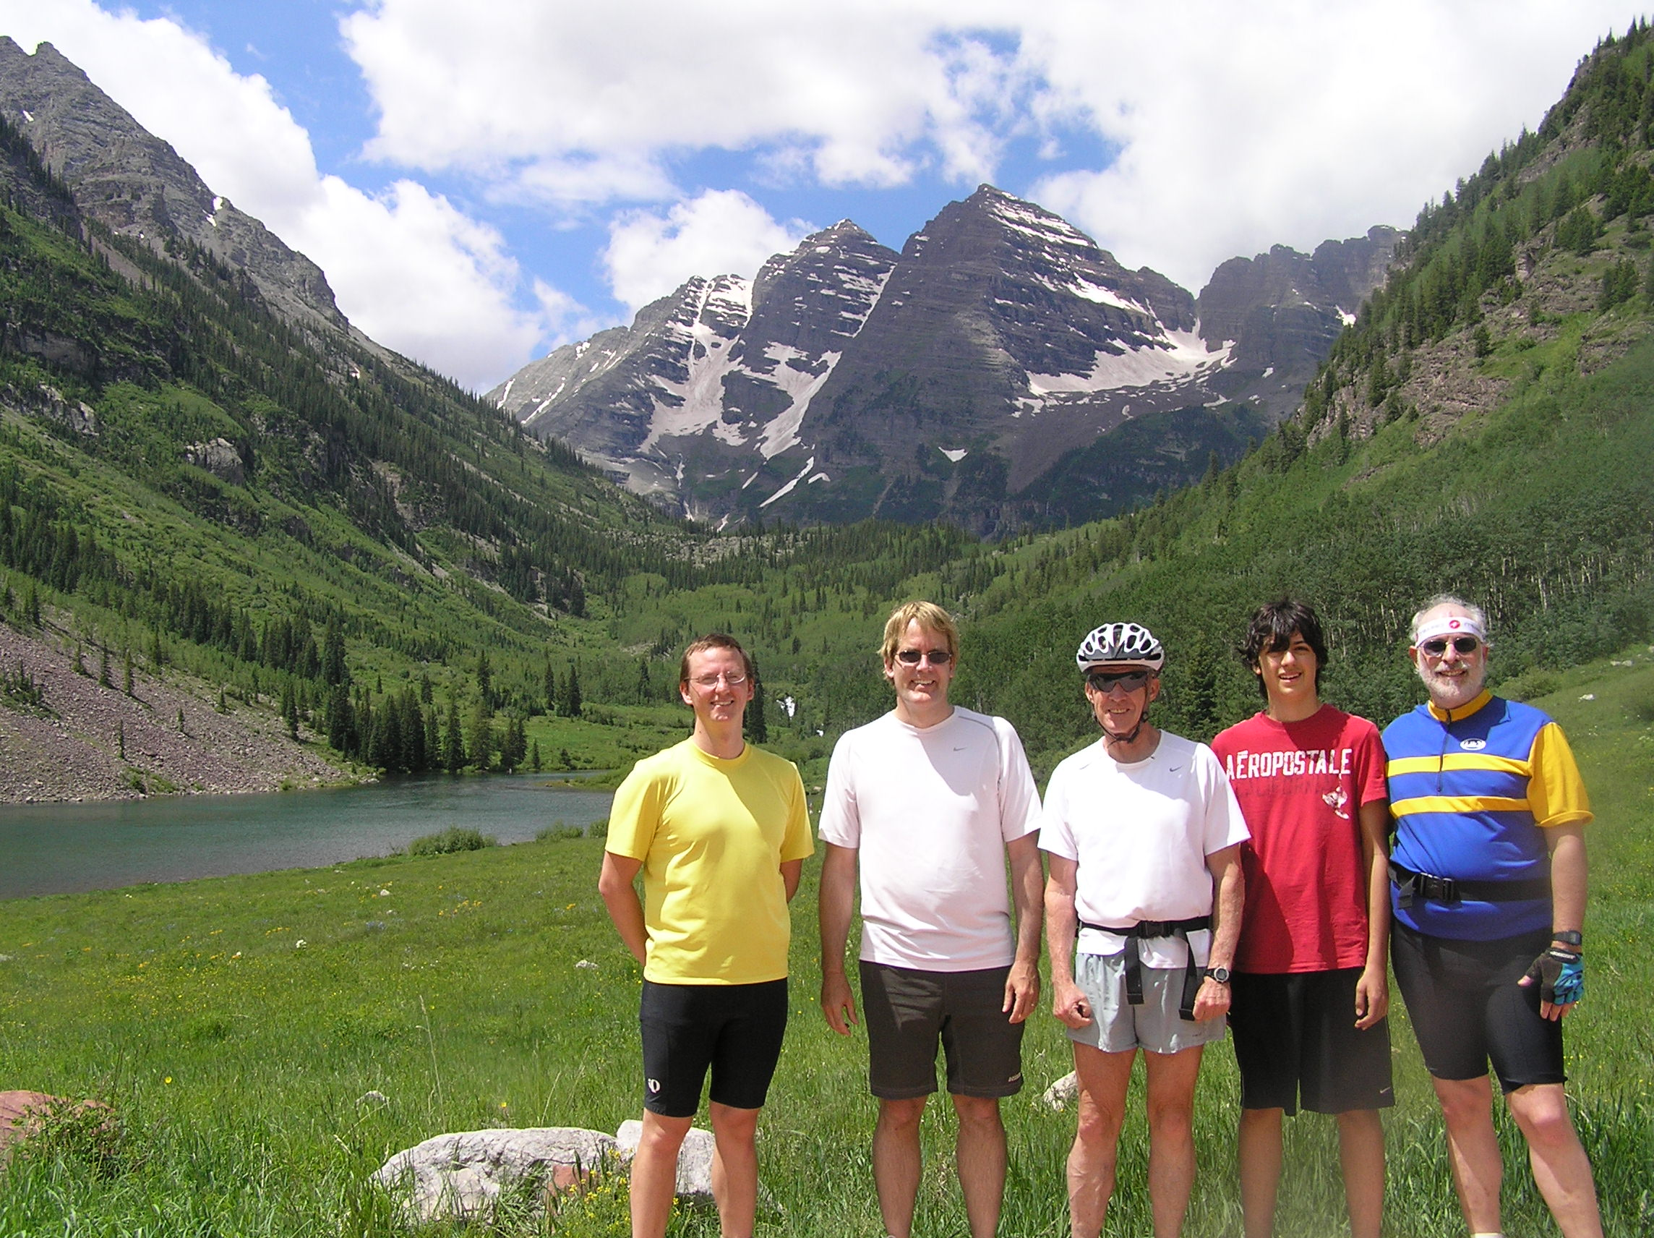
Maroon Lake bicycle ride near Aspen, CO on July 2, 2010

Slide 17
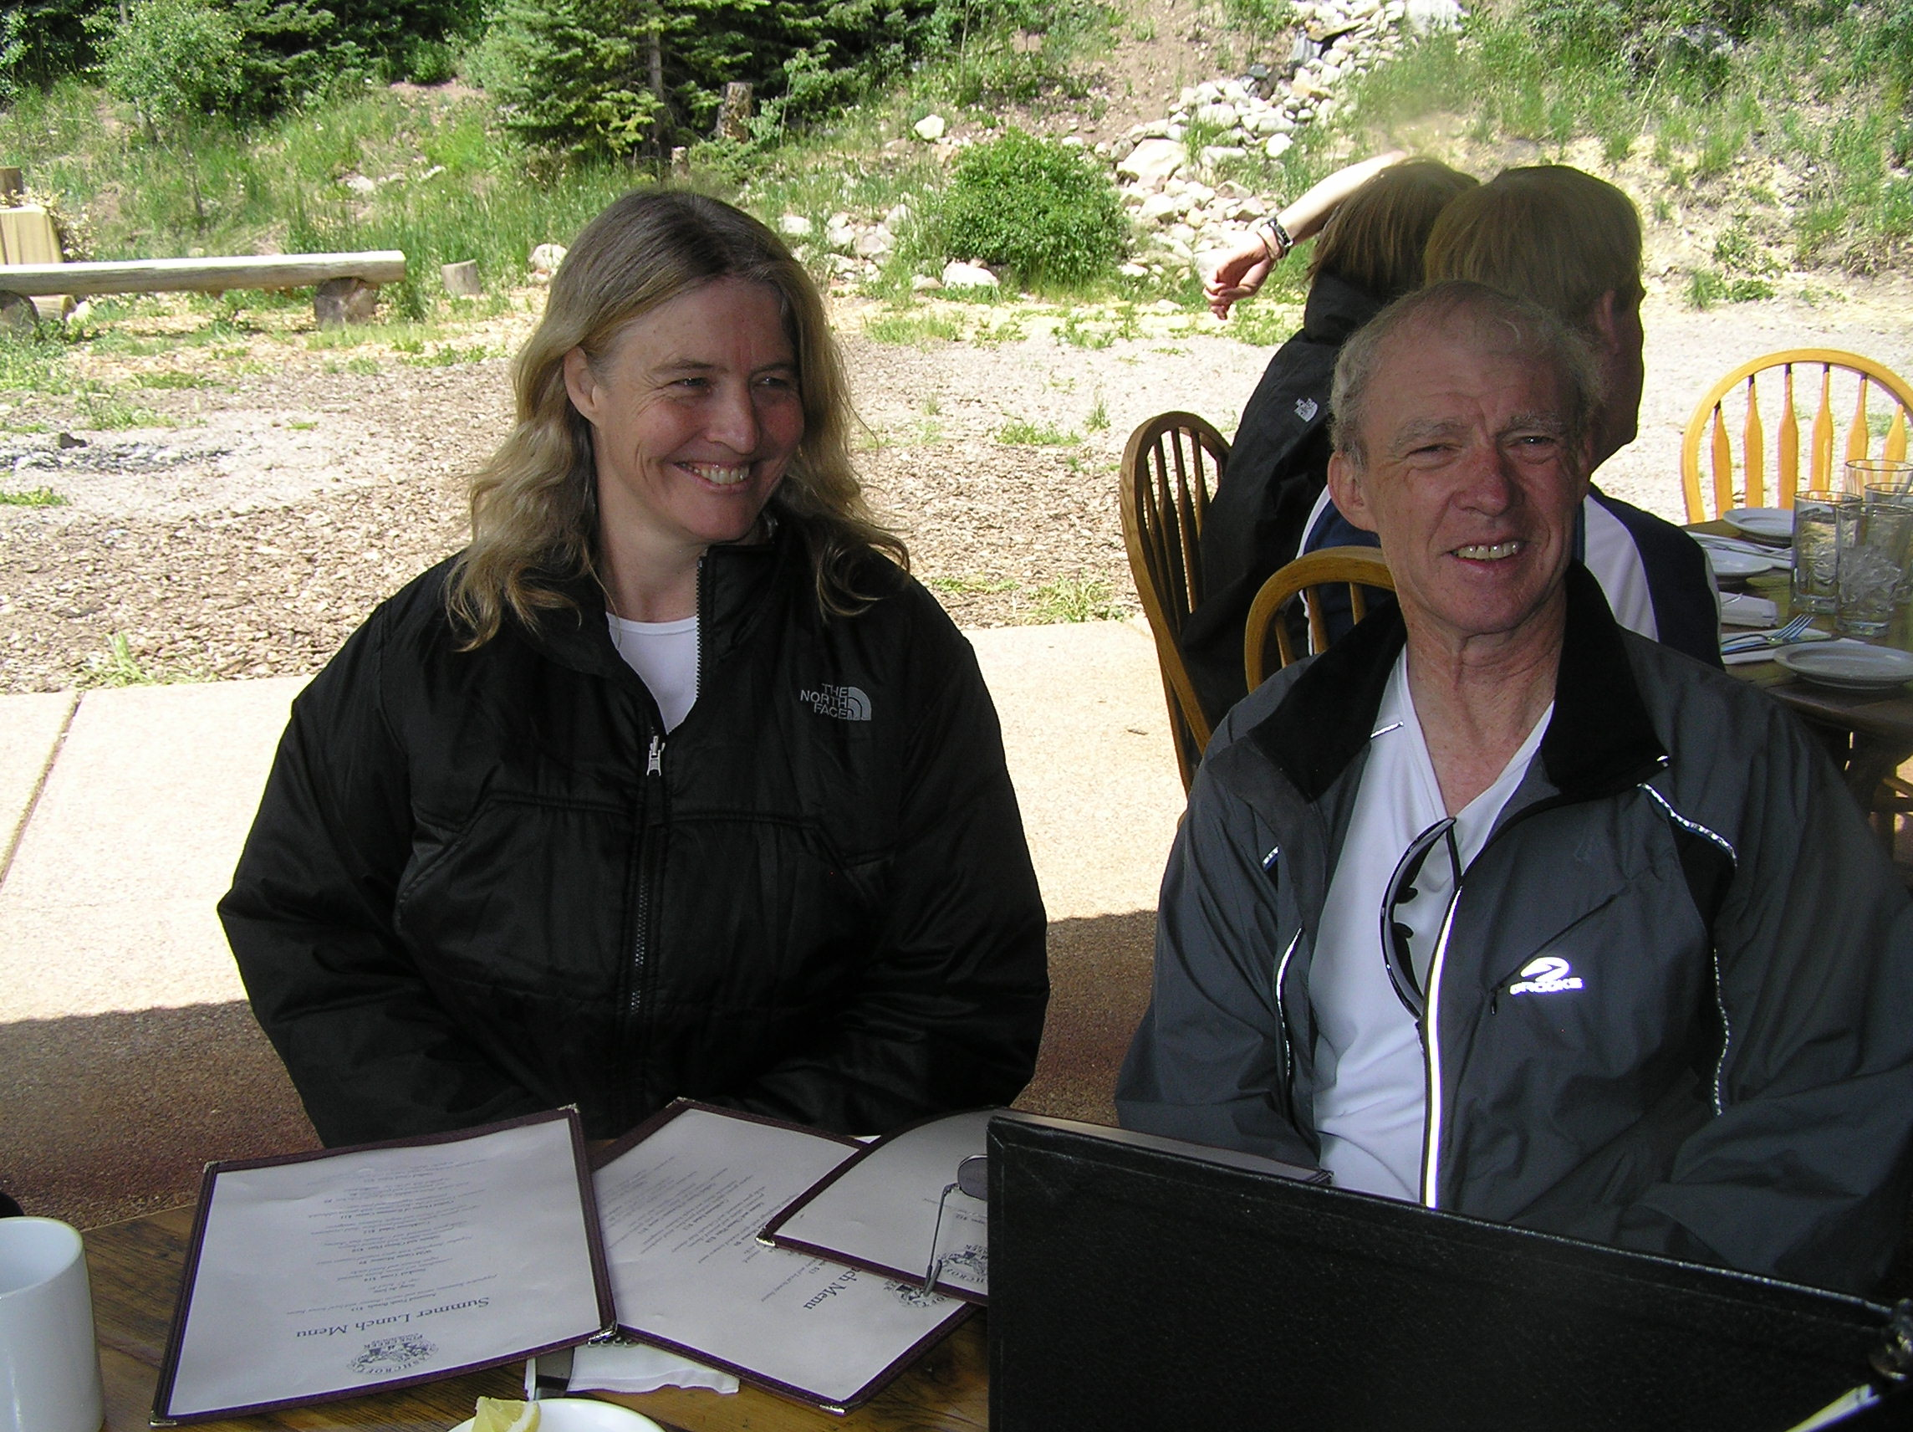
At the Pine Creek Cookhouse in Ashcroft, CO on July 7, 2010

Slide 18
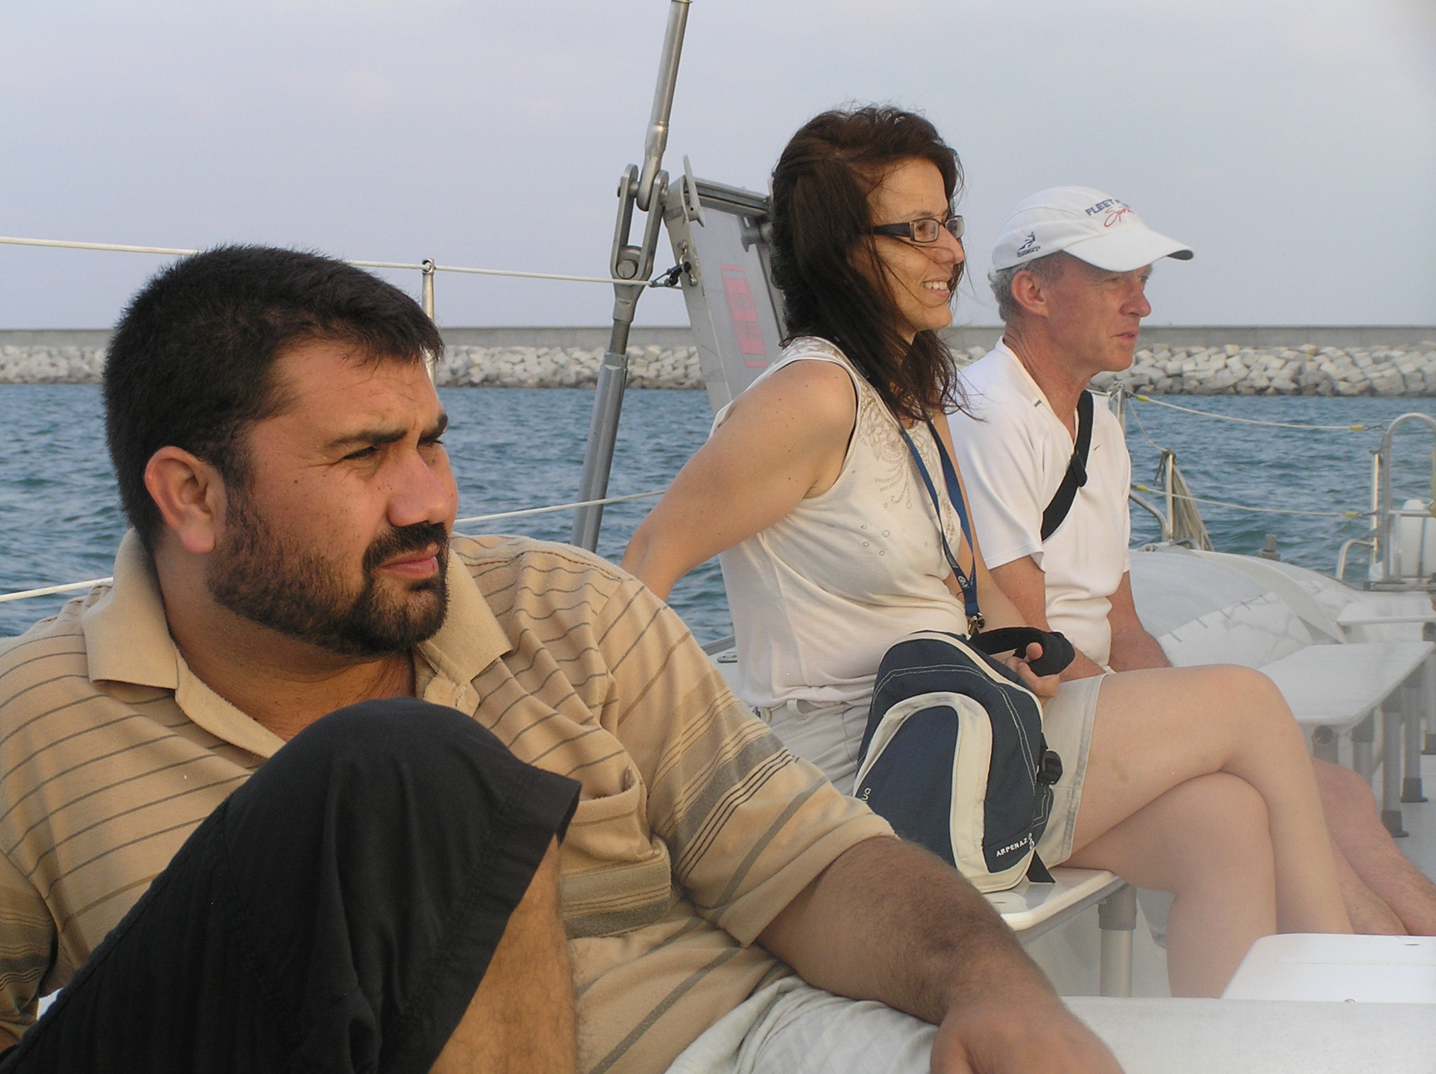
Hard at work in Valencia (July 21, 2010) at PASCOS-2010

Slide 19
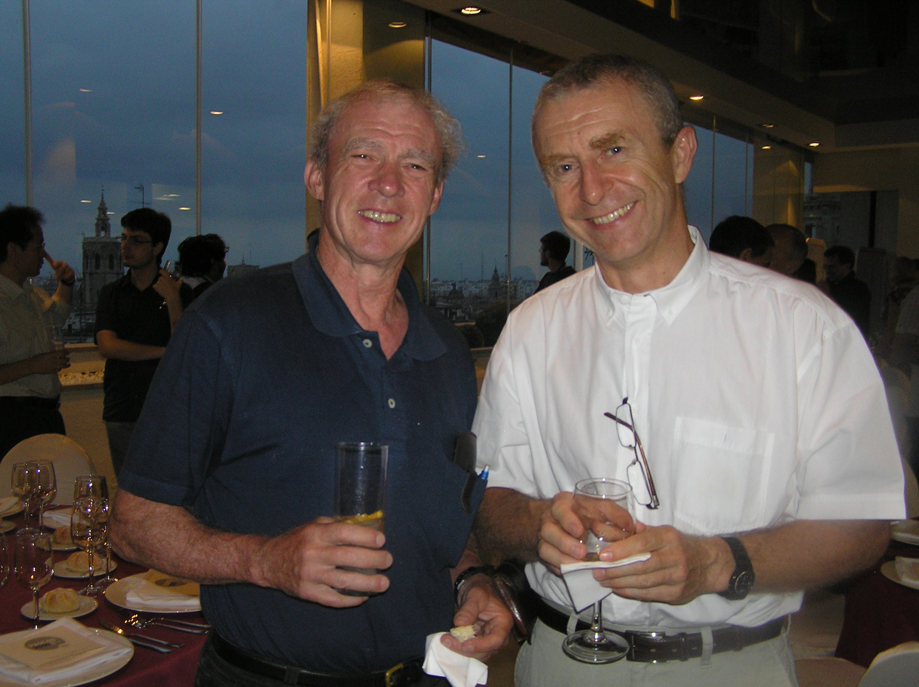
The next evening at the banquet (July 22, 2010 in Valencia)

Slide 20
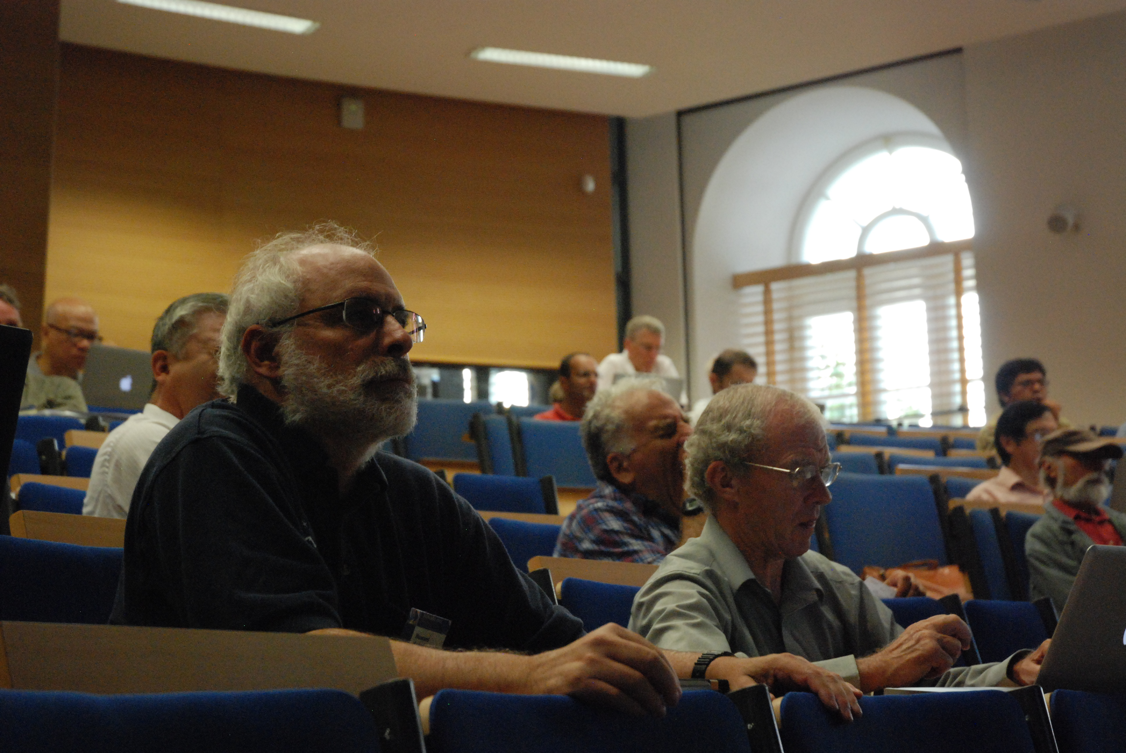
At Scalars-2011 in Warsaw on August 26, 2011. Finally, proof that
we actually attend lectures (Jack is checking out the stock market).

Slide 21
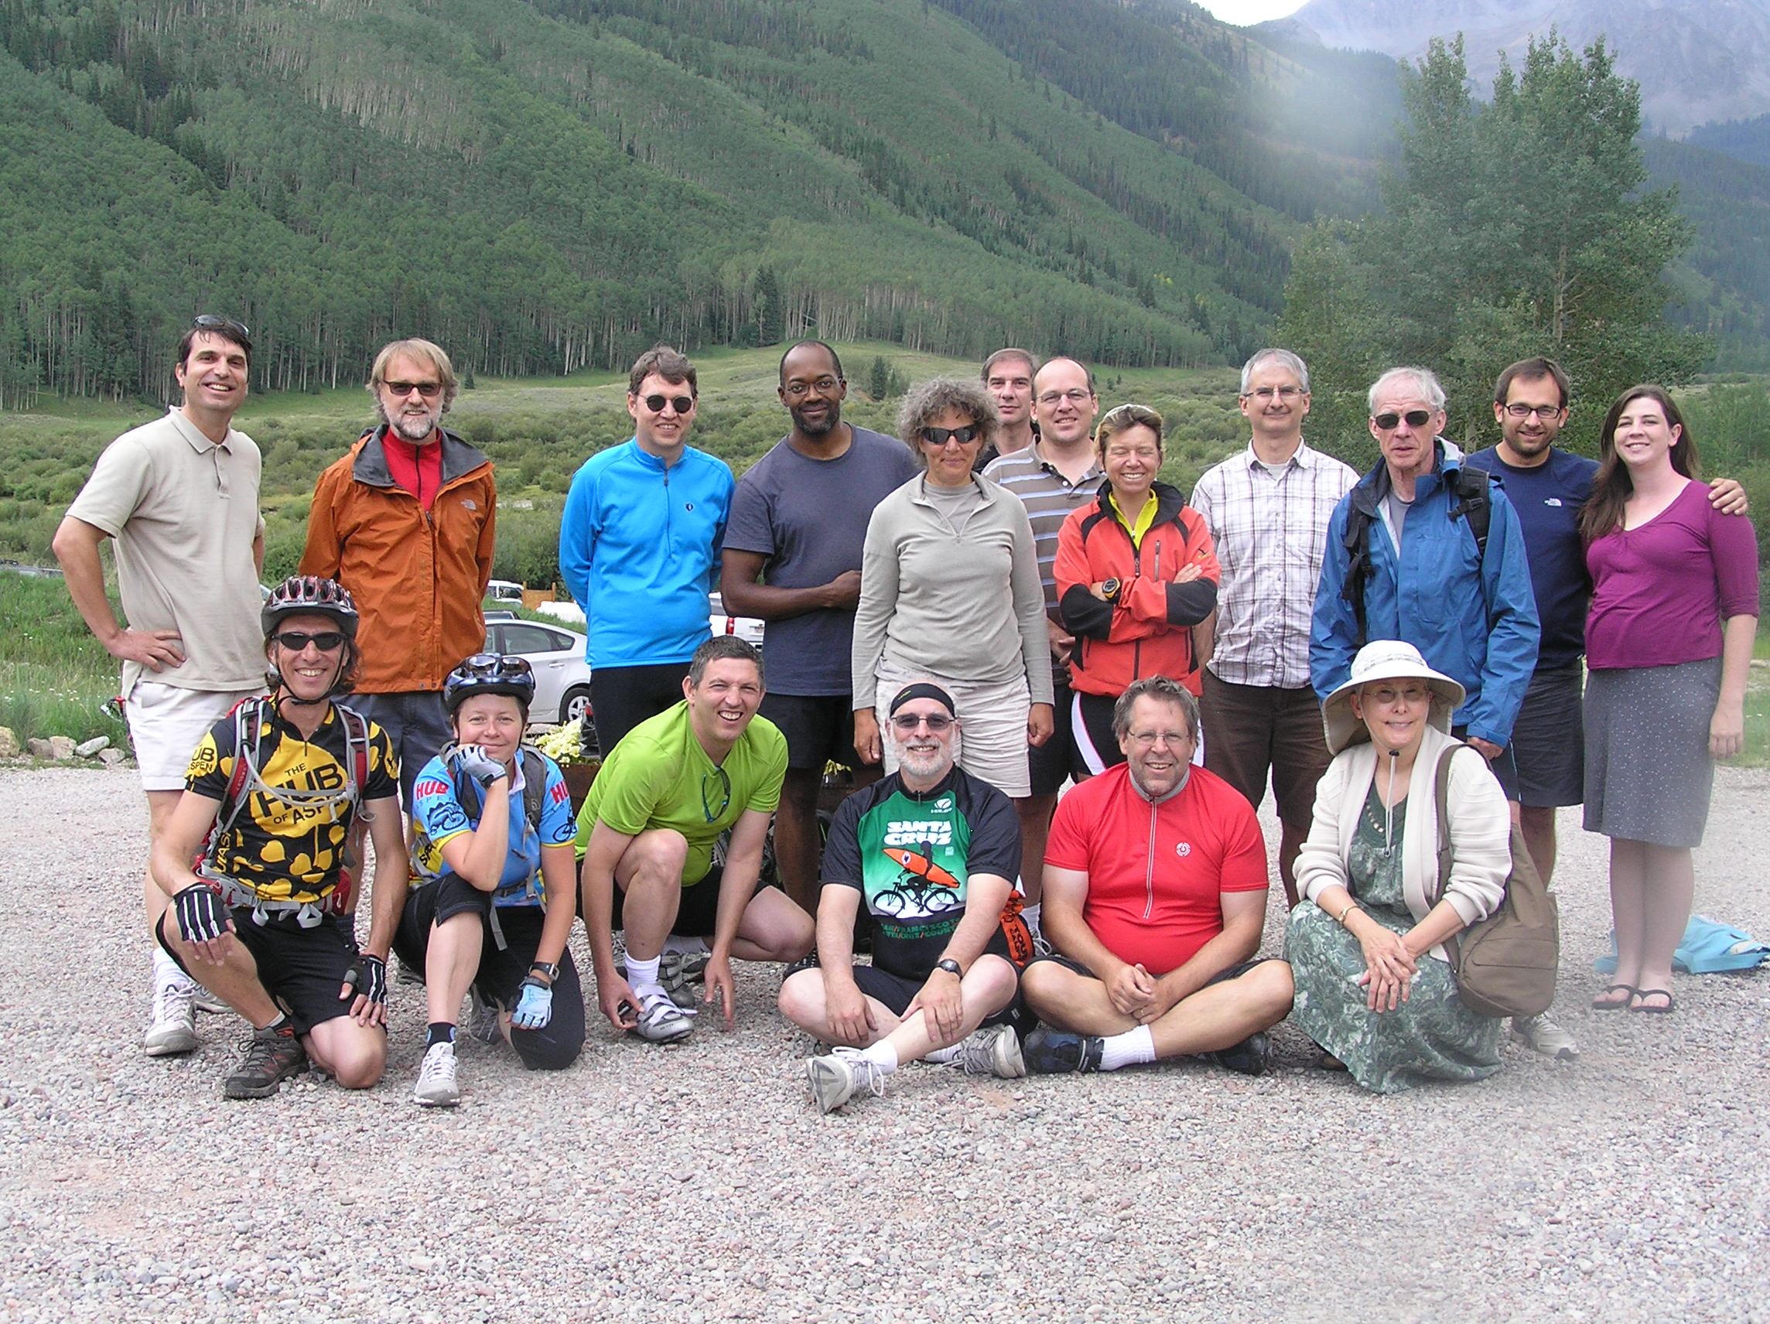
The Pine Creek Cookhouse ride of 2012

Slide 22
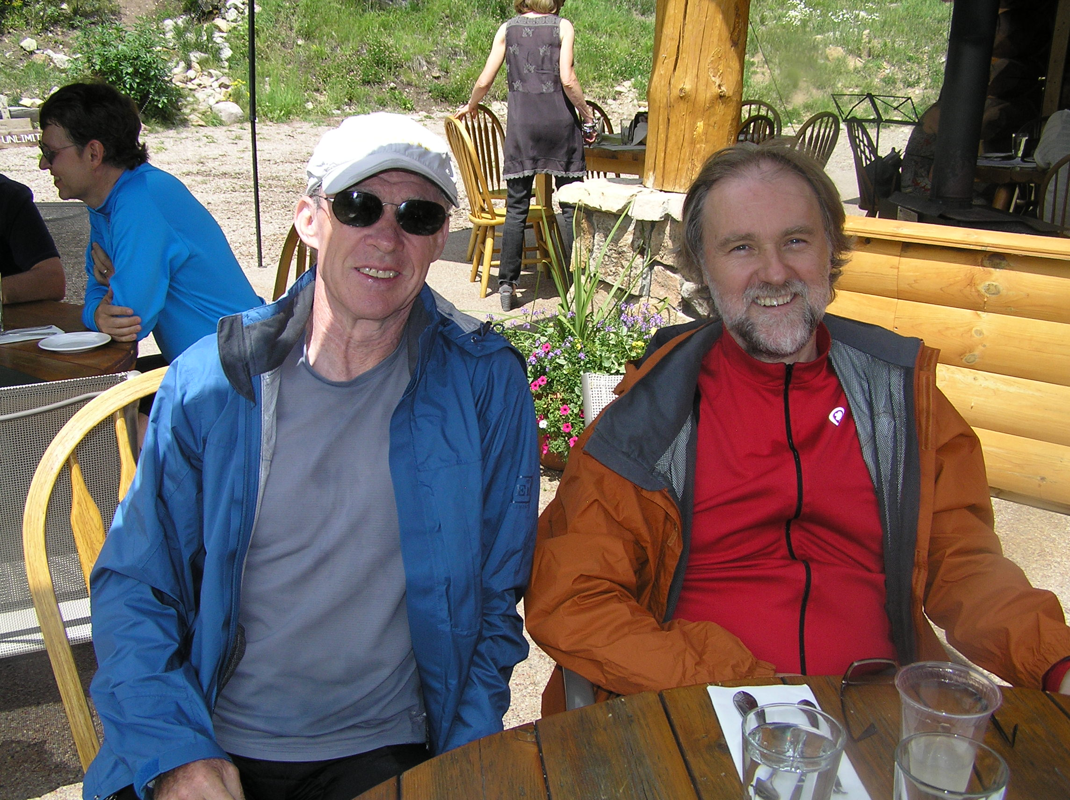
Enjoying lunch après bike (August 8, 2012)

Slide 23
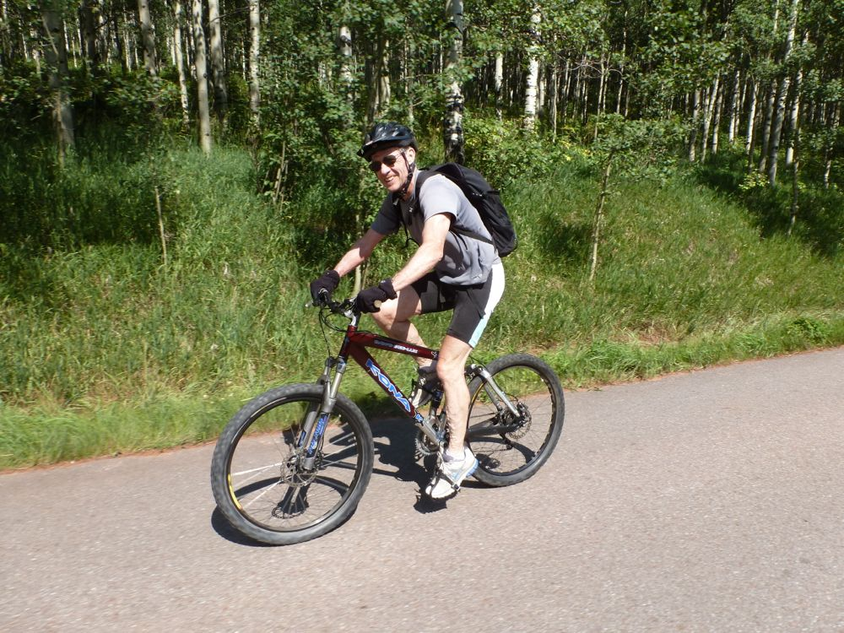
On the way to Maroon Lake on August 24, 2012

Slide 24
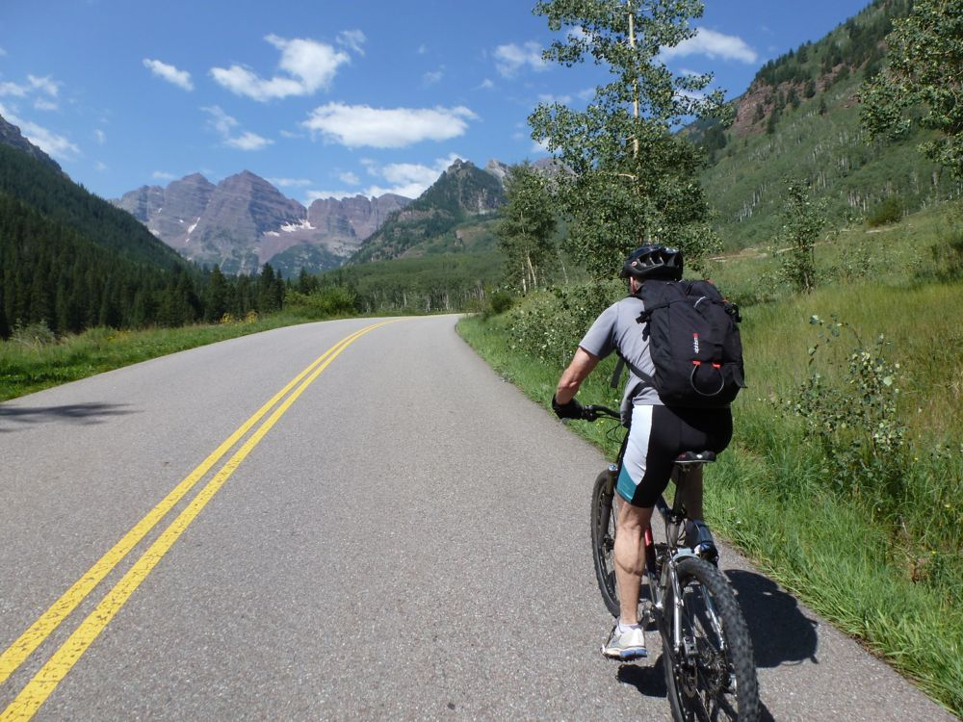
On the way to Maroon Lake (the usual view of fellow cyclists)

Slide 25
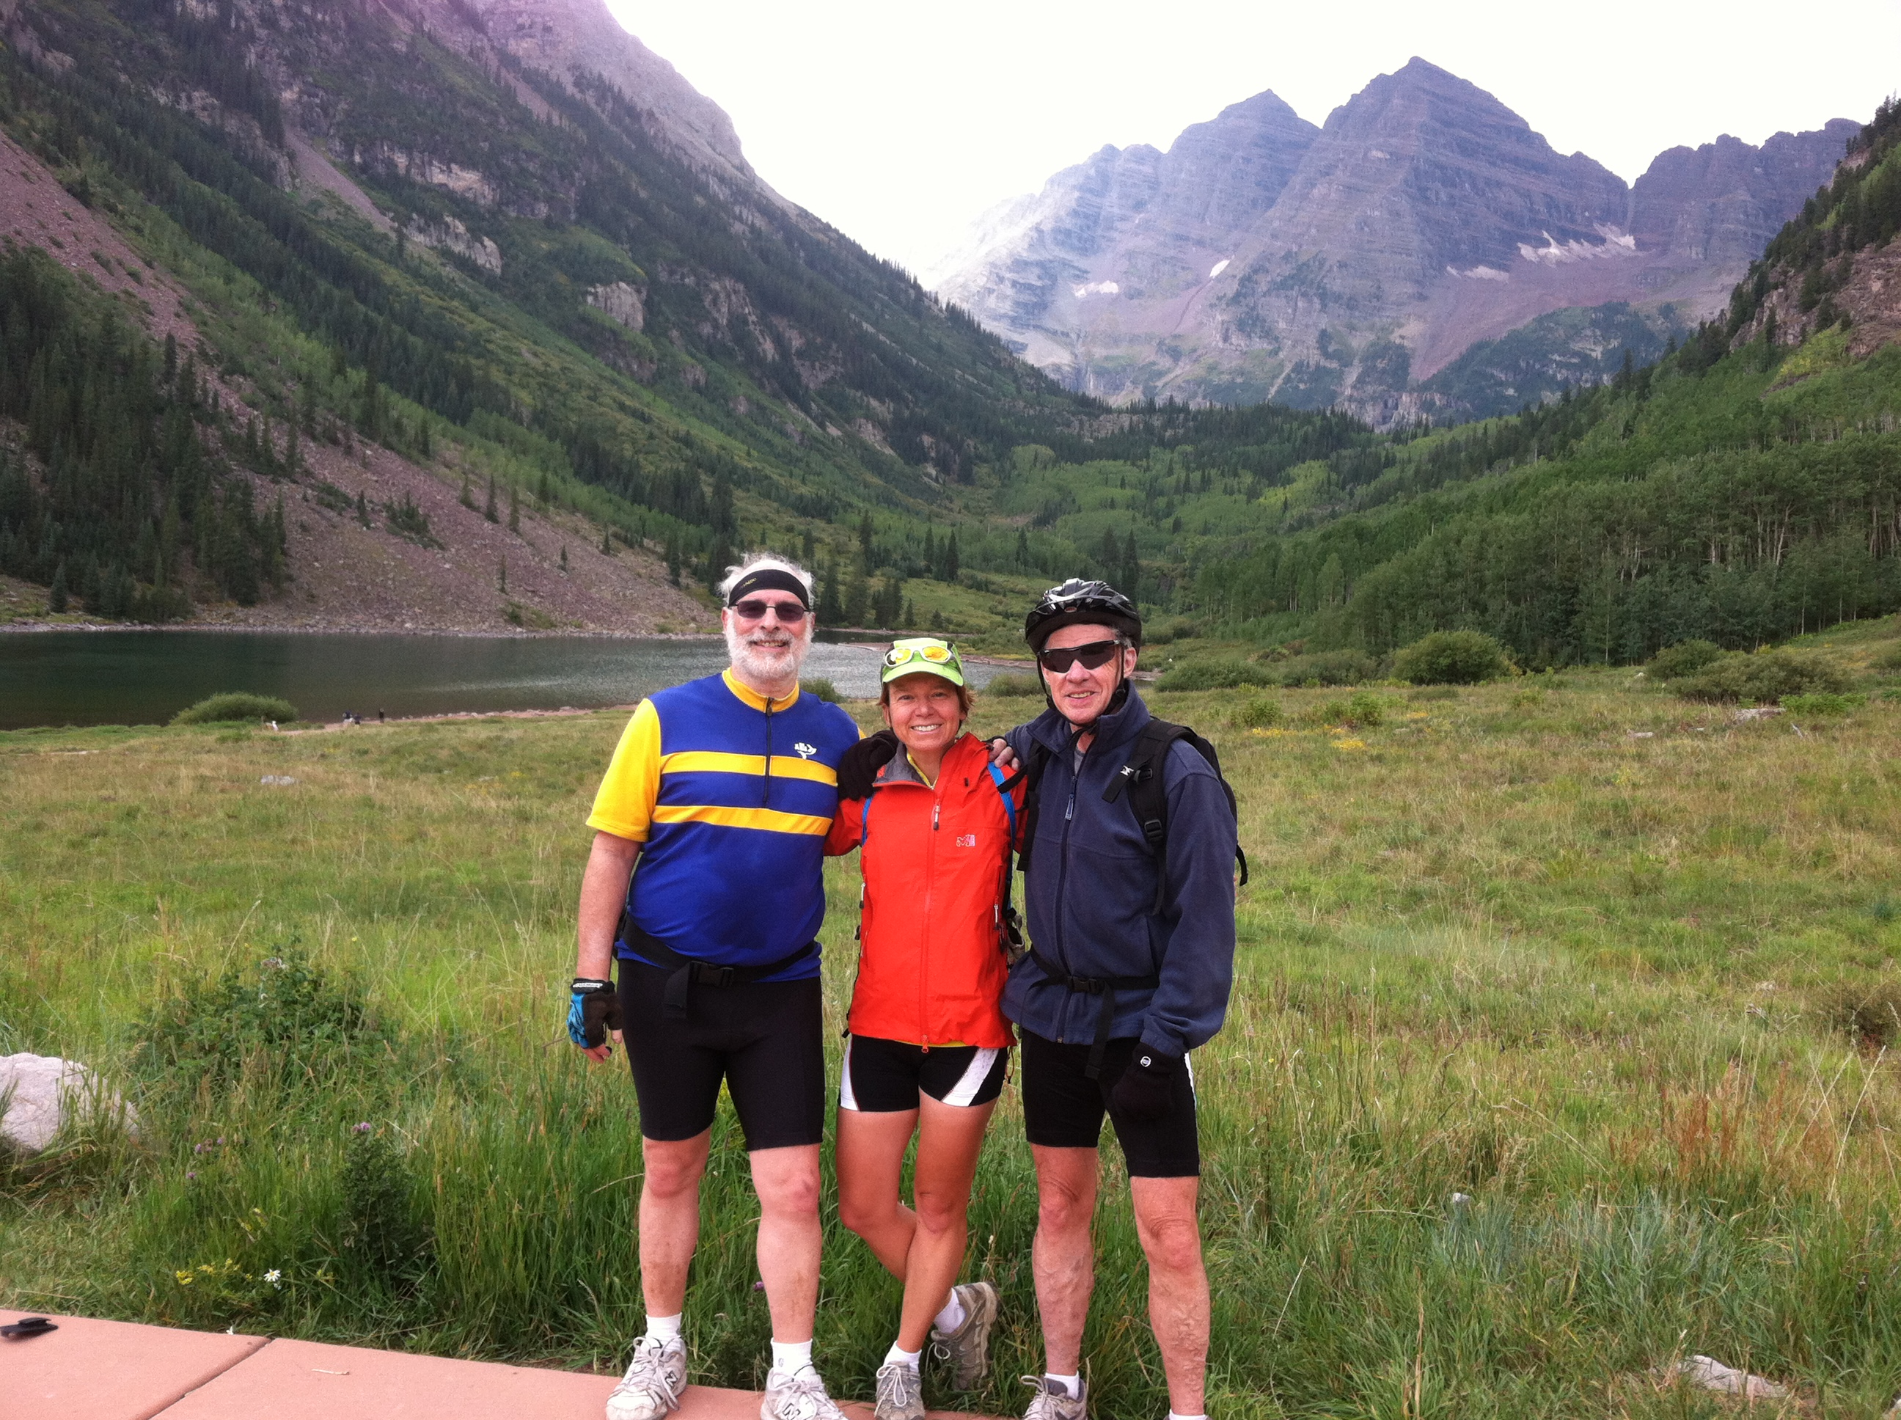
Final destination achieved

Slide 26
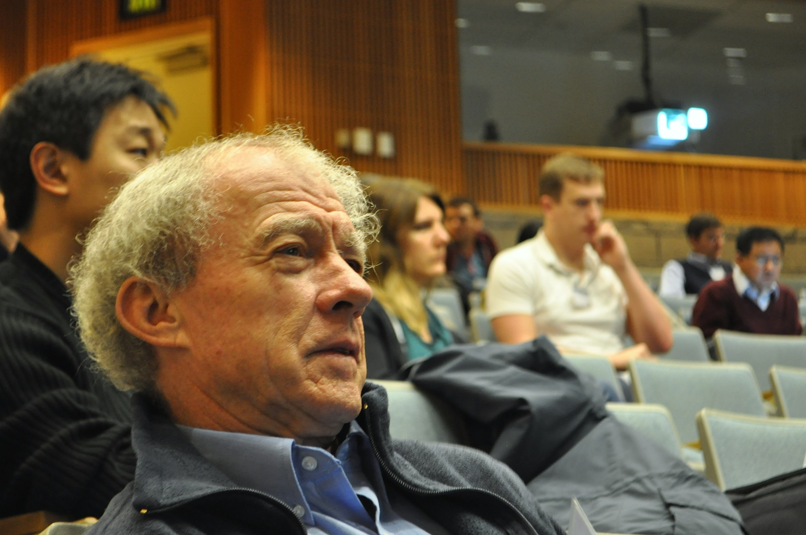
At the Dine/Haber Symposium in Santa Cruz, January 5, 2013

Slide 27
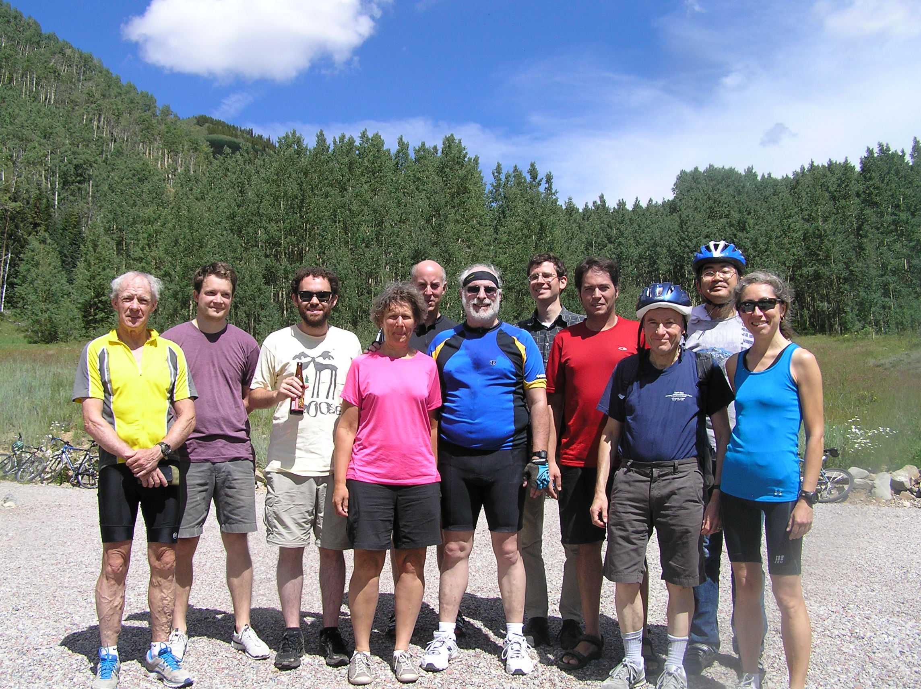
The Pine Creek Cookhouse Ride Redux (August 21, 2013)

Slide 28
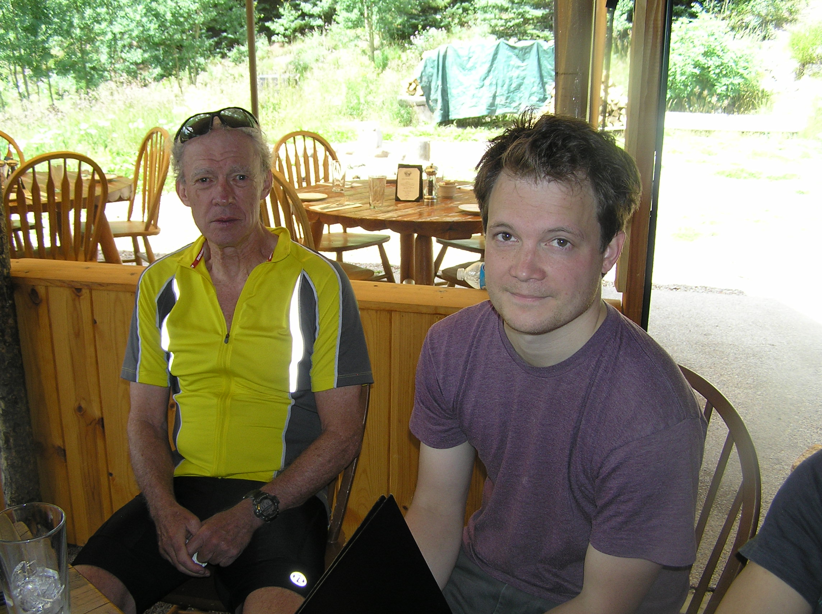
Another Pine Creek Cookhouse lunch

Slide 29
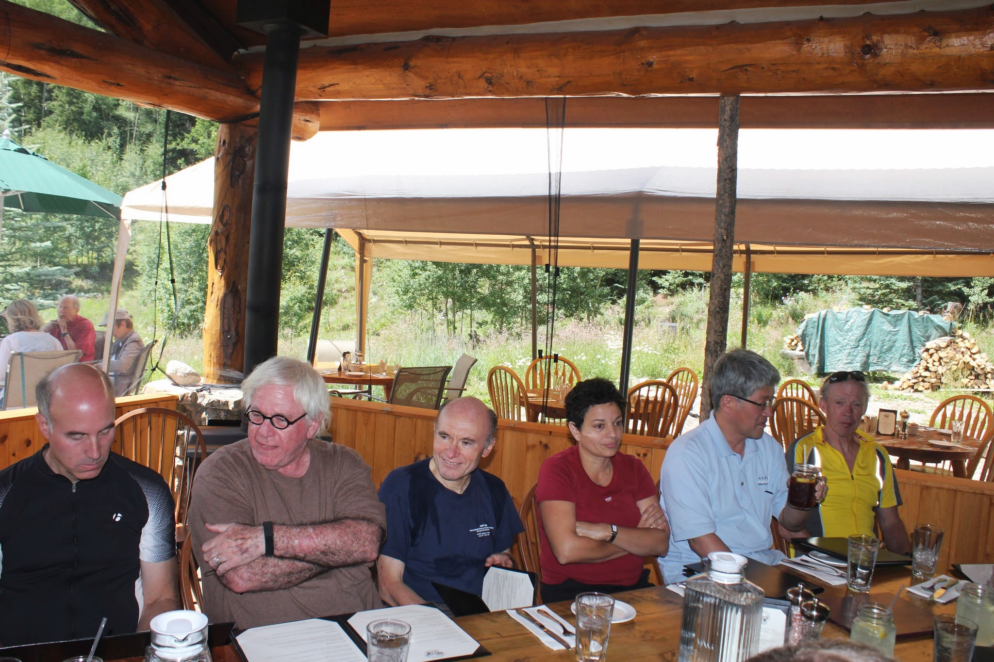
But can you solve the mystery…?

Slide 30
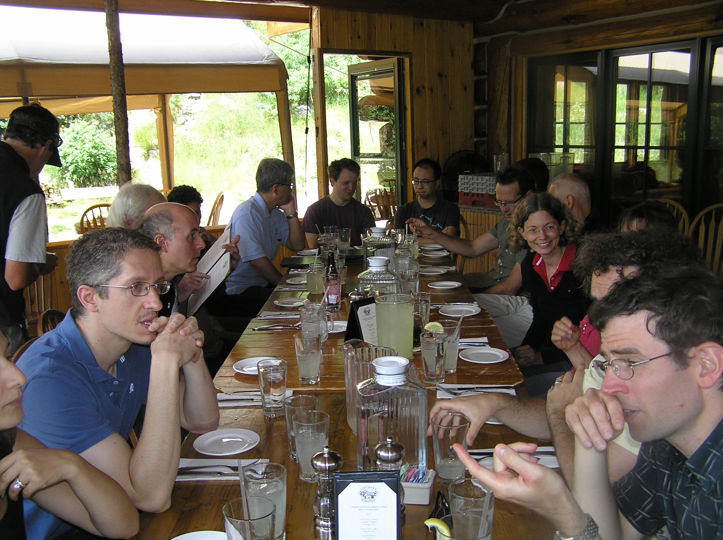
Where did Jack go? (Was $5 enough to cover the lemonade?)

Slide 31
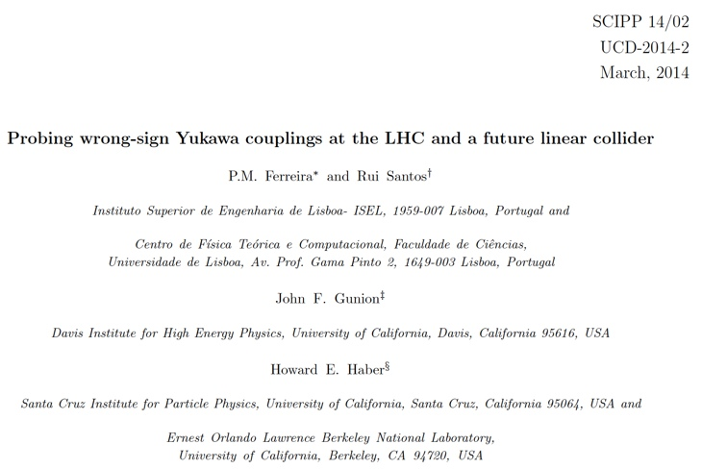
30 years later, the collaboration is alive and well…

Slide 32
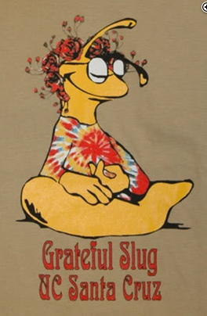
Oh, well, a touch of grey,
kind of suits you anyway.
That was all I had to say,
and it's alright.
…
We will get by.
We will survive.
Jerry Garcia and Robert Hunter

